Slide 1
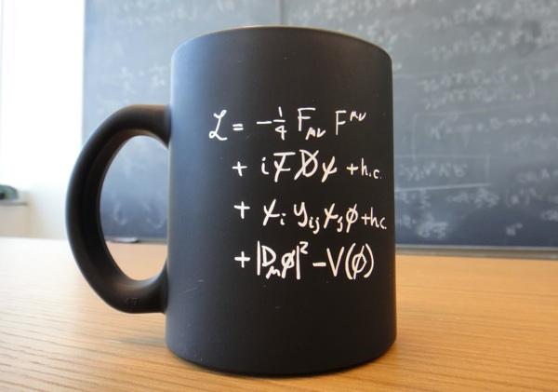
The Standard Model

Slide 2
Outline
A review of the basics
The theory behind the Standard Model
Quantum Field Theory
Feynman Diagrams
Quantum Electrodynamics
Weak and Strong Interactions
Back to reality
Particle creation and decay
Summary

Slide 3
The Birth of the Standard Model

Slide 4
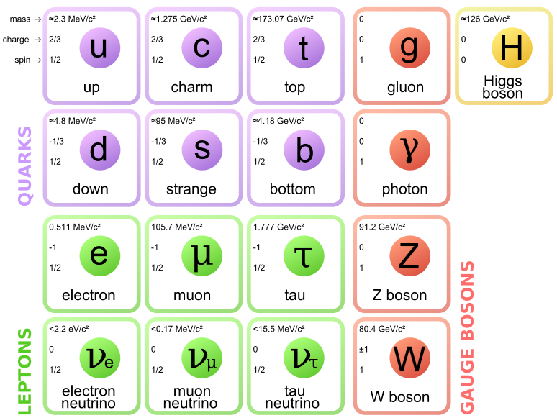
The Fundamental Particles
This is all of them! (As far as we know…)

Slide 5
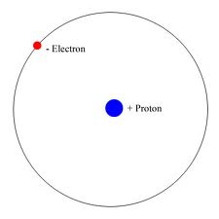
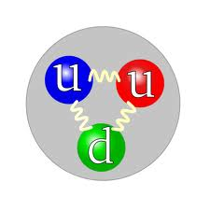
Matter Particles
Ordinary matter

Slide 6
Forces and Interactions
Strong Force ⬅
(100 times stronger than E&M)
Electricity & Magnetism ⬅
Weak Force
(10,000,000,000 times weaker)
Gravity is not included because it’s 10³⁶ times weaker!

Slide 7
Mass

Slide 8
Those are the particles, but what is the theory!?

Slide 9
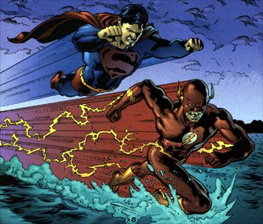
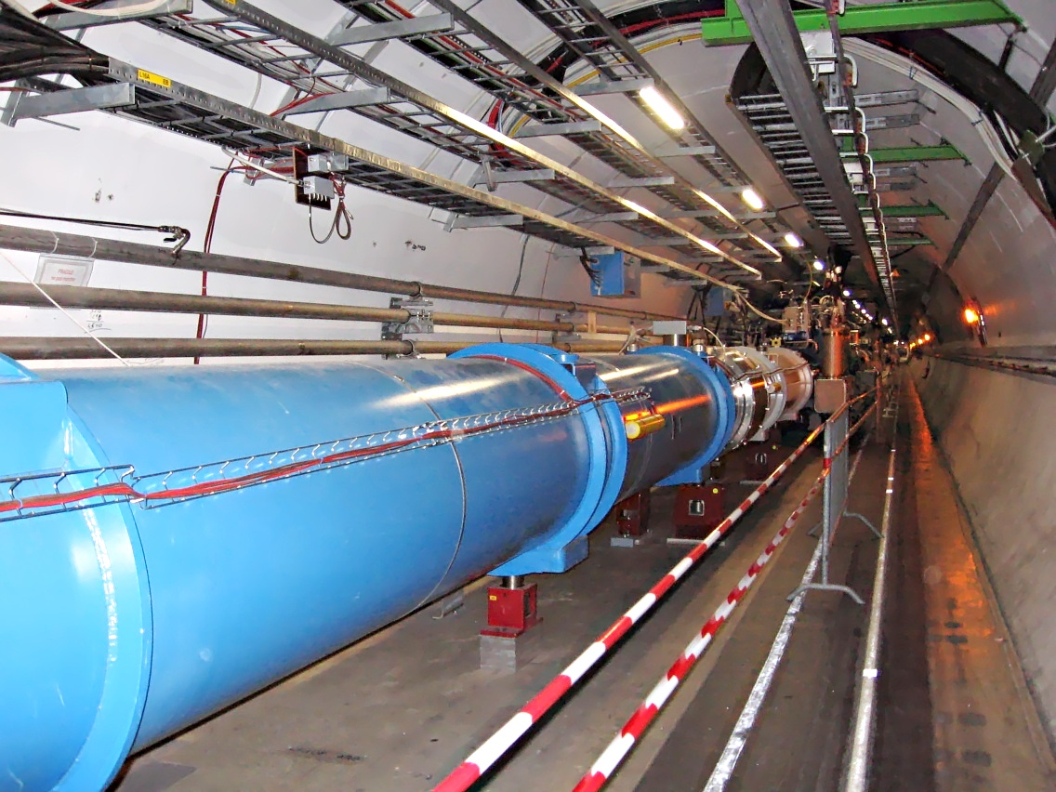
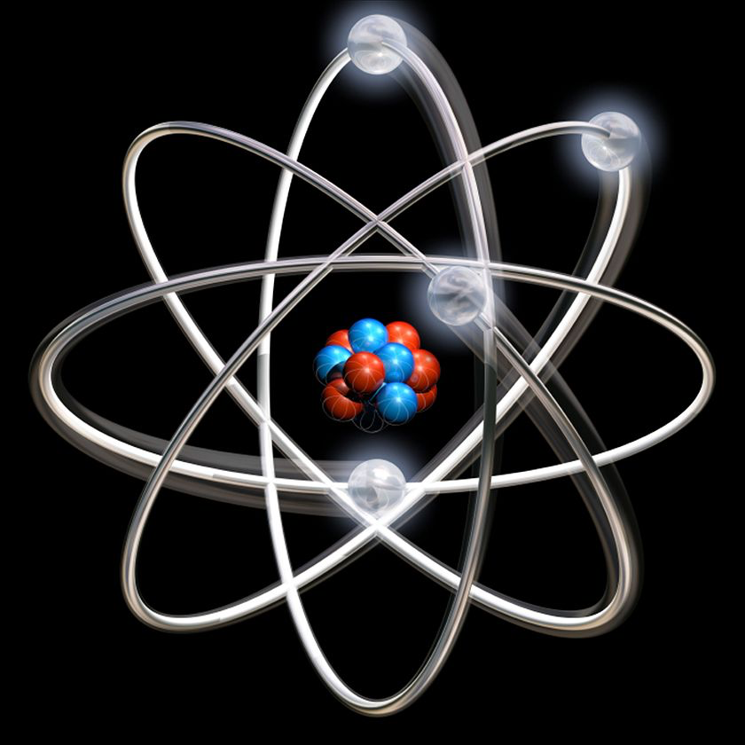
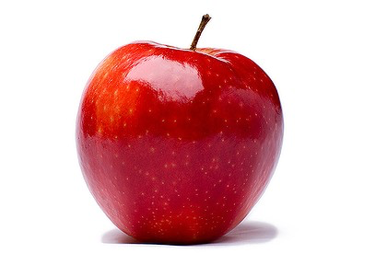
Realms of Mechanics
fast
Slow
LARGE
small

Slide 10
Realms of Mechanics
Quantum Field Theory
fast
Relativity
Classical Mechanics
Quantum Mechanics
Slow
LARGE
small

Slide 11
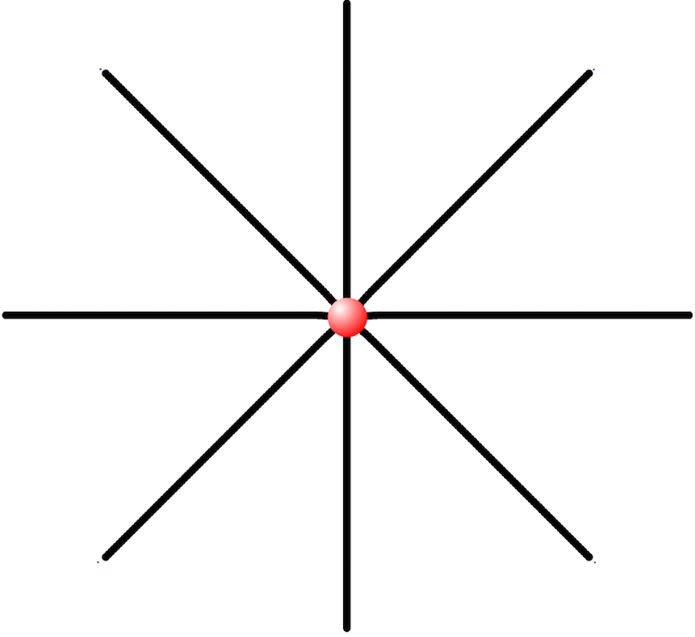
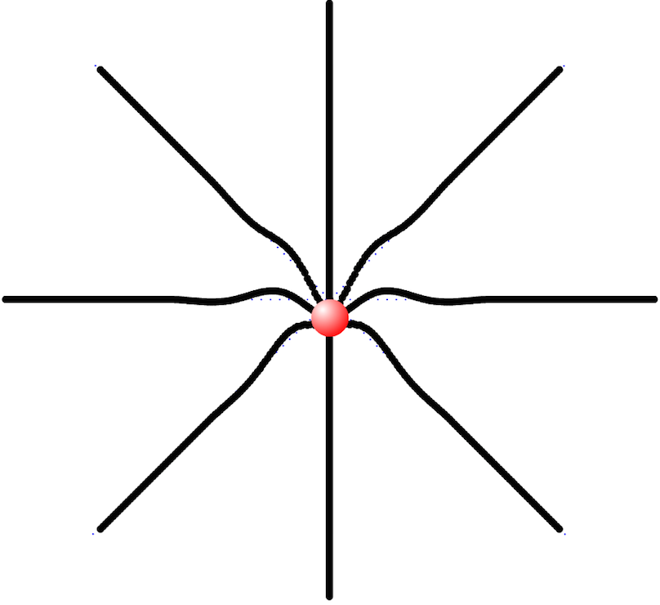
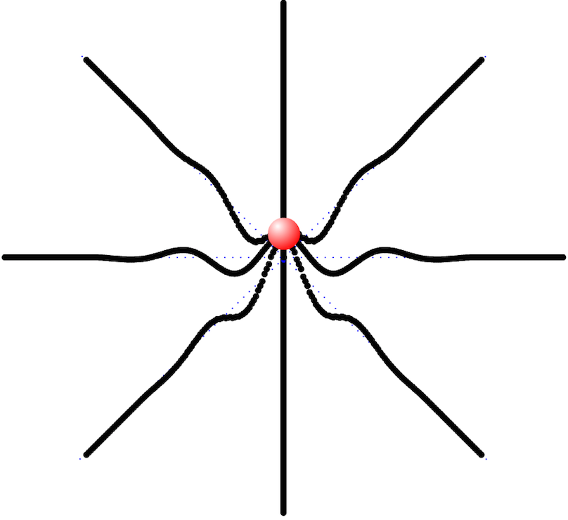
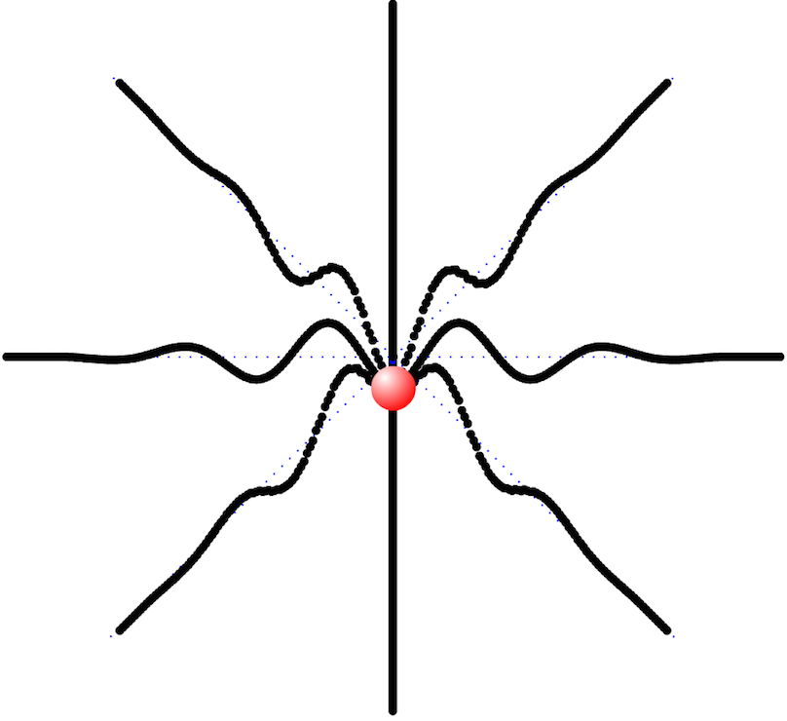
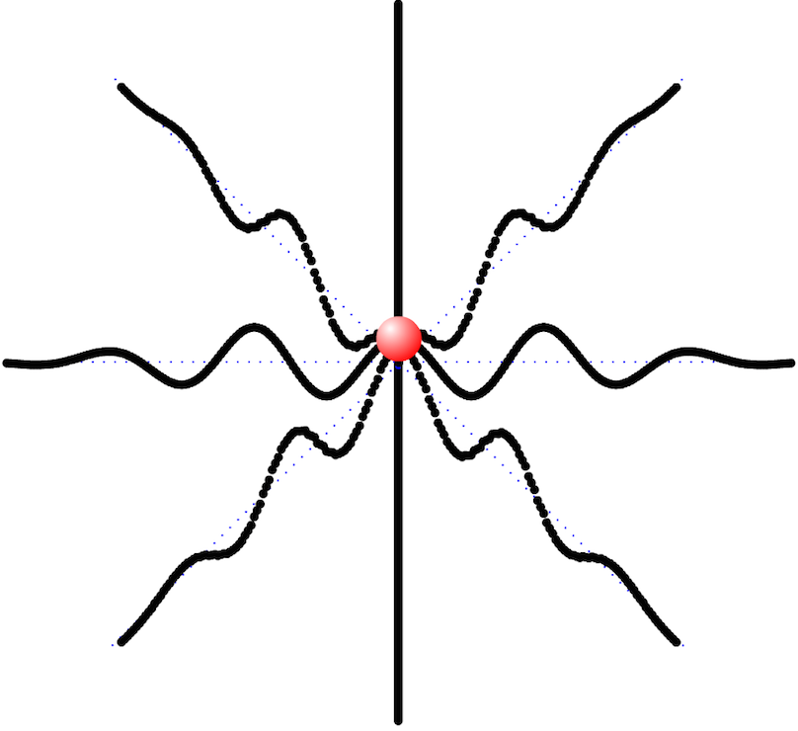
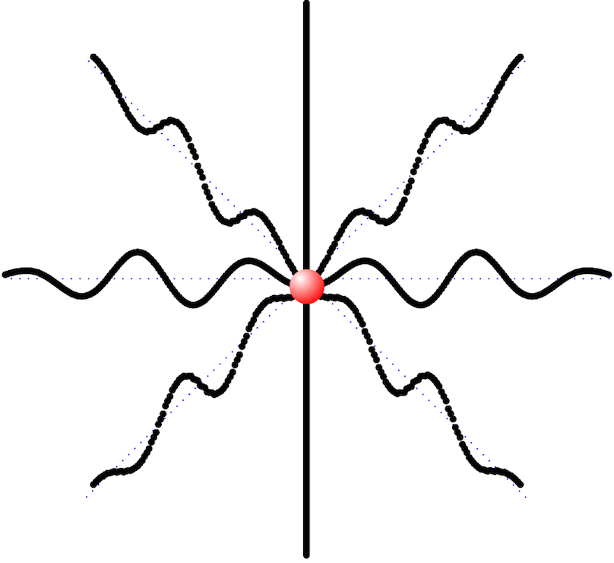
Quantum Field Theory
Classical fields
A static electric charge has an electric field around it.
If you wiggle the charge, you will make ripples in the field.
⇒ electromagnetic radiation

Slide 12
Quantum Field Theory
Quantum fields
Ripples in the field actually come in discrete pieces.
⇒ Excitations in the field are quantized.
One quantum of excitation = one fundamental particle
Each type of fundamental particle has a field
Electromagnetic field ⇒ photon
Electron field ⇒ electrons and positrons
Up quark field ⇒ up quarks and anti-quarks
If two fields interact with each other, then an excitation in one field can create/destroy/change excitations in the other field.

Slide 13
Quantum Electrodynamics (QED)
Let’s consider just electrons and photons.
The electron field
The unexcited field has a value of zero.

Slide 14
Quantum Electrodynamics (QED)
Let’s consider just electrons and photons.
The electron field
The unexcited field has a value of zero.
It requires at least E_{o} = 0.5 MeV of energy to create an excitation.
E = E_{o}
E = E_{o}+ E_{K}

Slide 15
Quantum Electrodynamics (QED)
Let’s consider just electrons and photons.
The electron field
The unexcited field has a value of zero.
It requires at least E_{o} = 0.5 MeV of energy to create an excitation.
Upward excitations have electric charge -1 ⇒ electrons
-

Slide 16
Quantum Electrodynamics (QED)
Let’s consider just electrons and photons.
The electron field
The unexcited field has a value of zero.
It requires at least E_{o} = 0.5 MeV of energy to create an excitation.
Upward excitations have electric charge -1 ⇒ electrons
Downward excitations have electric charge +1 ⇒ positrons
+
E = E_{o} + E_{K}

Slide 17
Quantum Electrodynamics (QED)
Let’s consider just electrons and photons.
The electron field
The unexcited field has a value of zero.
It requires at least E_{o} = 0.5 MeV of energy to create an excitation.
Upward excitations have electric charge -1 ⇒ electrons
Downward excitations have electric charge +1 ⇒ positrons
The photon field

Slide 18
Quantum Electrodynamics (QED)
Let’s consider just electrons and photons.
The electron field
The unexcited field has a value of zero.
It requires at least E_{o} = 0.5 MeV of energy to create an excitation.
Upward excitations have electric charge -1 ⇒ electrons
Downward excitations have electric charge +1 ⇒ positrons
The photon field
There is no minimum energy required to create an excitation.
Excitations have no charge.
Any field with electric charge will interact with this field.
E = E_{K}
E = E_{K}

Slide 19
Quantum Electrodynamics (QED)
Simplest process causing two electrons to repel:

Slide 20
Quantum Electrodynamics (QED)
Simplest process causing two electrons to repel:

Slide 21
Quantum Electrodynamics (QED)
Simplest process causing two electrons to repel:

Slide 22
Quantum Electrodynamics (QED)
Simplest process causing two electrons to repel:

Slide 23
Quantum Electrodynamics (QED)
Simplest process causing two electrons to repel:

Slide 24
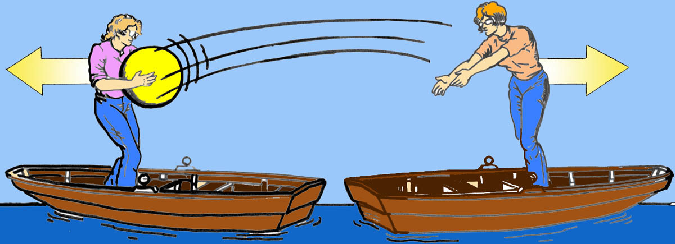
Quantum Electrodynamics (QED)
Simplest process causing two electrons to repel:

Slide 25
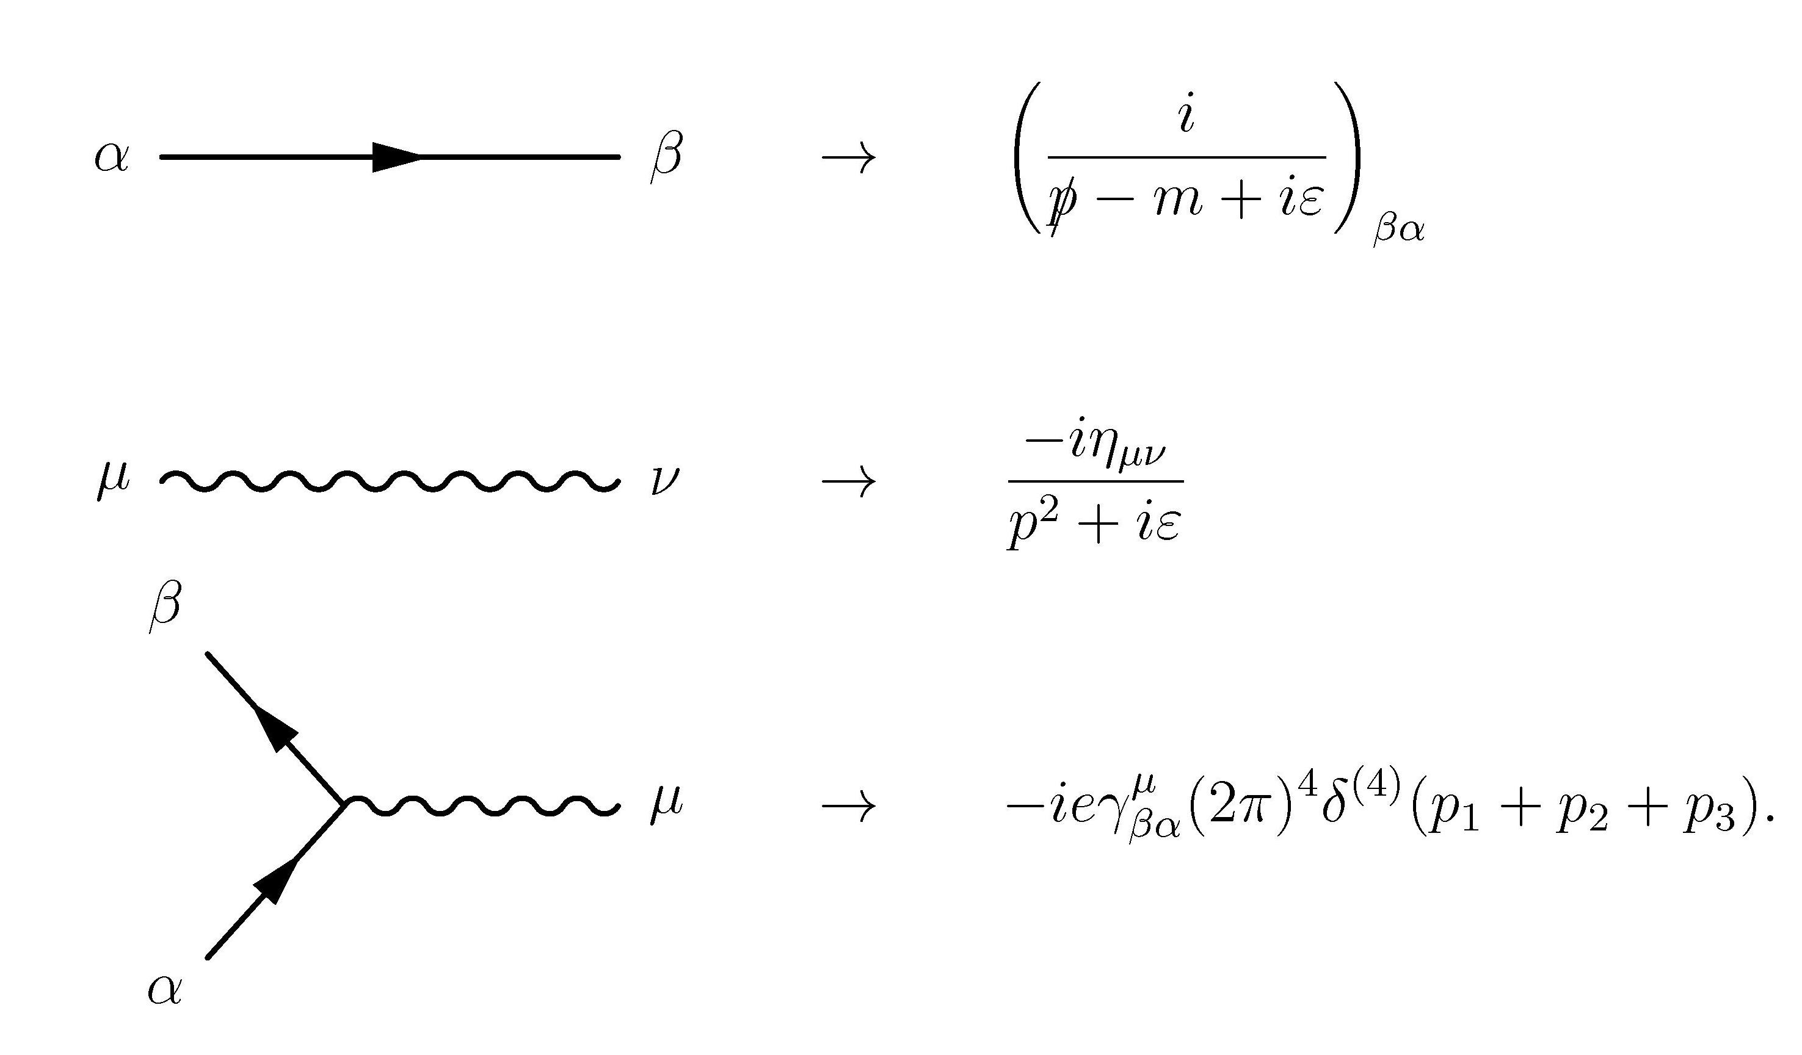
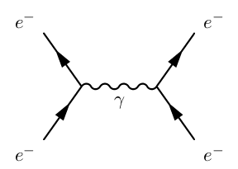
Feynman Diagrams
A more convenient way to represent particle interactions:
Electron (e⁻)
Photon (γ)

Slide 26
Rules of QED
All interactions between the electron field and the photon field can be represented by combinations of these pieces:

Slide 27
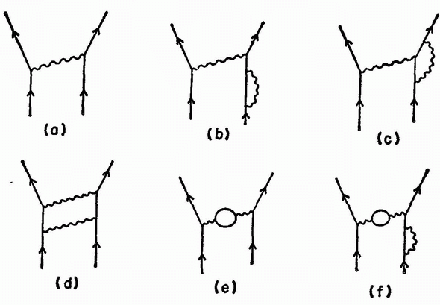
Rules of QED
More complex interactions:

Slide 28
Rules of QED
Anti-particles corresponds to a particles going backward in time!
e⁺
e–
γ
e–
e⁺

Slide 29
Rules of QED
The other fundamental particles follow basically the same rules as electrons.
The probability for an interaction is proportional to the particle’s charge.
Neutrinos, gluons, Z bosons, and Higgs bosons have no charge, so they don’t interact with photons.
Additional rules:
Energy must be conserved
Momentum must be conserved
Electric charge must be conserved

Slide 30
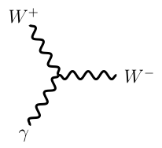
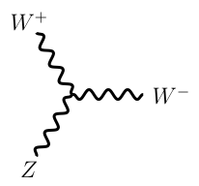
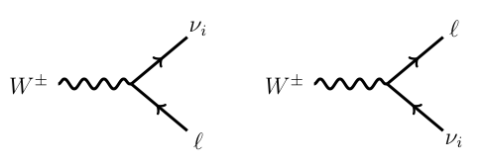
Weak Interactions
Same basic concepts as QED, but
The weak field has three types of excitations: W⁺, W⁻, Zº.
The weak field interacts with fields that have “weak isospin” charge.
The weak field interacts with itself.
The interactions can change different matter particles into each other!
d,s,b
Z
u,c,t

Slide 31
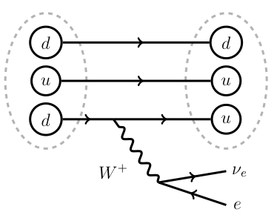
Weak Interactions
Responsible for radioactive decay:

Slide 32
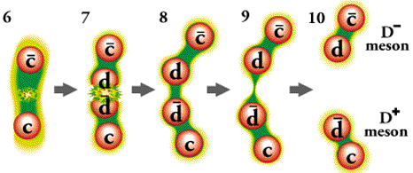
Strong Interactions
Same basic concepts, but new dynamics:
There are 8 types of gluons.
Gluons interact with fields that have “color” charge.
Quarks
Themselves
Gluons change the “color” charge of things the interact with.
The strength of the strong force increase with distance!

Slide 33
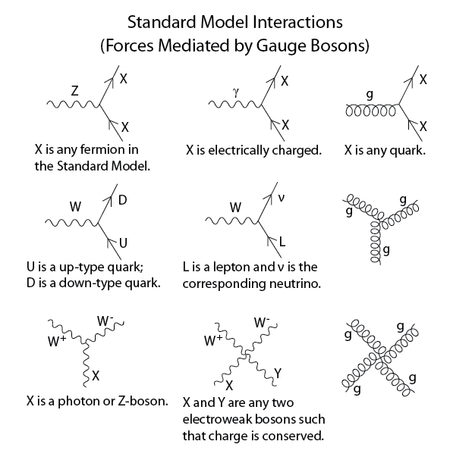
All Interactions

Slide 34
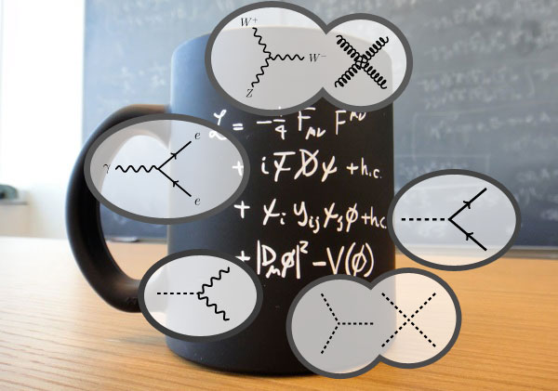
Standard Model Lagrangian

Slide 35
Enough theory! Back to reality….

Slide 36
Particle creation
E = mc²
With enough energy, we can create new heavy particles

Slide 37
Particle creation
E = mc²
With enough energy, we can create new heavy particles
We use Feynman diagrams to calculate the probability of creating various types of particles.

Slide 38
Particle decay
Conversely, particles with a lot of mass have a lot of energy, so they can decay to lighter particles
This is why ordinary matter is only made from the lightest copy of the quarks and leptons
Feynman diagrams will also tells us the probability for a give decay.

Slide 39
Decay products
We only detect the decay products of the heavy particles
But the mass of the heavy particles was converted into the energy of the decay products
Thus, if we find the decay products and measure their energy, we can determine the mass of the parent particle!

Slide 40
Decay Examples
e
γ
Z
H
e
γ
μ
ν
Z
W
μ
μ

Slide 41
Summary
The Standard Model describes physics at short distances and high energies
The fundamental particles are excitations in fields that permeate the universe
Particle interactions can be represented by Feynman diagrams
The Standard Model tells us the rules for the Feynman diagrams and how to use them to make calculations

Slide 42
Thank You

Slide 43
How do particles cause forces?
Two boats are pushed apart by exchanging a medicine ball

Slide 44
How do particles cause forces?
Two matter particles are pushed apart by exchanging a force particle

Slide 45
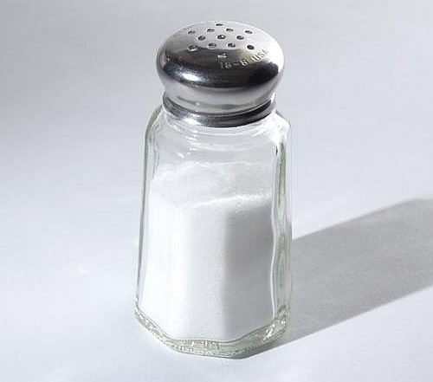
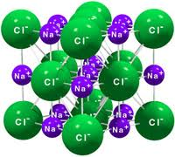
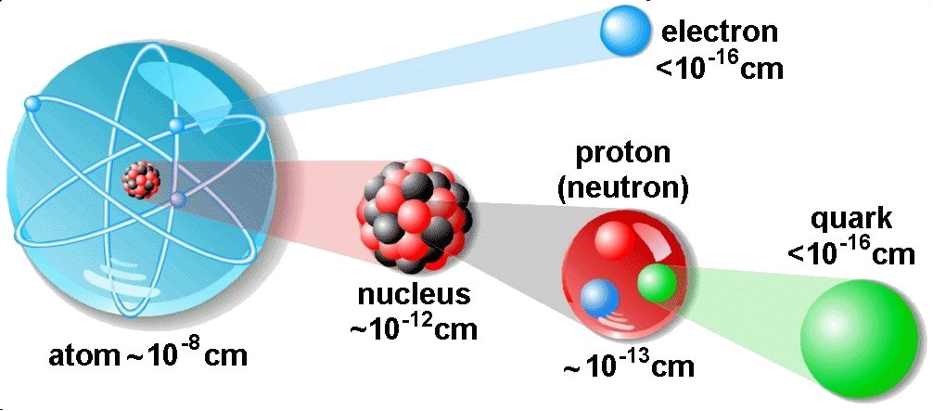

Slide 46
Matter Particles
So what are the other quarks and leptons?
They are just higher mass copies.
Why are there three copies?
Good question!

Slide 47
Matter Particles
Why is ordinary matter only made from the lightest of the copies?
We’ll come back to this…

Slide 48
Rules of QED
All interactions between electrons and photons are described by combinations of these basics pieces:
To calculate the total electron repulsion, we add the contributions from all of the processes that can cause it.

Slide 49
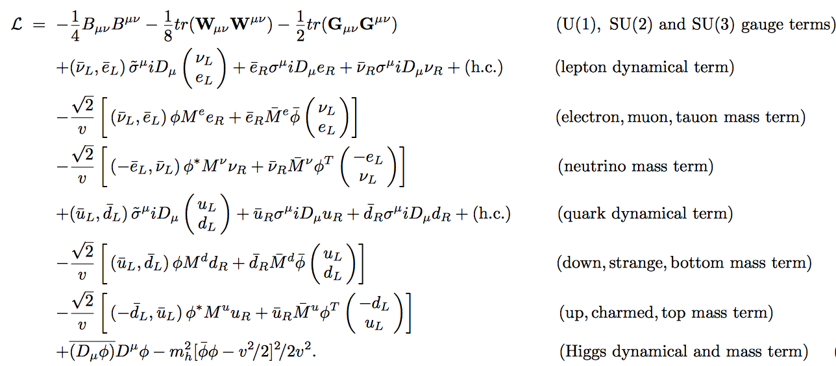
Standard Model Lagrangian

