Slide 1

Finding the Higgs Boson
2015

Slide 2
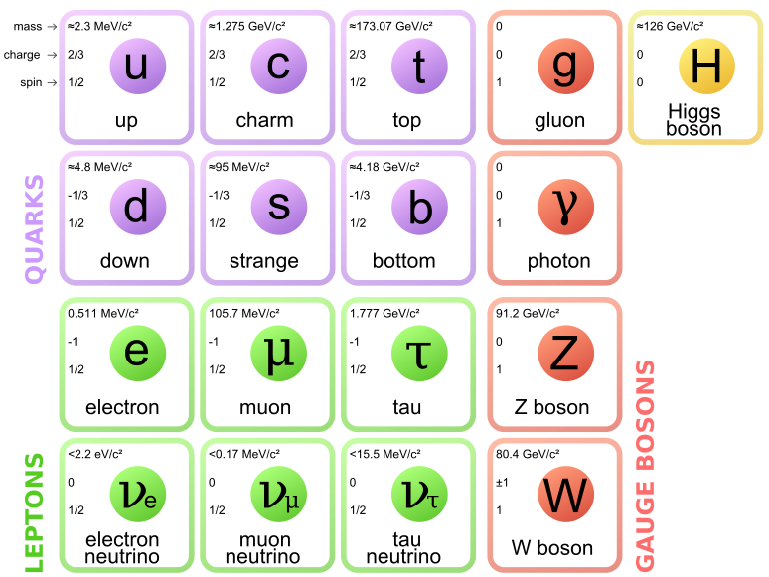
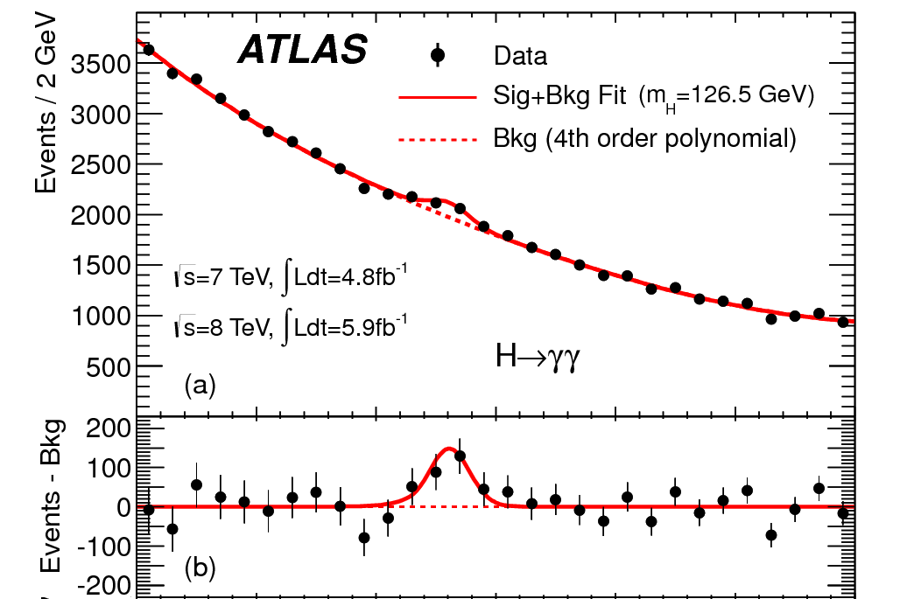
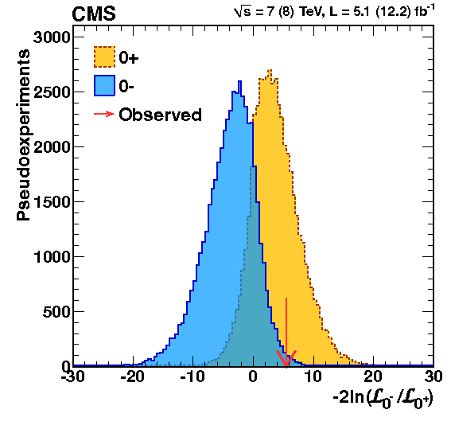
Overview
The Higgs boson
Creating Higgs bosons
The discovery of a “Higgs-like” particle on July 4, 2012
Is it really the Higgs boson?

Slide 4
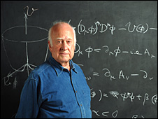
Origin of mass
The mathematics requires all fundamental particles must be massless.
  Adding particle masses to the equations “by hand” makes the theory mathematically inconsistent.
But we know from experiment that most elementary particles have mass!!
Prof. Peter Higgs was one of the first physicists to explain how particles could acquire mass.
Born in 1929, Prof. Higgs is an English theoretical physicist and Emeritus professor at the University of Edinburg. His work on the origin of mass was published in 1964.

Slide 5
What is mass?
F = ma
Mass is an objects resistance to change velocity.
E_{total} = mc² + E_{K}
Mass is the energy a particle has even when its not moving.
⇒ Massless particles must always be moving
⇒ Massless particles must travel at the speed of light or else I could (in principle) catch up to them.
⇒ Mass allows particles to travel slower than the speed of light.
  Without mass, atoms could not form and we would not exist!

Slide 6
Higgs field
There is a Higgs field that permeates all of the universe and its default value is non-zero.
  Similar to how there is a non-zero magnetic field around you right now, but unlike the Earth’s magnetic field, the Higgs field has no direction… and it is everywhere in the universe.
All particles are massless in the equations, but then some of them acquire mass by interacting with the Higgs field.
What does that mean, they “acquire” mass?
  You know how some particles feel a force when they are in a magnetic field.
  Some particles resist accelerating when in the Higgs field.
  ⇒ Bingo! Particles that interact with the Higgs field have mass.
    Just as the forces are mediated by force carrier particles, interactions with the Higgs field is mediated by Higgs bosons.

Slide 7

Origin of Mass

Slide 8
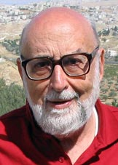
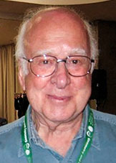
2013 Nobel Prize in Physics
Awarded to François Englert and Peter W. Higgs "for the theoretical discovery of a mechanism that contributes to our understanding of the origin of mass of subatomic particles, and which recently was confirmed through the discovery of the predicted fundamental particle, by the ATLAS and CMS experiments at CERN's Large Hadron Collider”

Slide 9
Higgs boson
The Standard Model assumes the simplest possible form for the Higgs boson.
    A single fundamental particle;
    Spin = 0 (no intrinsic angular momentum);
    Even parity (it behaves the same as its mirror image);
    No electric charge;
    Its interaction with other particles is precisely predicted.
      Fermions interactions are directly proportional to the fermion mass.
  Basically the same as proposed by Prof. Higgs and colleagues in 1964.
There are also more complex and exotic versions.
  Multiple Higgs bosons, composite Higgs made of smaller particles, …
  But Occam’s razor says to start with the simplest version until there is evidence for something more complicated.
… so how do we find it?

Slide 10
Particle creation
Mass is just a form of energy: E = mc²
  With enough energy, we can create new heavy particles.

Slide 11
Particle creation
Mass is just a form of energy: E = mc²
  With enough energy, we can create new heavy particles.
  For example, a Z boson and a Higgs boson.
Z
H

Slide 12
Particle decay
Conversely, particles with a lot of mass have a lot of energy and will decay to lighter particles.
We should be able to create Higgs bosons in high energy collisions, which will quickly decay back to the lighter particles that we will see in our detector.
e
e
μ
μ

Slide 13
Searching for the Higgs Boson
If Higgs bosons exist, what will we see?
  How will Higgs boson be created and how will they decay?
  How frequently do we expect to see these events?
What other processes can result in the same final particles?
  How many of those background events do we expect?
Discriminate the signal from the background.
  The energies and directions of the detected particles will have different characteristics for different processes.
What do we observe in the data?
  Do the data agree with the background-only prediction or the
  signal+background prediction?
  How strongly do the data reject the background-only prediction?

Slide 14
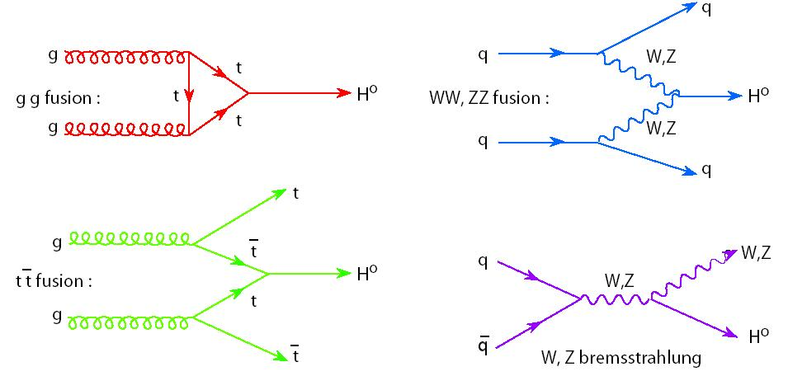
1) If Higgs bosons exist, what will we see?
Theory predicted how the a Higgs boson would be produced

Slide 15
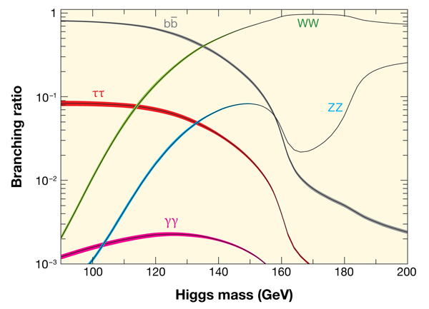
1) If Higgs bosons exist, what will we see?
Theory predicted how the a Higgs boson would be produced
And how it will decay

Slide 16
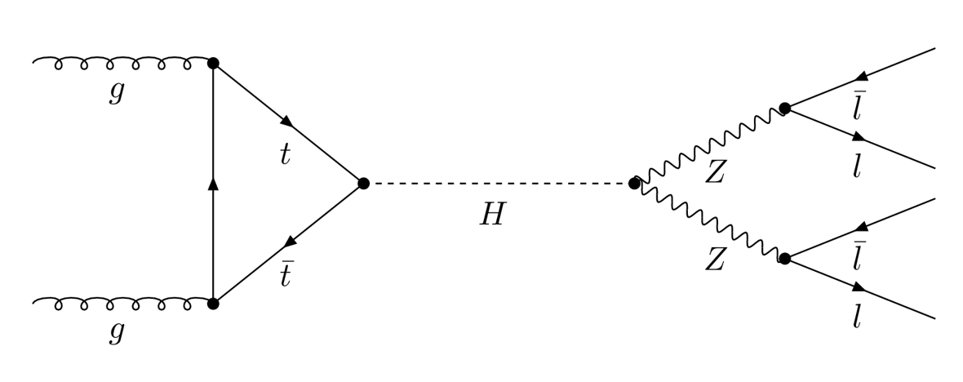
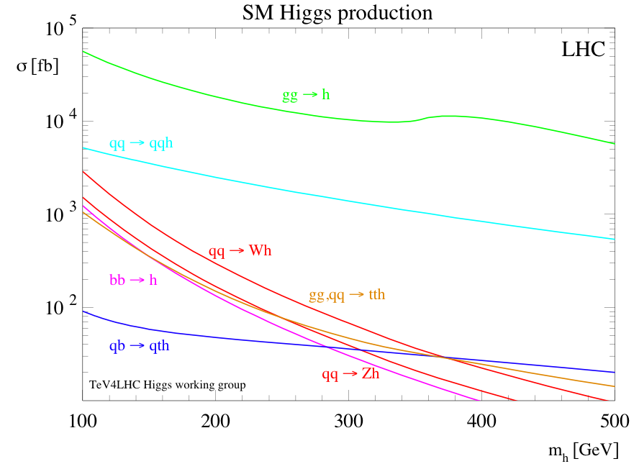
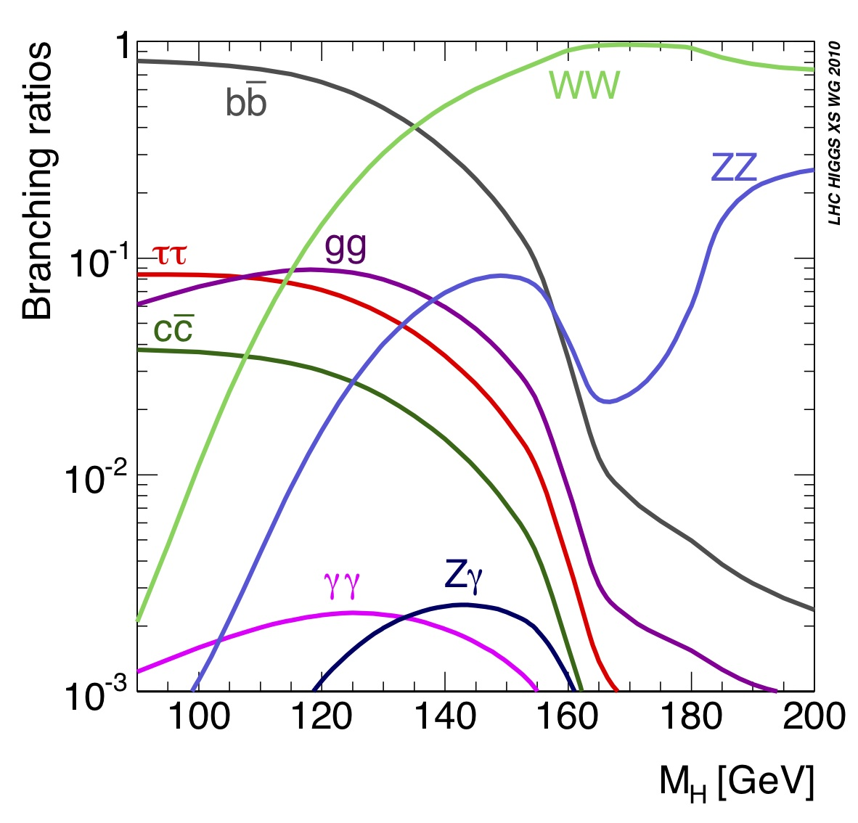
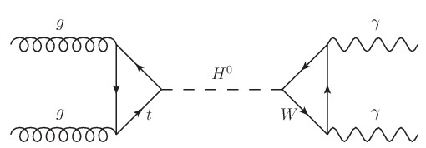
1) If Higgs bosons exist, what will we see?
Production Rates
Decay Fraction
gg ⟶ H
gg ⟶ H ⟶ ZZ ⟶ ℓℓℓℓ
qq ⟶ qqH
gg ⟶ H ⟶ γγ
Highest production rate: gg ⟶ H
Easiest decays to see: ZZ and γγ

Slide 17
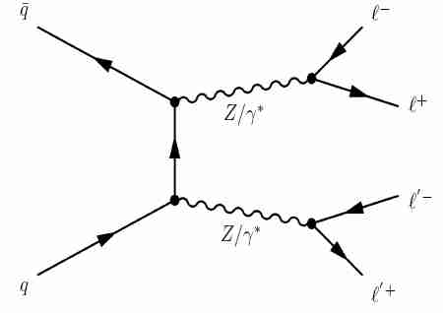
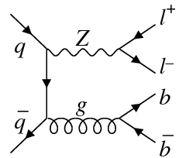
2) What other processes can result in four charged leptons?
One main background:
qq ⟶ ZZ ⟶ ℓℓℓℓ
Plus a small background
from “fake” leptons:
qq ⟶ Zqq ⟶ ℓℓ“ℓℓ”

Slide 18
3) Differentiate signal from background.
In both cases. the detected leptons came from the decay of Z bosons.
For the background, the two Z bosons have basically random momenta.
For the signal, the Z bosons come from the decay of the Higgs boson.

Slide 19
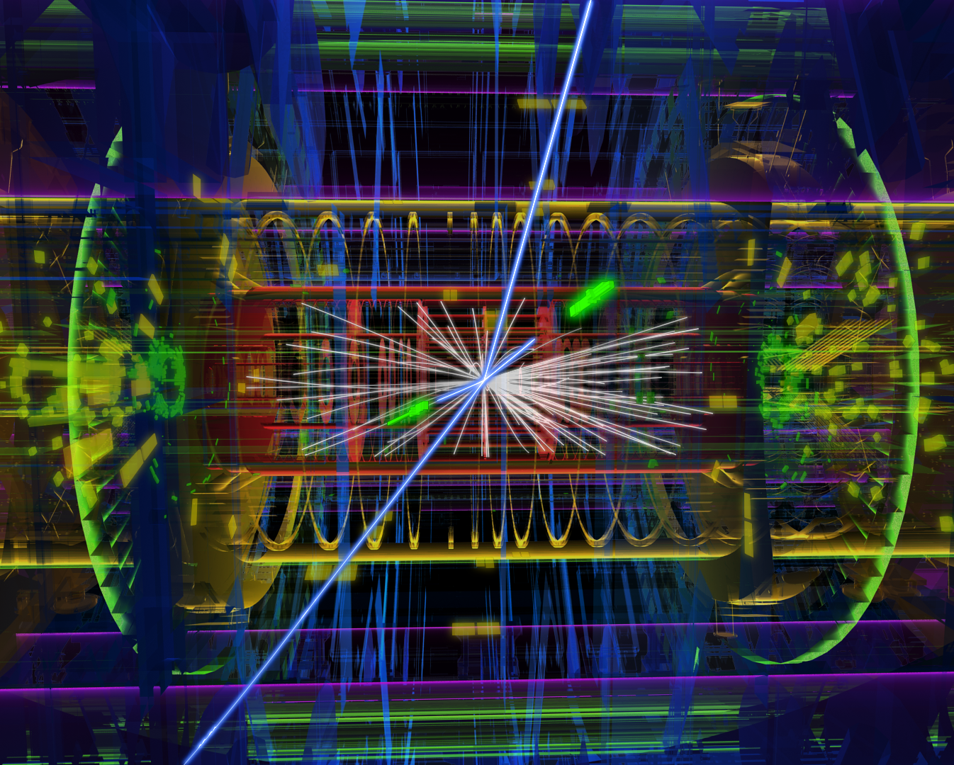
3) Differentiate signal from background.
By measuring the energy and direction of each lepton, we can calculate the mass of the parent particle
μ
μ
Z
Z
Higgs
e
e

Slide 20
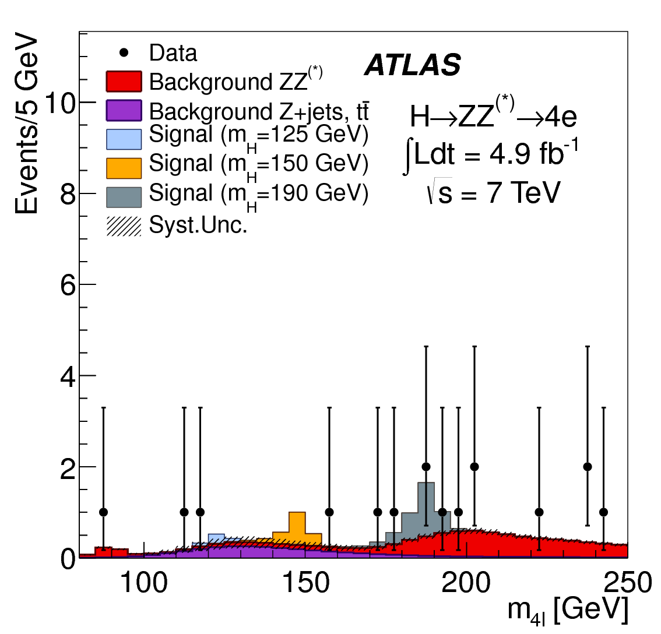
3) Differentiate signal from background.
Find every event with four high energy charged leptons.
For each event:
  Assume the four leptons came from the decay of a Higgs boson.
  Calculate the mass that Higgs boson would have had.
  Enter that mass
  into a histogram.

Slide 21
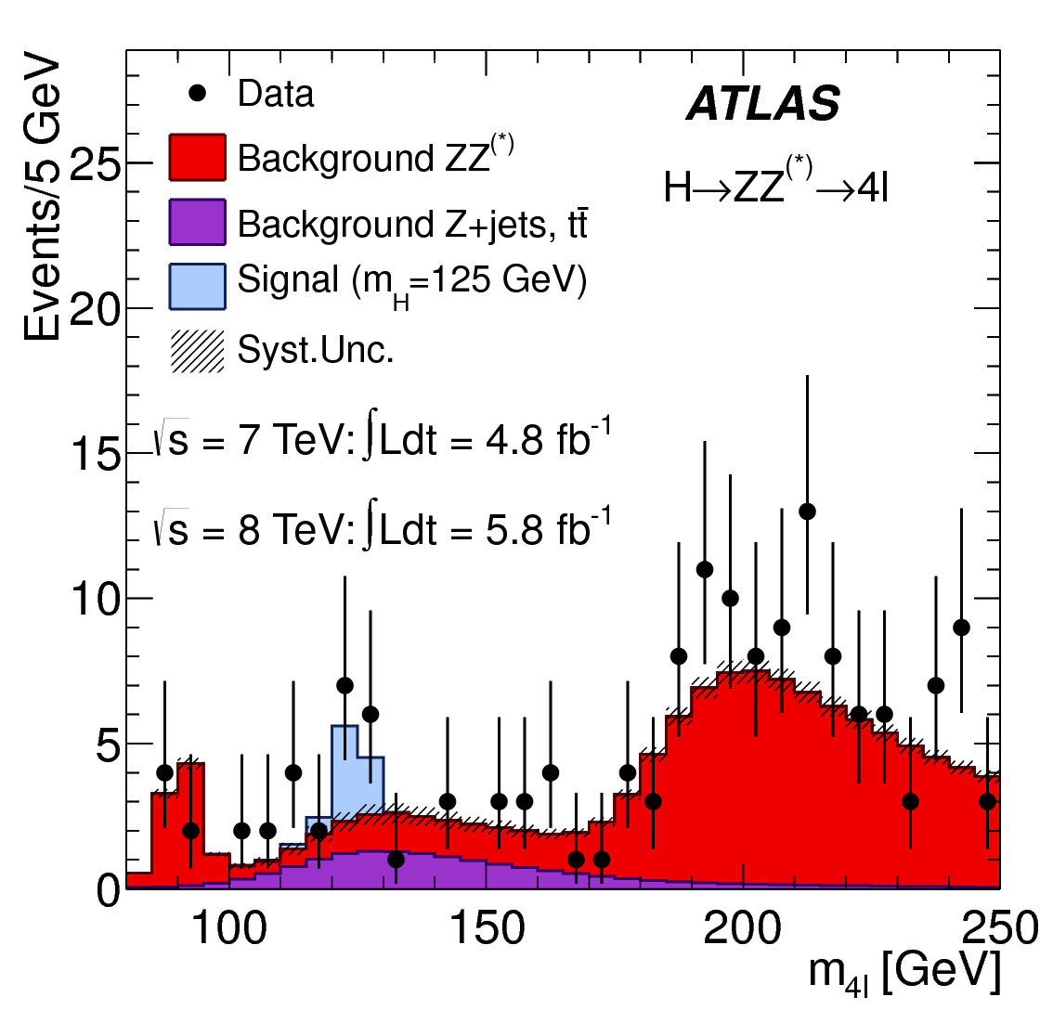
4) What do we observe in data?
Full H ➞ ZZ ➞ ℓℓℓℓ results on July 4, 2012:
Excess of events above background near a mass of 125 GeV!
Consistent with prediction for a Higgs boson!

Slide 22
H ➞ γγ
Plot the invariant mass of the two photons.
Full H ➞ γγ results on July 4, 2012:
Also sees an excess above the background consistent with a Higgs boson with mass around 125 GeV.

Slide 23
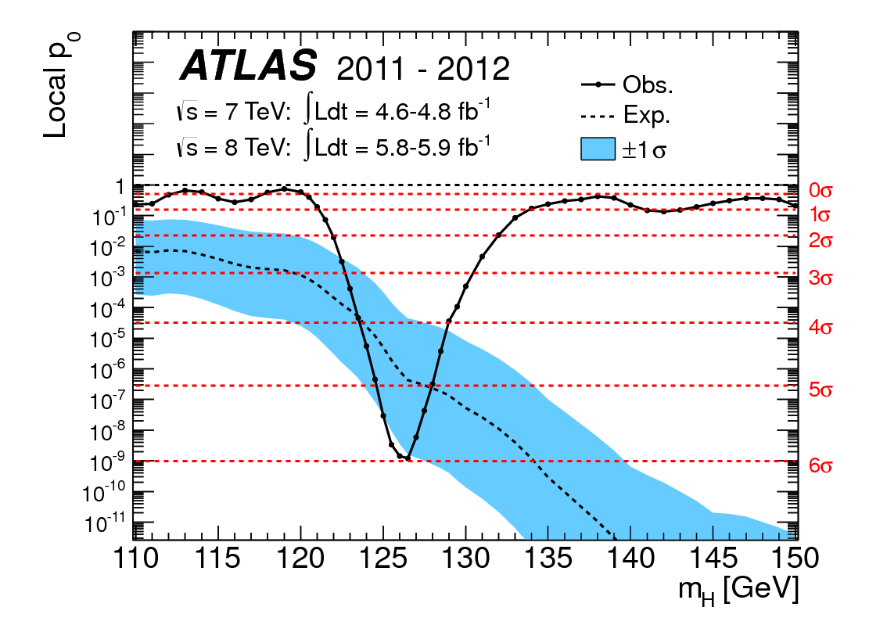
Significance of Excess
The probability that the excesses are just due to random fluctuations or our misunderstanding of the backgrounds:
“Higgs-like”
Particle Discovered
by ATLAS!
≈1 in a billion! ⟶

Slide 24

H ➞ ZZ ➞ llll with All Data

Slide 25
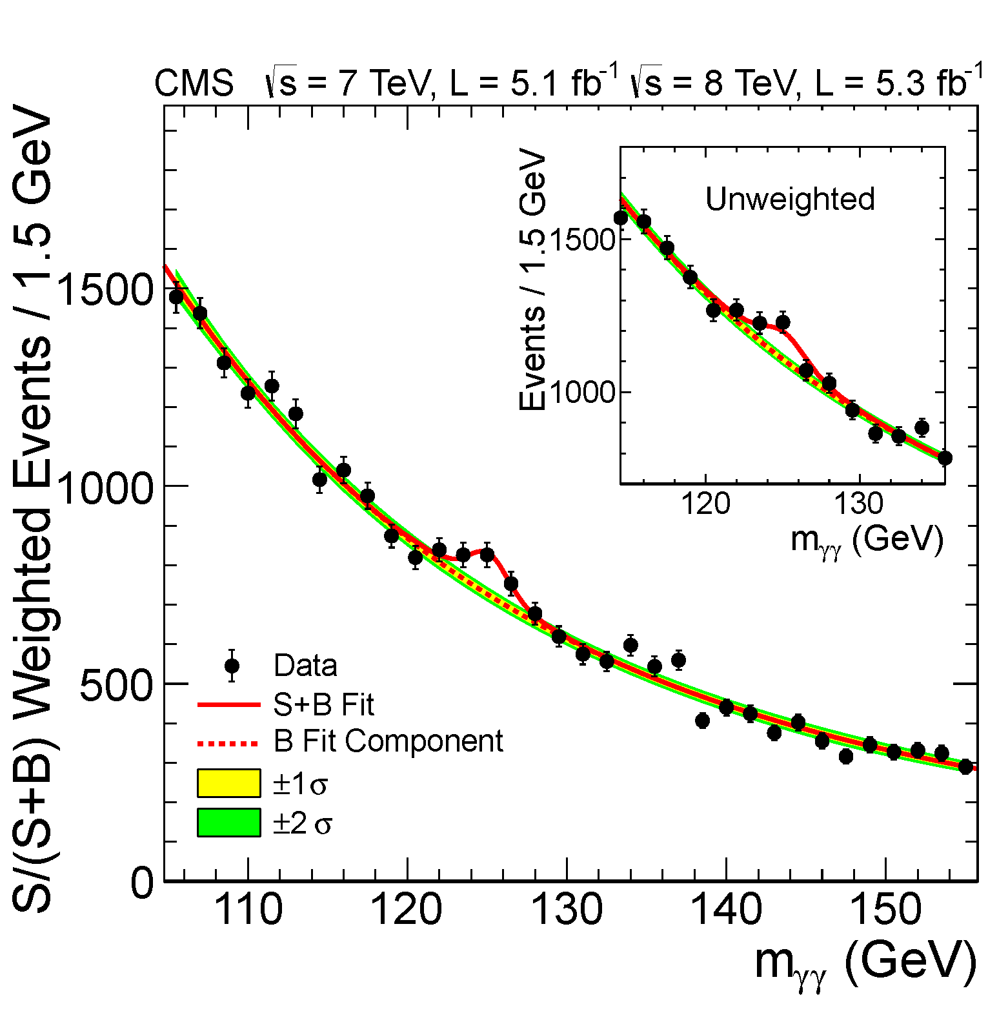
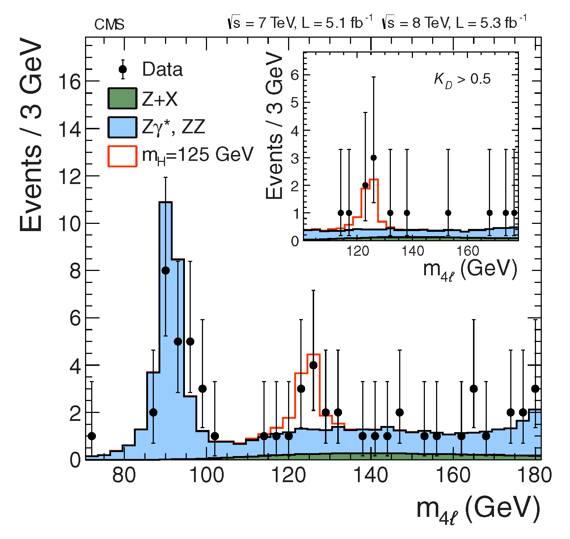
Results from CMS
On the opposite side of the LHC, the CMS experiment observed basically identical results in their data:
H ➞ ZZ ➞ llll
H ➞ γγ
“Higgs-like”
Particle Discovered
by CMS!

Slide 26
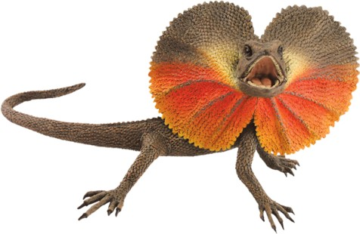


“Higgs-like”
My grandpa told me: if it looks like a Higgs boson, swims like a Higgs boson, and quacks like a Higgs boson… it’s probably a Higgs boson.
  We’ve seen a new particle that looks like a Higgs boson
  But does it quack and swim like a Higgs boson?
    Like the simple Standard Model version?
    Or a more exotic type of Higgs boson?
  Or could it even be something totally unexpected?

Slide 27
Is it a Higgs Boson?
Is it a single fundamental particle?
Does it have zero intrinsic angular momentum (spin=0)?
Does it have even parity?
Is it electrically neutral?
Does it interact with fermions as predicted?
  Probability is directly proportional the the fermion mass.
Does it interact with W and Z bosons as predicted?
  Tied the relationship between EM and Weak forces.
✓
☚
☚

Slide 28
Testing Interaction Strengths
Studies from both the LHC (CERN) and Tevatron (Fermilab)
  LHC collided protons with protons at energies of 7 – 8 TeV
  Tevatron collided protons with anti-protons at an energy of 2 TeV
Analyses are like before,
but for specific decays
  Select events one would expect
  for a specific Higgs production
  and decay.
  Discriminate that signal from
  the backgrounds.
  Measure the signal rate.
    Does it agree with theory?

Slide 29
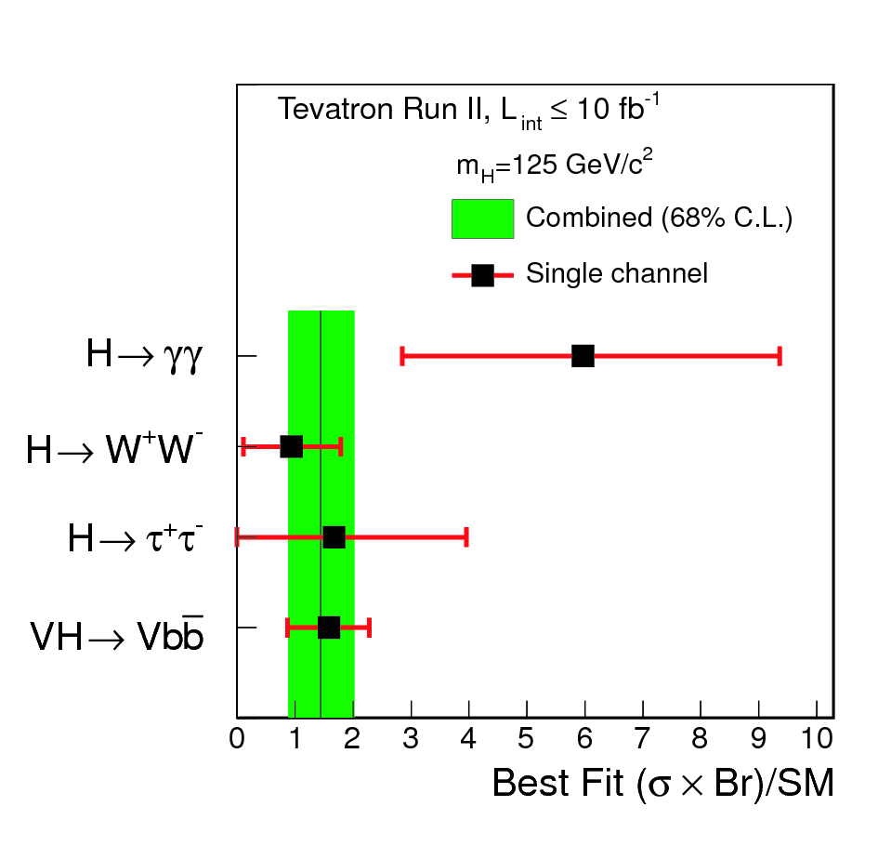
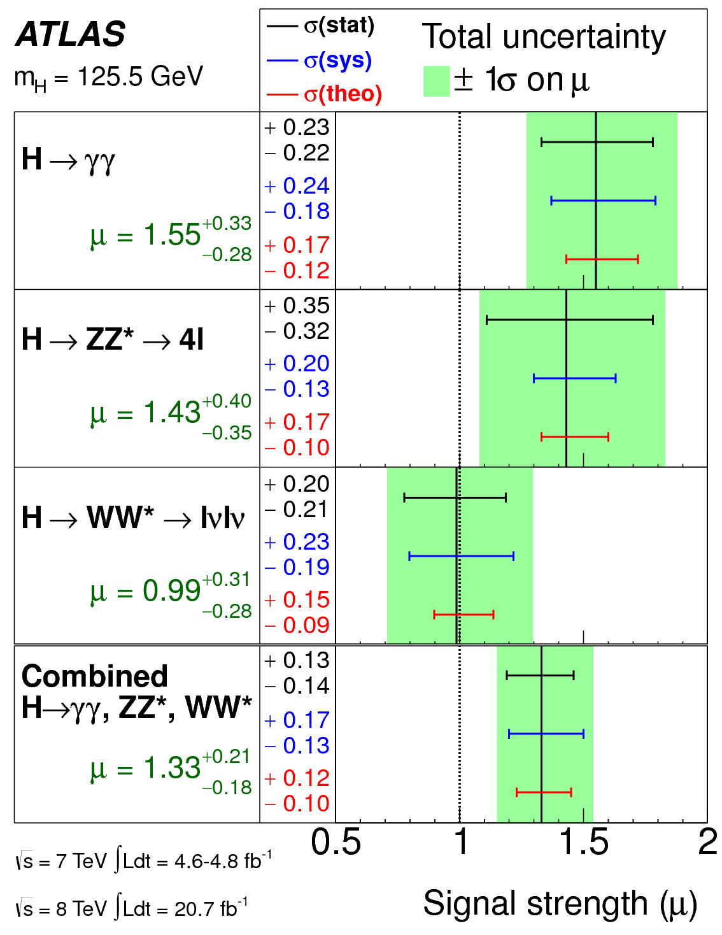
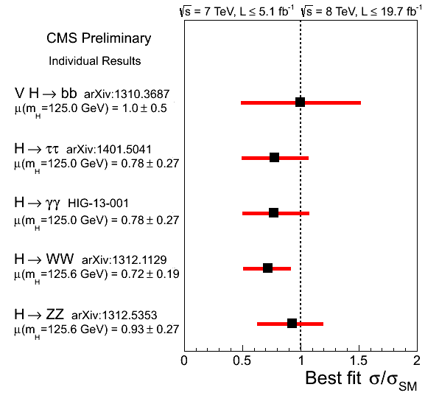
Higgs Interaction
Strengths

Slide 30
Is it a Higgs Boson?
Is it a single fundamental particle?
Does it have zero intrinsic angular momentum (spin=0)?
Does it have even parity?
Is it electrically neutral?
Does it interact with fermions as predicted?
  Probability is directly proportional the the fermion mass.
Does it interact with W and Z bosons as predicted?
  Tied the relationship between EM and Weak forces.
☚
☚
✓
OK
OK

Slide 31
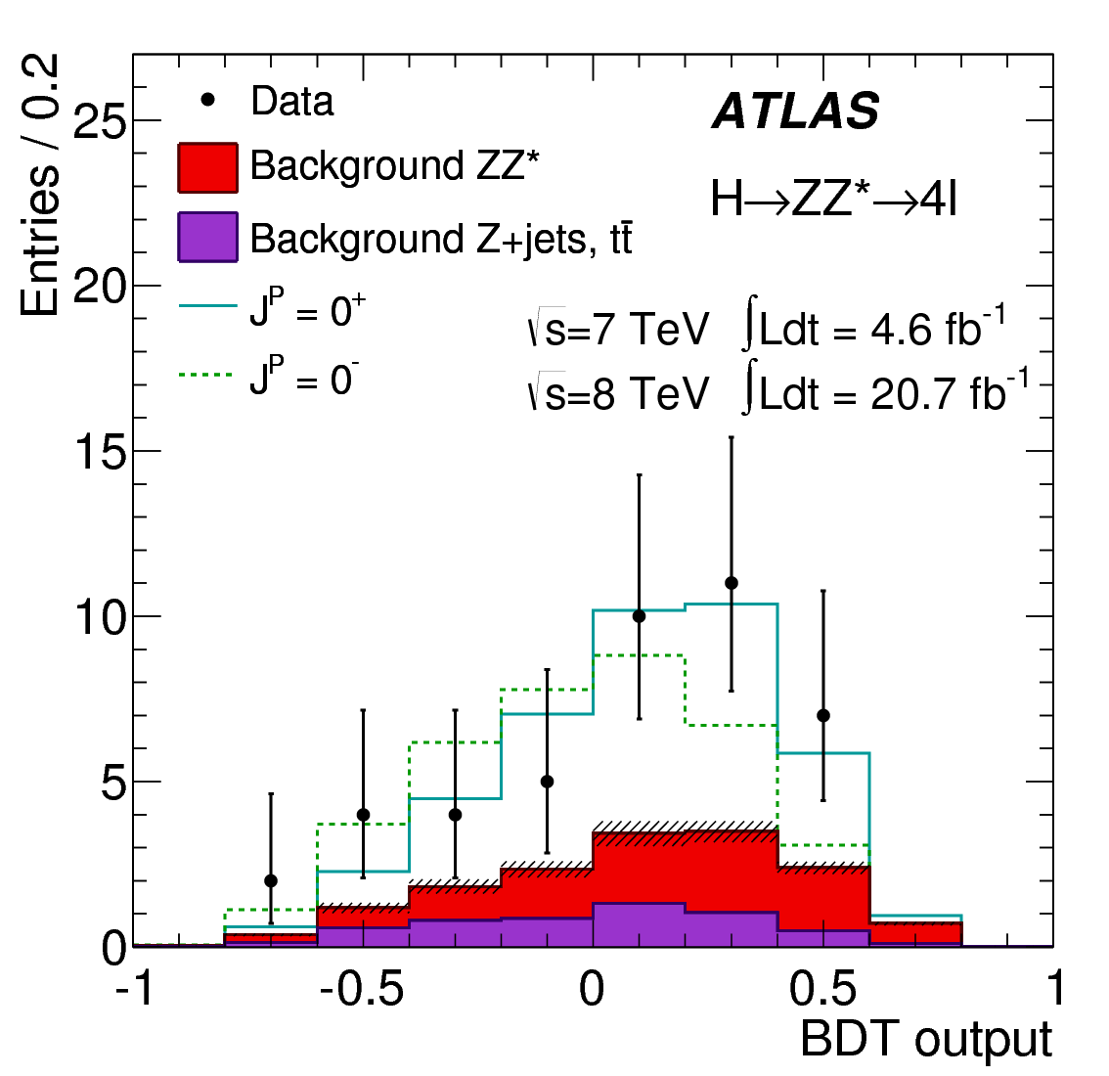
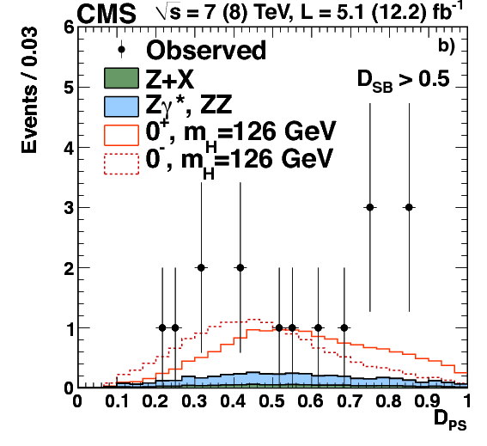
Testing Spin and Parity
Results from both LHC experiments
After discriminating signal from background, find distributions that discriminated between different spin and parity hypotheses: Spin^{Parity} = 0⁺, 0⁻, or 2⁺ ?

Slide 32
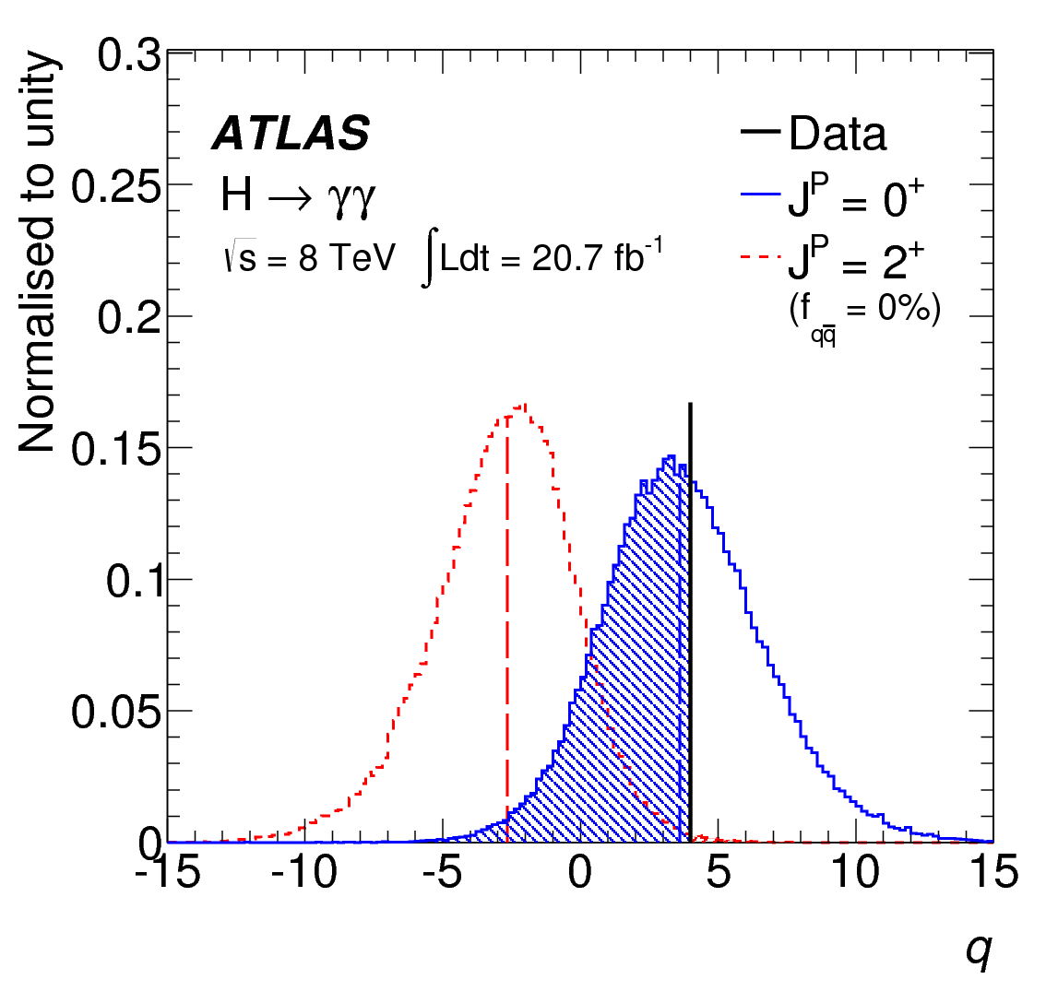
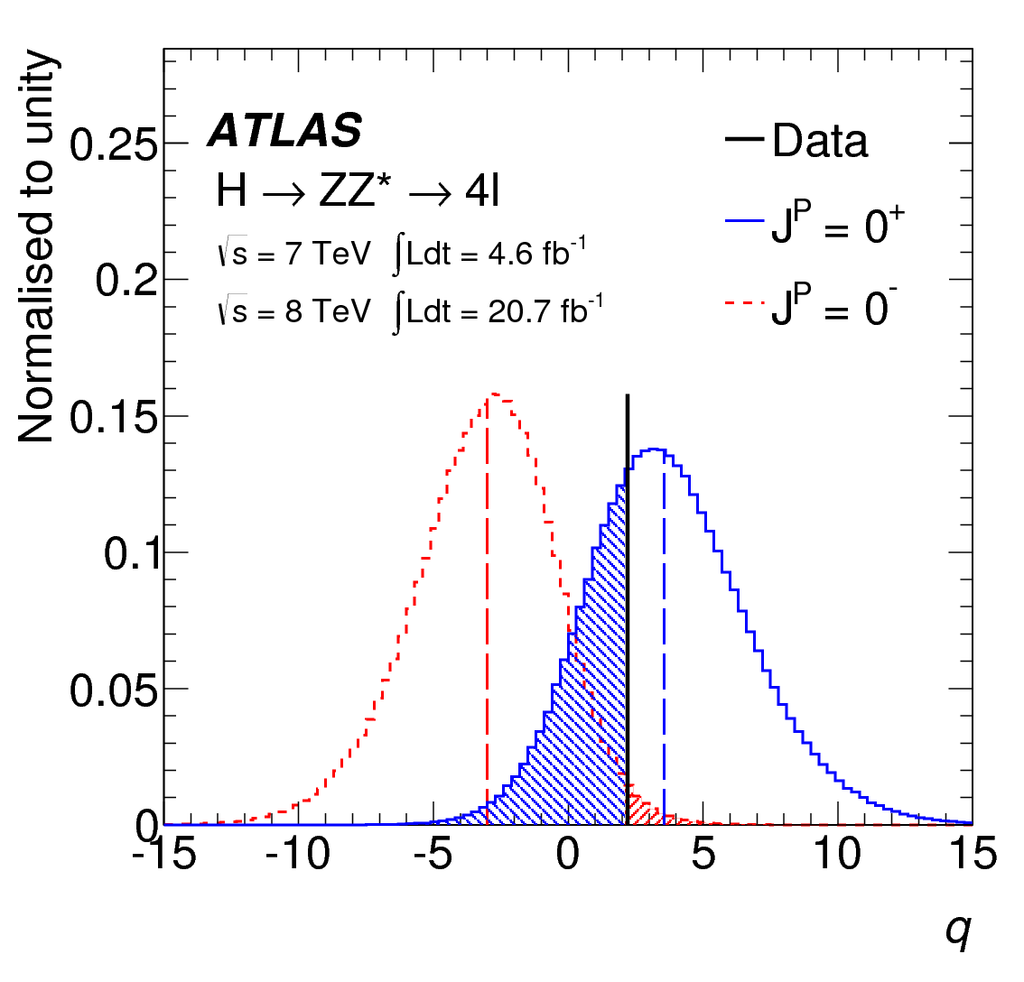
Spin and Parity
Results

Slide 33
Is it a Higgs Boson?
Is it a single fundamental particle?
Does it have zero intrinsic angular momentum (spin=0)?
Does it have even parity?
Is it electrically neutral?
Does it interact with fermions as predicted?
  Probability is directly proportional the the fermion mass.
Does it interact with W and Z bosons as predicted?
  Tied the relationship between EM and Weak forces.
✓
✓
✓
OK
OK

Slide 34

Higgs Boson
It looks, swims, and quacks like a Higgs boson.
Though we need more precision to know which kind of Higgs boson.
  The simple Standard Model Higgs boson?
  Just one of many Supersymmetry Higgs bosons?
  A technicolor Higgs boson?
  …

Slide 35
Summary
The Standard Model describes
the fundamental particles and
three of the four forces.
Matter is made from quarks
and leptons, which come in
three copies of increasing mass.
  Ordinary matter is made from the
  lightest copies.
Forces are caused by exchanging force carrier particles.
The non-zero Higgs field gives mass to particles that interact with it.

Slide 36
Higgs Discovery
We create new heavy particles in high energy collisions and then detect the decay products.
  Using the energies and angles of the decay products, we can differentiate the new particles from the backgrounds.
A “Higgs-like” particle
was found in 2012.
  Mass ≈ 126 GeV
  Spin = 0 or 2
  Electrically neutral

Slide 37
To Be Continued…
?
The new particle is definitely a Higgs boson.
But we need more precision to know
if it is the “vanilla” Standard Model
version or something more exciting.
  Hopefully it is something more exciting!

Slide 38
Thank you!

