Slide 1
Stellar Astrophysics with Ultrasat
Muk Kilic
University of Oklahoma

Slide 2
Ultrasat WDs
What WDs can do for Ultrasat:
Flux calibration, Linearity correction, Extinction
What Ultrasat can do for WDs:
Source characterization with the all-sky UV map
Variability: Pulsation, Rotation, Binarity, Planets, Asteroids
UV Excess WDs: Double Degenerates
UV Deficit WDs

Slide 3
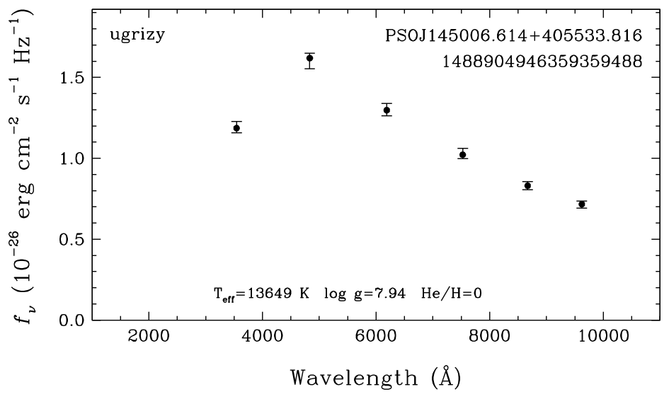
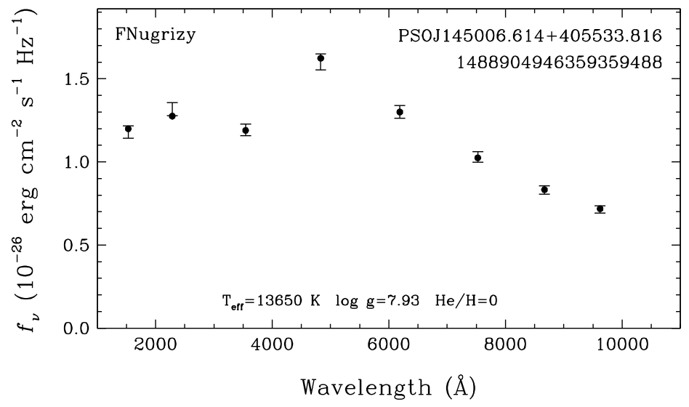
DA WDs as Flux standards There are ~36,000 confirmed DA WDs in the MWDD. Hence, ~200 DA WDs per Ultrasat pointing.

Slide 4
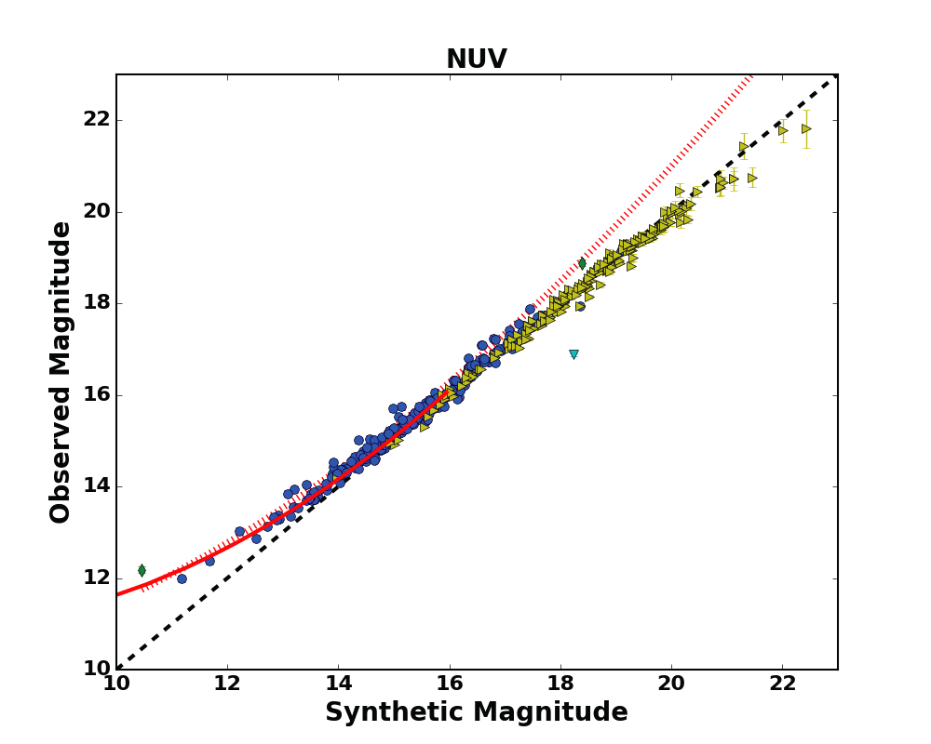
Flux Calibration + Linearity
Linearity correction for
GALEX NUV based on the 100 pc DA sample.
DA WDs can help verify the linearity of the Ultrasat detector.
Wall et al. 2019, MNRAS, 489, 5046

Slide 5
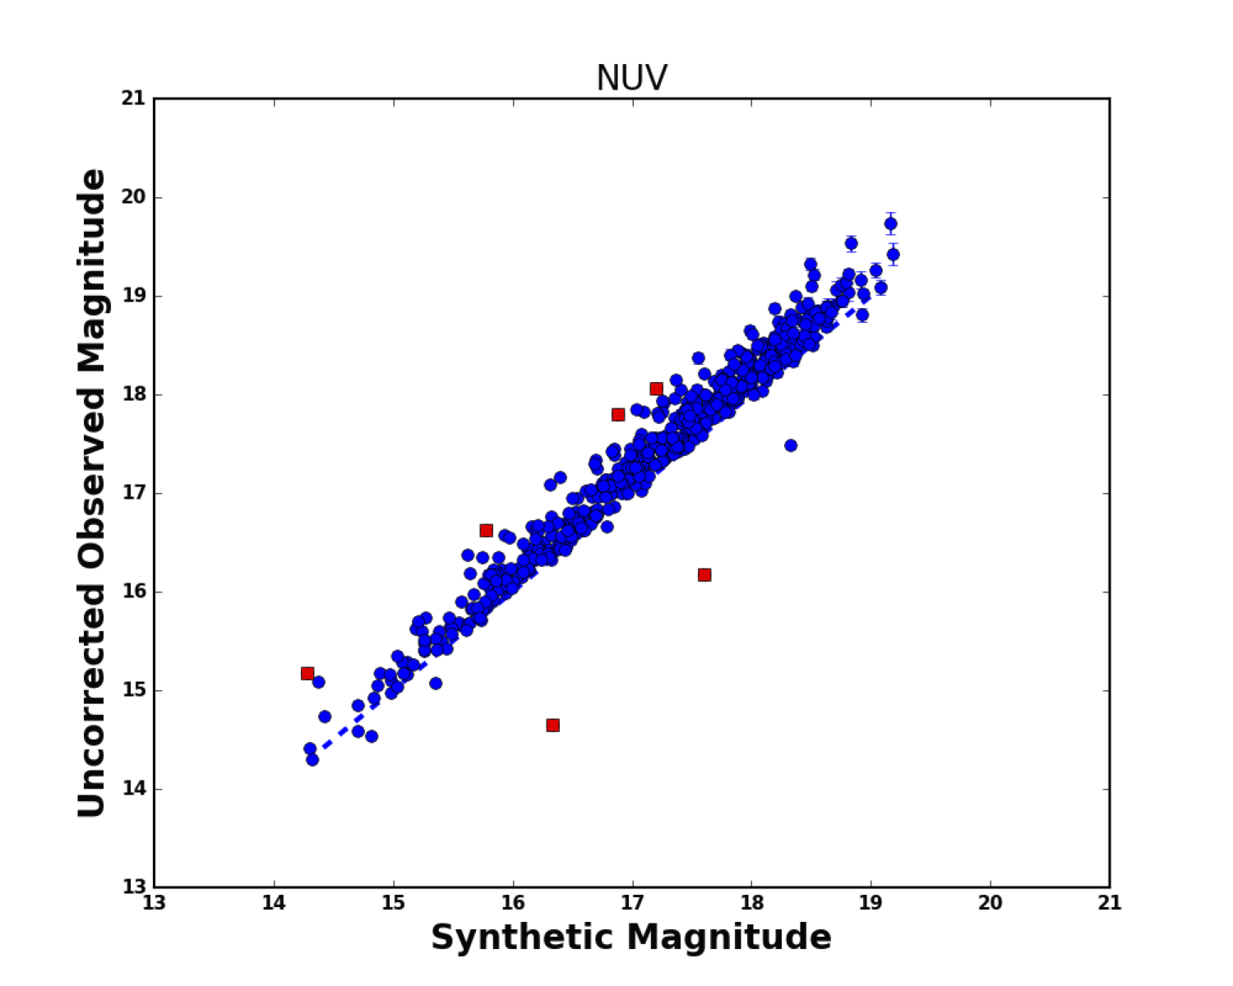
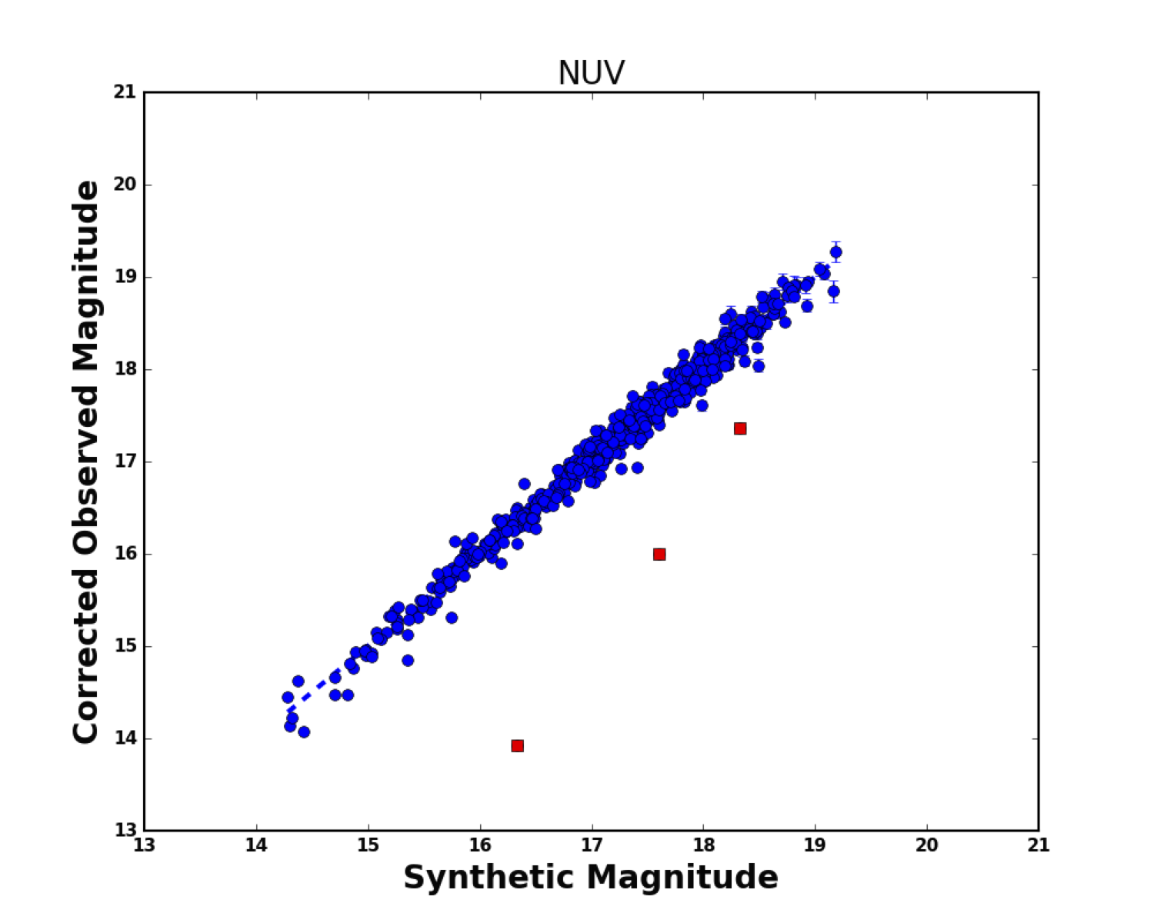
Extinction in the NUV: DA WDs can help.
Rnuv = 6.72 based on the >250 pc DA sample.
Wall et al. 2019, MNRAS, 489, 5046

Slide 6
What Ultrasat can do for WDs?

Slide 7
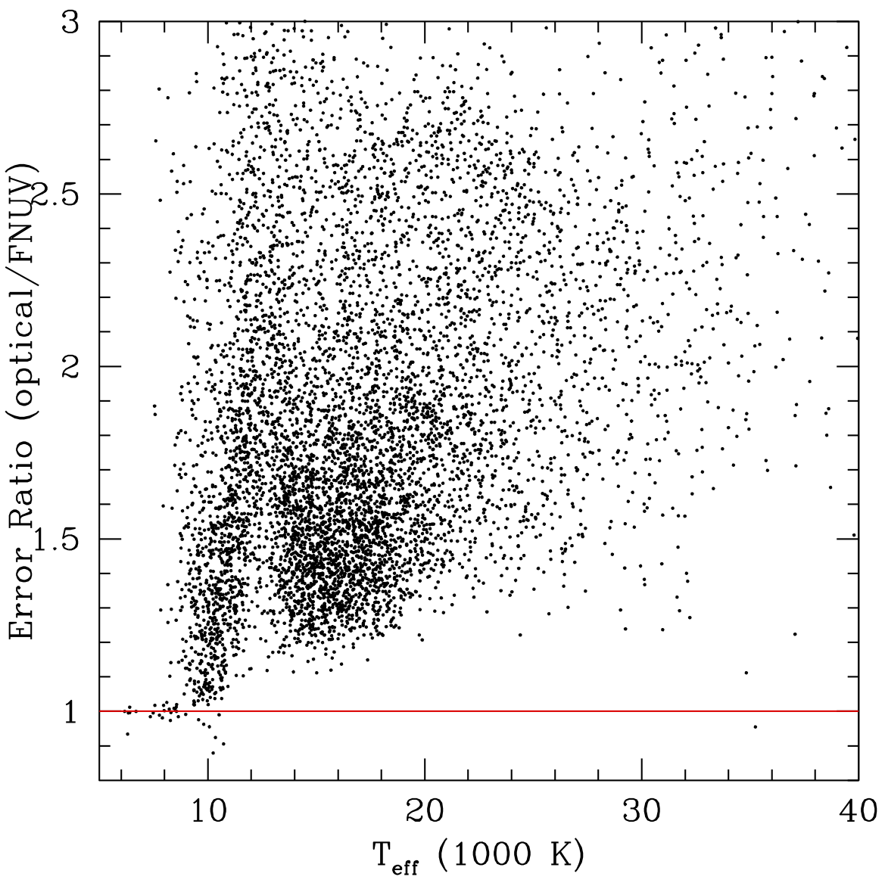
1- Source characterization with the all-sky UV Map
259,687 WDs with Pwd > 0.7 and Teff ≥ 6500 K
in Gaia EDR3 (Gentile-Fusillo et al. 2021).
For Teff<10,000 K, errors are better by 1.3x
For hotter WDs, errors are significantly better with
UV data!

Slide 8
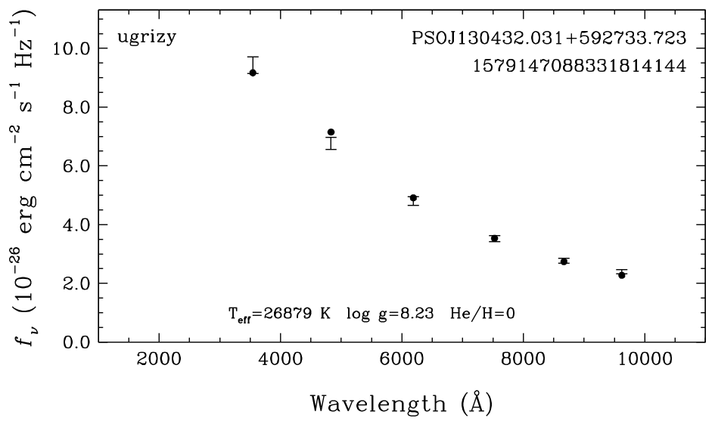
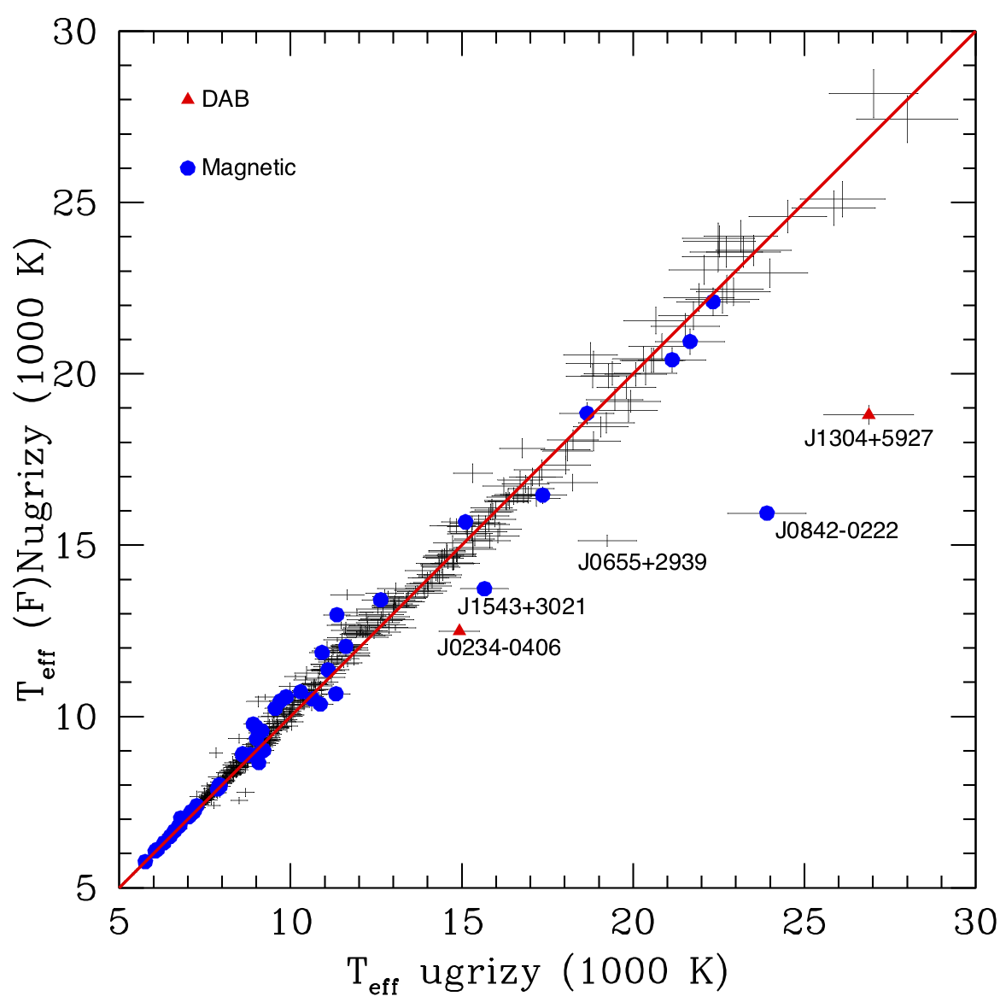
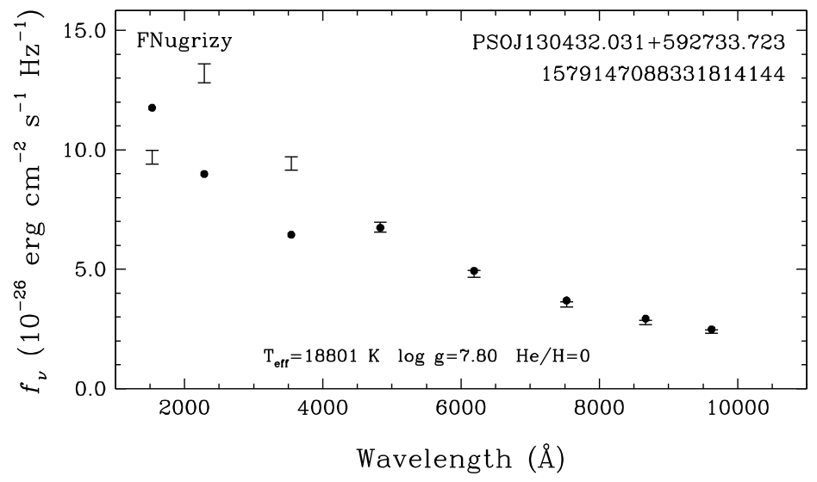
Source characterization:
100 pc sample

Slide 9
High and Low-Cadence Surveys
High cadence: 2 fields with 5 min exposures over 6 months.
Low cadence: 40 fields with 4 day cadence, 3 consecutive exposures each time.
Isolated WDs: Pulsation, rotation, planetary transits
Binary WDs: Relativistic beaming, ellipsoidal variations, eclipses, reflection effects.

Slide 10
Pulsations
DAVs pulsate between ~10,000 – 13,000 K
DBVs pulsate between ~22,000 – 30,000 K
Pulsation periods 100 s to 20 min, but up to ~40 min for ELM WDs
Rowan et al. (2019): 53 pulsators (33 with P>10 min, 4-29% NUV amplitudes), 9 eclipsing systems
Can Ultrasat do 1min exposures for the High/Low-cadence fields for a few hours?

Slide 11
Eclipsing systems from GALEX
Rowan et al. (2019)
WD + M dwarfs are most common and easier to find.

Slide 12
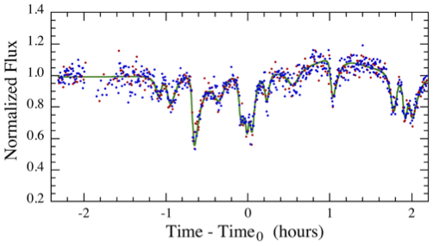
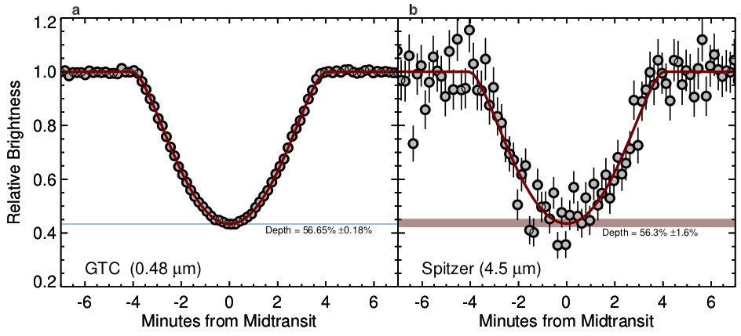
Rotation, transiting debris and planets
WD 1145+017 (Vanderburg+ 2015)
J1529+2928 (Kilic+ 2015)
WD 1856+534 (Vanderburg+ 2020)

Slide 13
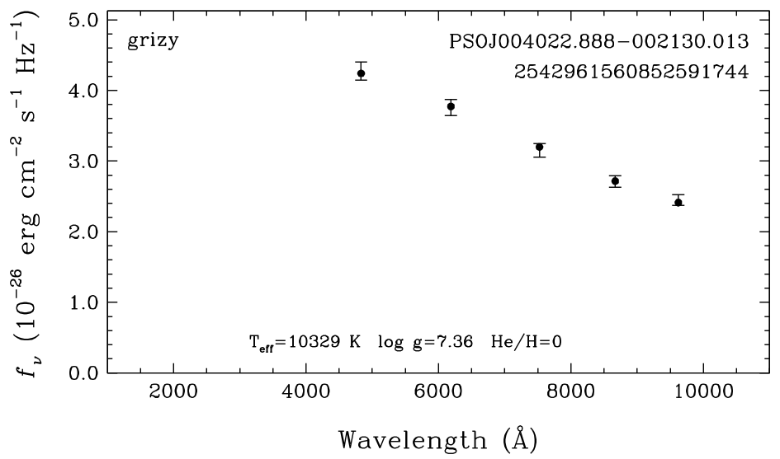
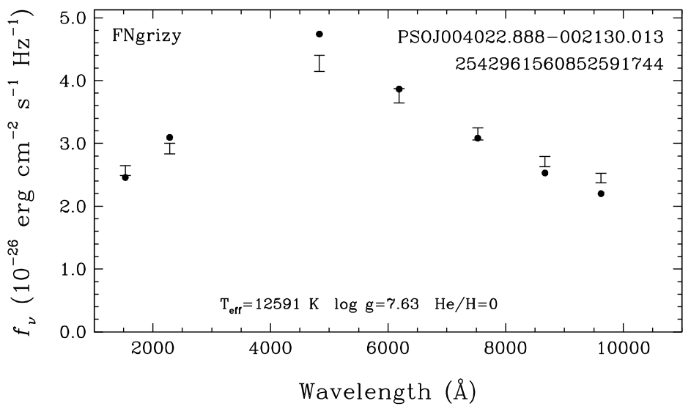
DoubleWDs: UV-excess or high-cadence survey
P<1 hour ZTF binaries (Burdge+ 2020).
The majority of the shortest period binaries in ELM/ZTF have Teff>12,000 K.
Known double-lined spectroscopic binary.
~100 LISA sources may be detected in EM (Korol+2017,2022).

Slide 14
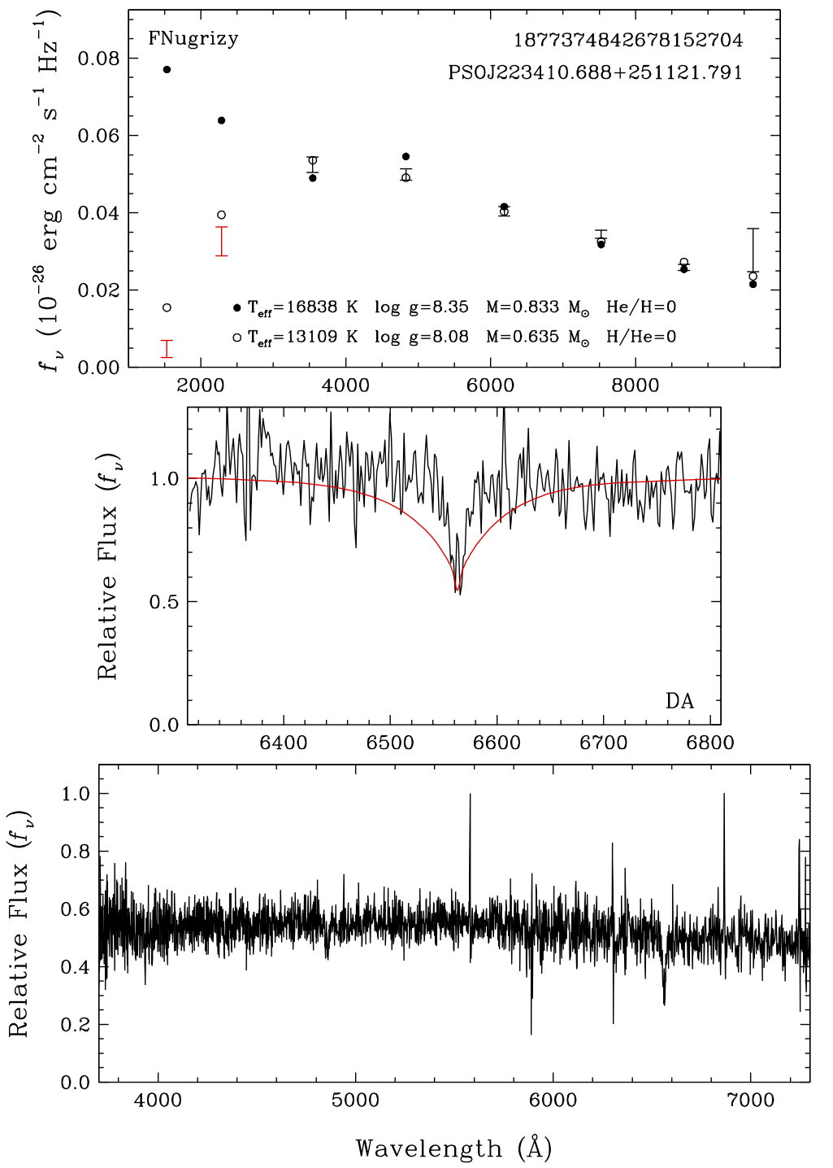
Unusual WDs
We know ~400,000 K high probability WDs from Gaia.
SDSS V, DESI, WEAVE, 4MOST are following up a large fraction
of these WDs.
Many of these will be detected by Ultrasat.
Ultrasat will be powerful in finding WDs with unusual
compositions, magnetism etc.

Slide 15
Action Plan
Prior to the launch:
1- Use currently available astrometry + photometry to predict NUV brightness of each Gaia WD to characterize the expected Ultrasat All-sky WD sample
2- Fit available photometry + astrometry to identify pulsating WD candidates in the high and low-cadence fields, obtain follow-up spectroscopy/photometry to characterize this sample using APO 3.5m + NOIRLab facilities + NASA Keck time etc.

Slide 16
Action Plan
After the Ultrasat data becomes available:
1- Use Ultrasat NUV + SDSS, PS1, Gaia, LSST, 2MASS, WISE photometry to constrain the physical parameters of all WDs in the Ultrasat All-sky map.
2- Use high cadence data to identify pulsating WDs. 6-month long light curves would be phenomenal.
3- Use high-/low-cadence data to identify binaries (eclipses, ellipsoidal, reflection, doppler boosting), transits (debris, asteroids, planets).
Interested in contributing to
WG5: Stars, Stellar Structure, and Evolution
WG2: Gravitational Wave Sources
WG3: Exoplanets and Star-Planet Connection
WG 13: Follow-up

