Slide 1
The Stable Inverted Pendulum
θ
ω
mg

Slide 2
Experimental Setup
Frequency Counter
Frequency Generator
Amplifier
Oscilloscope
Mechanical Vibrator

Slide 3
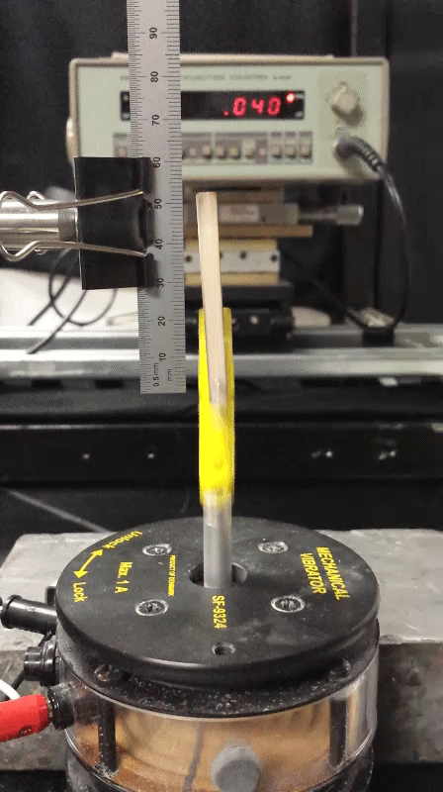

Slide 4
Experimental Design
Friction at the pivot
Originally friction existed between 0090 sleeve and rod.
Reduced by implementing graphite lubricant (AERODAG) and heat shrink (Hardman extra fast setting)
Slop at the pivot
Washers added to hug the 0090 sleeve to reduce off axis cycloidal motion.
Result
These corrections to the experiment allowed us to reach points of amplitude and frequency closer to the mathieu curve.
Notes:
(AERODAG) initially resulted in an unusably frictive pendulum. By rotating the pendulum quickly we believe the graphite sheared in the direction of rotation which resulted in a lubricated pivot.

Slide 5
Improved Experimental Design (future)
Reducing the effects of friction
During the course our focus was on the pivot and introducing materials to reduce frictive contact.
For future experiments we propose scaling up the physical pendulum itself: increased inertia would decrease the effects of friction on the system.
Improving measurements
Ability to measure the friction of the system, quantitative analysis of the pendulum in hanging modes and more precise measurement of natural frequency.

Slide 6
Deriving the EOM
Setup from FBD:
$$y= y_{0}+lcos θ$$
$$\ddot{y}={\ddot{y}}_{0}−l{\dot{θ}}^{2}\sin{θ+l\ddot{θ}\cos{θ}}$$
$$m\ddot{y}= F_{y}$$
$$x= x_{0}+lsin θ$$
$$\ddot{x}={\ddot{x}}_{0}−l{\dot{θ}}^{2}\sin{θ+l\ddot{θ}\cos{θ}}$$
$$m\ddot{x}= F_{x}$$
Defining generalized moment of inertia for rod:
$$I_{C}\ddot{θ}=ml\left(\ddot{y}+g\right)\sin{θ−ml\ddot{x}\cos{θ}}$$
$$\frac{I_{C}}{ml}\ddot{θ}=\left({\ddot{y}}_{0}+g\right)\sin{θ−{\ddot{x}}_{0}\cos{θ}}$$
θ
$$I_{C}+ml^{2}=I$$
l
Initial Conditions:
ω
$$x_{0}=x_{i}$$
$$y_{0}=y_{i}+A\cos{ωt}$$
$$\ddot{x_{0}}=0$$
$$\ddot{y_{0}}=−A\sin{ωt}$$
Solve for the EOM:
$$\ddot{θ}=\frac{m}{l}(g−Aω^{2}\cos{ωt)\sin{θ}}$$
mg

Slide 7
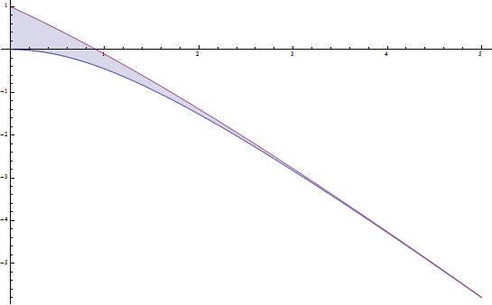
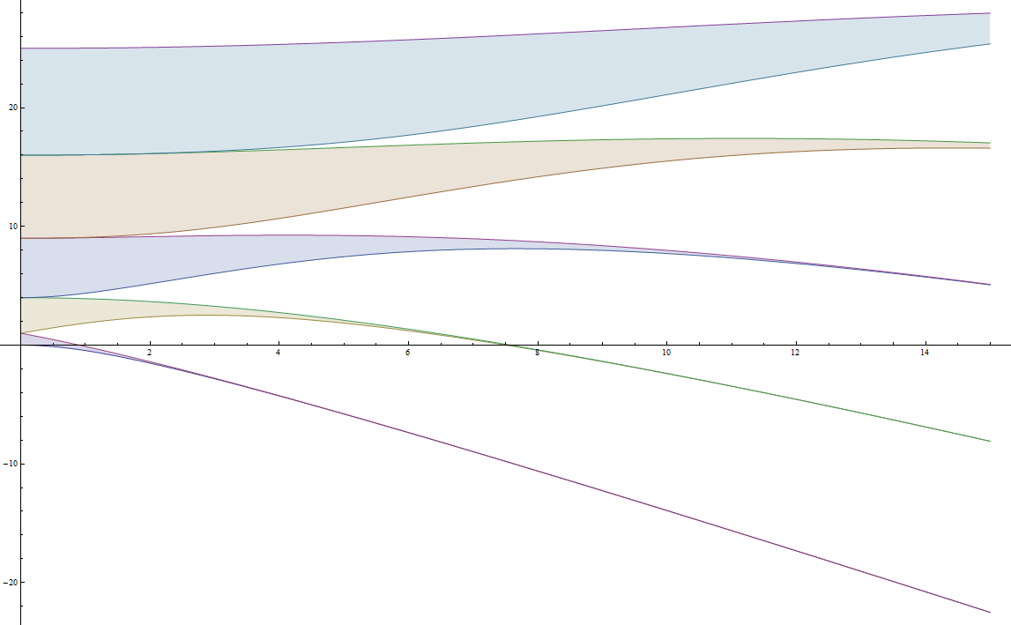
Deriving the Mathieu Equation
Inverted Pendulum EOM:
$$\ddot{θ}=\frac{m}{l}(g−Aω^{2}\cos{ωt)\sin{θ}}$$
Stability Region
$$\frac{1}{ω^{2}}\frac{d^{2}θ}{dt^{2}}= (\frac{mlg}{Iω^{2}}−\frac{mlA}{I}\cos{ωt})\sin{θ}$$
Dimensionless driving frequency, time, amplitude:
-ω
+A
$$δ=\frac{mlg}{Iω^{2}}={(\frac{ω_{o}^{}}{ω})}^{2}$$
$$τ=ωt$$
Constant A
$$ε=\frac{mlA}{I}=\frac{A}{l}$$
Hanging
Mathieu Equation:
Constant ω
$$\frac{d^{2}θ}{dτ^{2}}= (δ−ε\cos{τ})\sin{θ}$$
Inverted

Slide 8
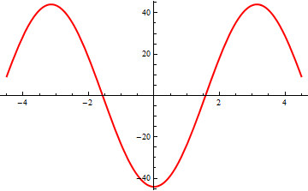
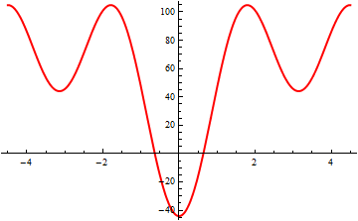
Deriving the Effective Potential
The EOM is split into rapid oscillation (ε) and slow oscillation (θ₀) components:
$$A≪l; ω≫ω_{0}$$
$$\ddot{θ}={\ddot{θ}}_{0}+\ddot{ε}$$
$${\ddot{θ}}_{0}=\ddot{θ}−\ddot{ε}$$
$$\ddot{θ}=\frac{m}{l}(g−Aω^{2}\cos{ωt)\sin{θ}}$$
$$ε=\frac{A}{l}\sin{θ_{0}\cos{ωt}}$$
Solving for the slow component EOM:
$${\ddot{θ}}_{0}=− \left(g+Aω^{2}\cos{ωt}\right)\frac{\sin{θ}}{l}−\frac{A}{l}({\ddot{θ}}_{0}\cos{θ_{0}}\cos{ωt}−{\dot{θ}}^{2}\sin{θ_{0}\cos{ωt−2ω{\dot{θ}}_{0}}}\cos{θ_{0}}\sin{ωt−ω^{2}\sin{θ_{0}\cos{ωt}}})$$
Hanging Well
$${\ddot{θ}}_{0}=−\frac{g}{l}\sin{θ_{0}−\frac{1}{2}{(\frac{Aω}{l})}^{2}}\sin{θ_{0}}\cos{θ_{0}}$$
Inverted Well
Defining the Effective Potential:
$${ml^{2}\ddot{θ}}_{0}=−\frac{∂U_{eff}}{∂θ_{0}}$$
$$U_{eff}=−mgl\cos{θ_{0}+m{(\frac{Aω}{2}\sin{θ_{0}})}^{2}}$$

Slide 9
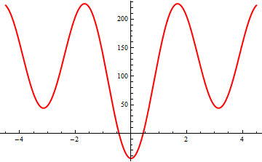
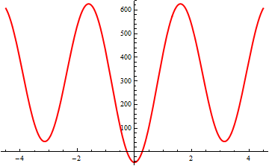
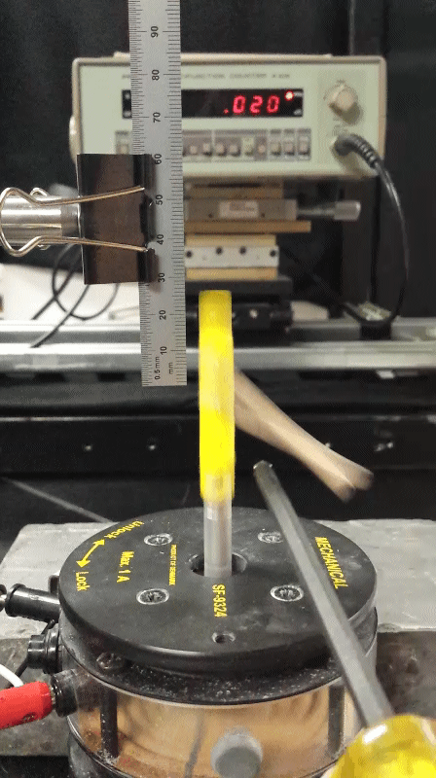
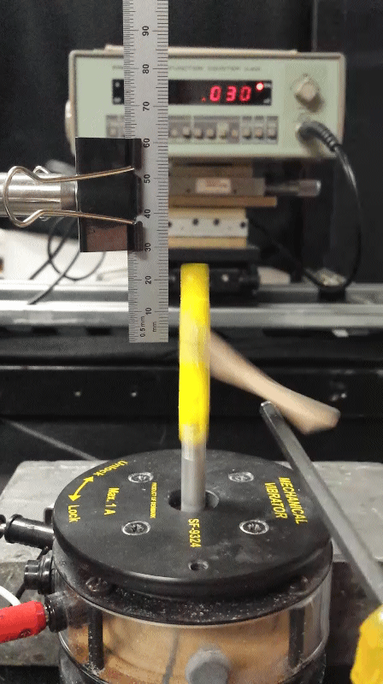
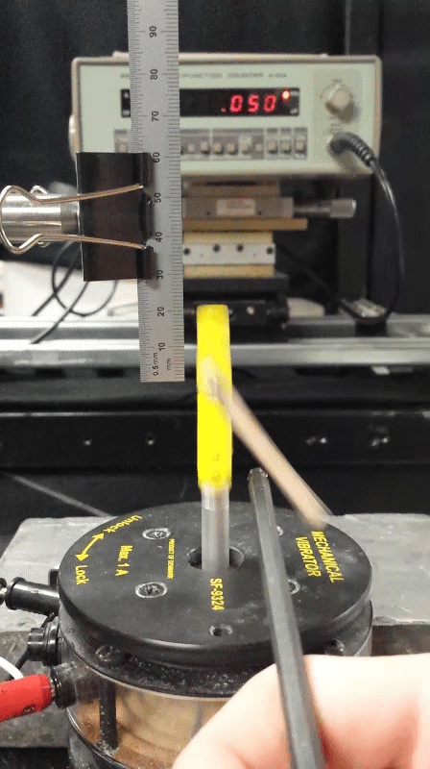
Viewing Potential Well Strength
~70°
~30°
~5°

