Slide 1
Chaotic Spring Pendulum
Jacob Stinnett and Logan Maingi
Advanced Lab II
Fall 2011

Slide 2
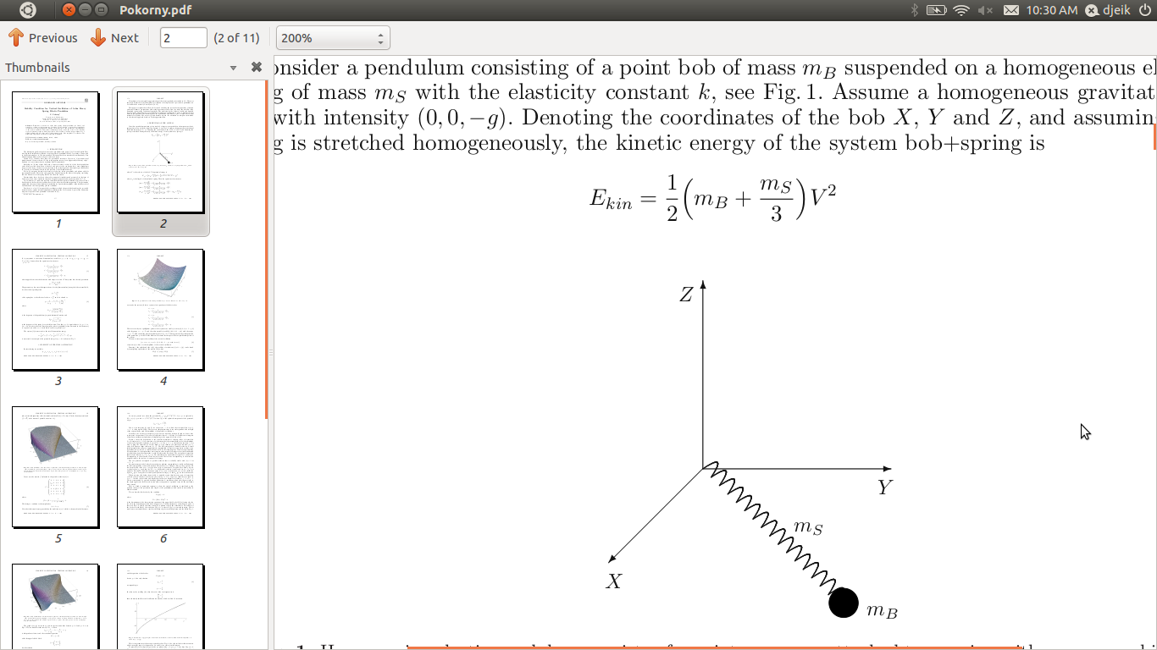
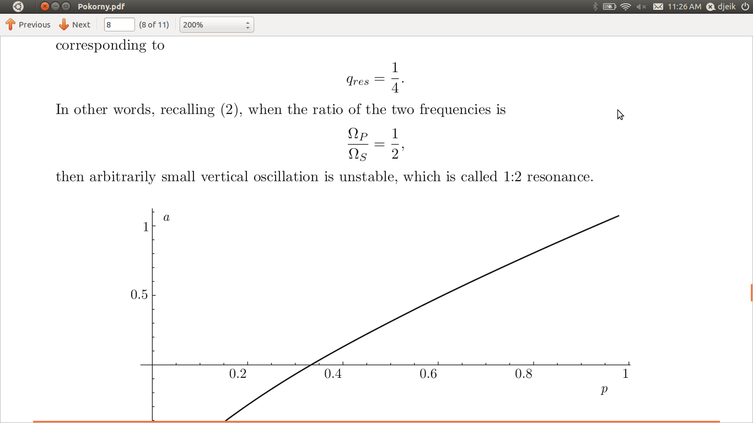
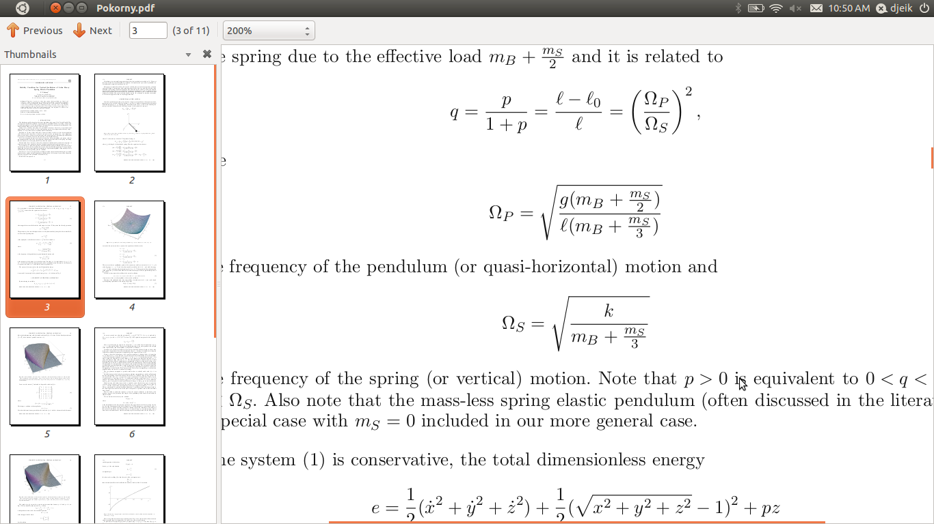
The System
Spring acts as pendulum arm
Equilibrium position (pendulum pointed down) is unstable for
: pendulum frequency
: spring frequency
Setting m_{s} = 0 gives the standard uncoupled frequencies.

Slide 3
An Intuitive Explanation of the Instability at 2:1 Resonance
Force of spring
Force of spring
Force of spring
At left position, spring force has a component rightward, and vice versa.
At 2:1 spring to pendulum frequency resonance, spring phase is same for all angular maxima.
Pendulum frequency angular dependence becomes significant for large oscillations.
Eventually, the swinging will not be synchronized with the spring oscillations, leading to chaotic behavior.

Slide 4
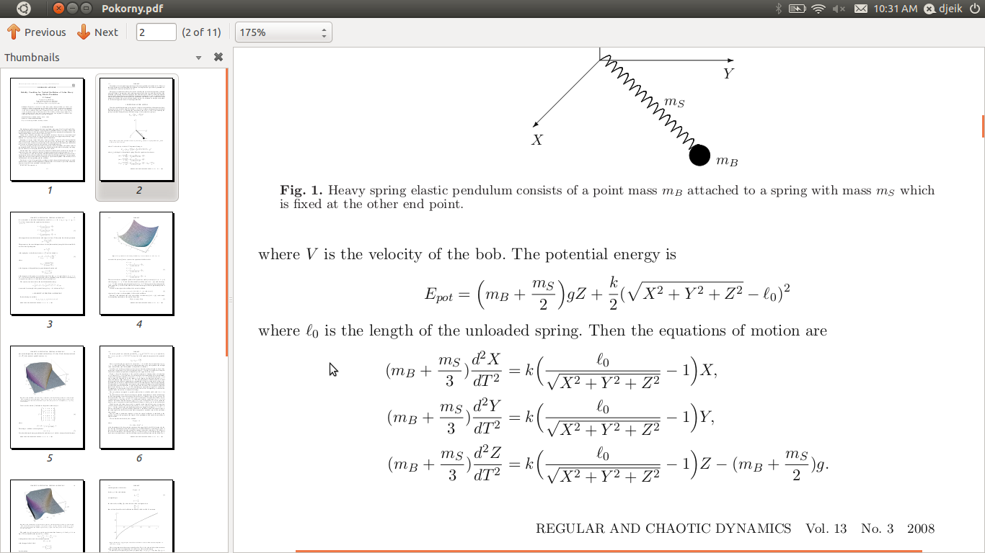
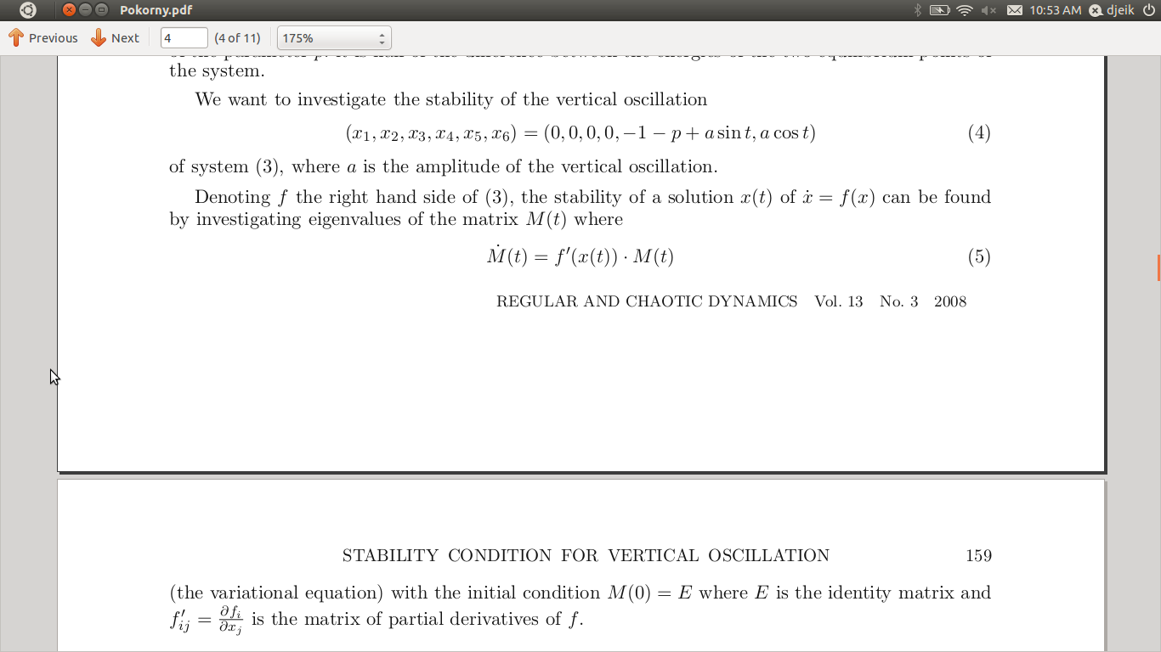
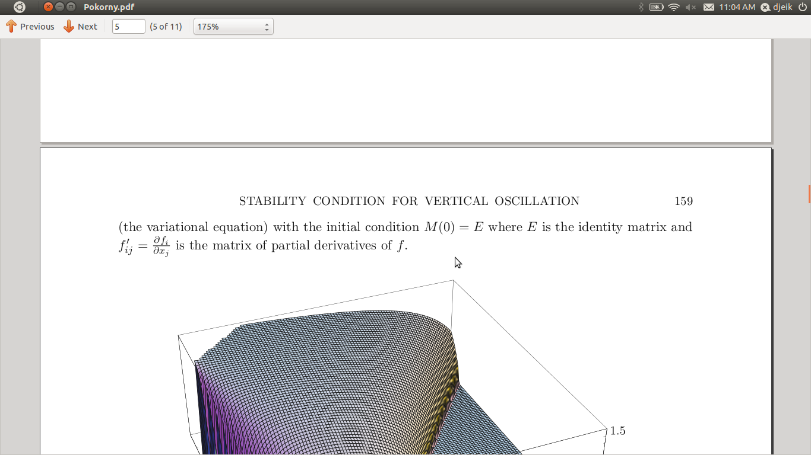
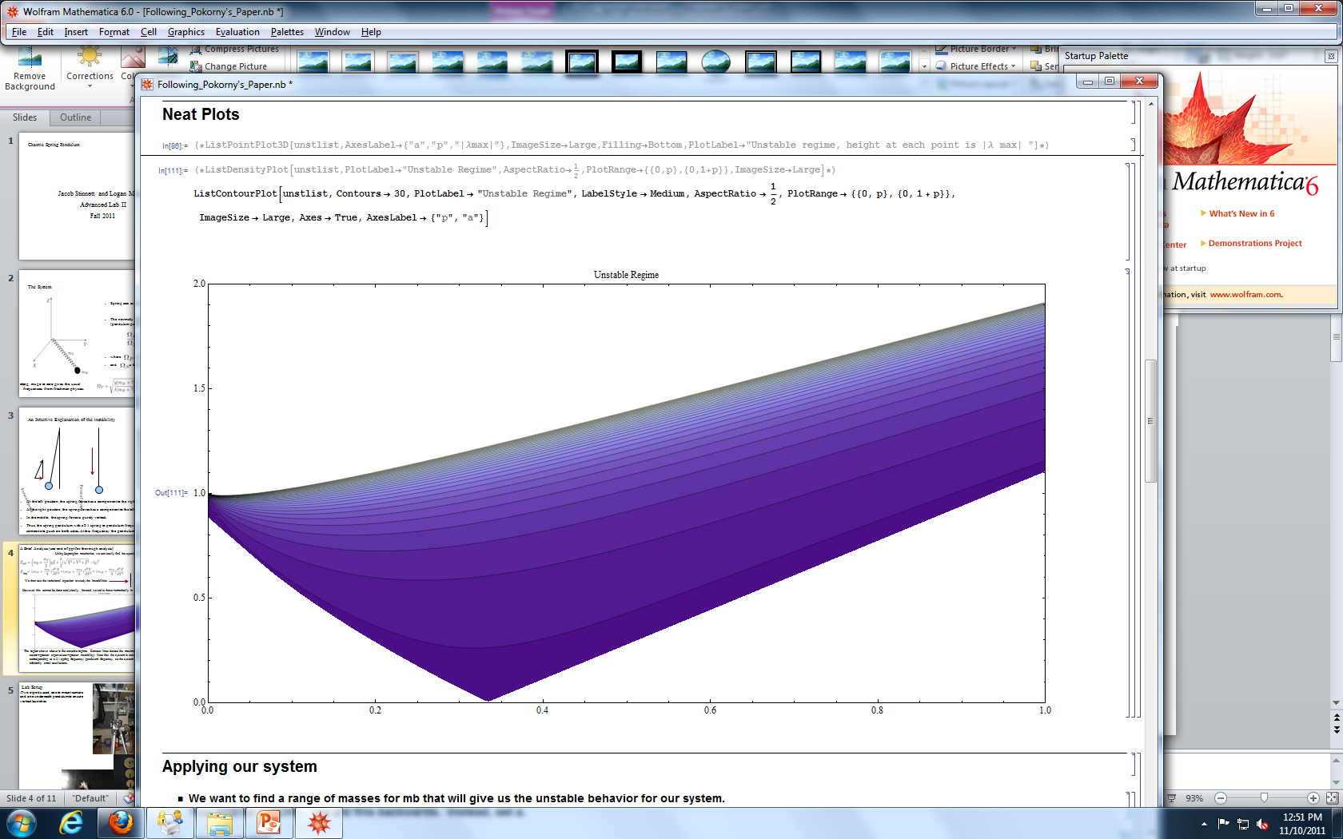
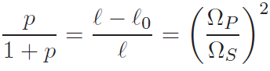
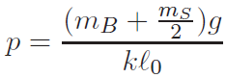
A Brief Analysis (see end of ppt for thorough analysis)
Using Lagrangian mechanics, we can easily find the equations of motion.
We then use the variational equation to study the instabilities.
kin
However, this cannot be done analytically. Instead, we solve these numerically in Mathematica.
Unstable Regime
a= amplitude of oscillation
a
p
The region shown above is the unstable regime. Contour lines denote the maximum eigenvalue of M(2π) (lighter colors->greater eigenvalues->greater instability). Note that the system is unstable for a>0 at p=1/3, corresponding to a 2:1 spring frequency: pendulum frequency, so the system is unstable at this frequency for arbitrarily small oscillations.

Slide 5
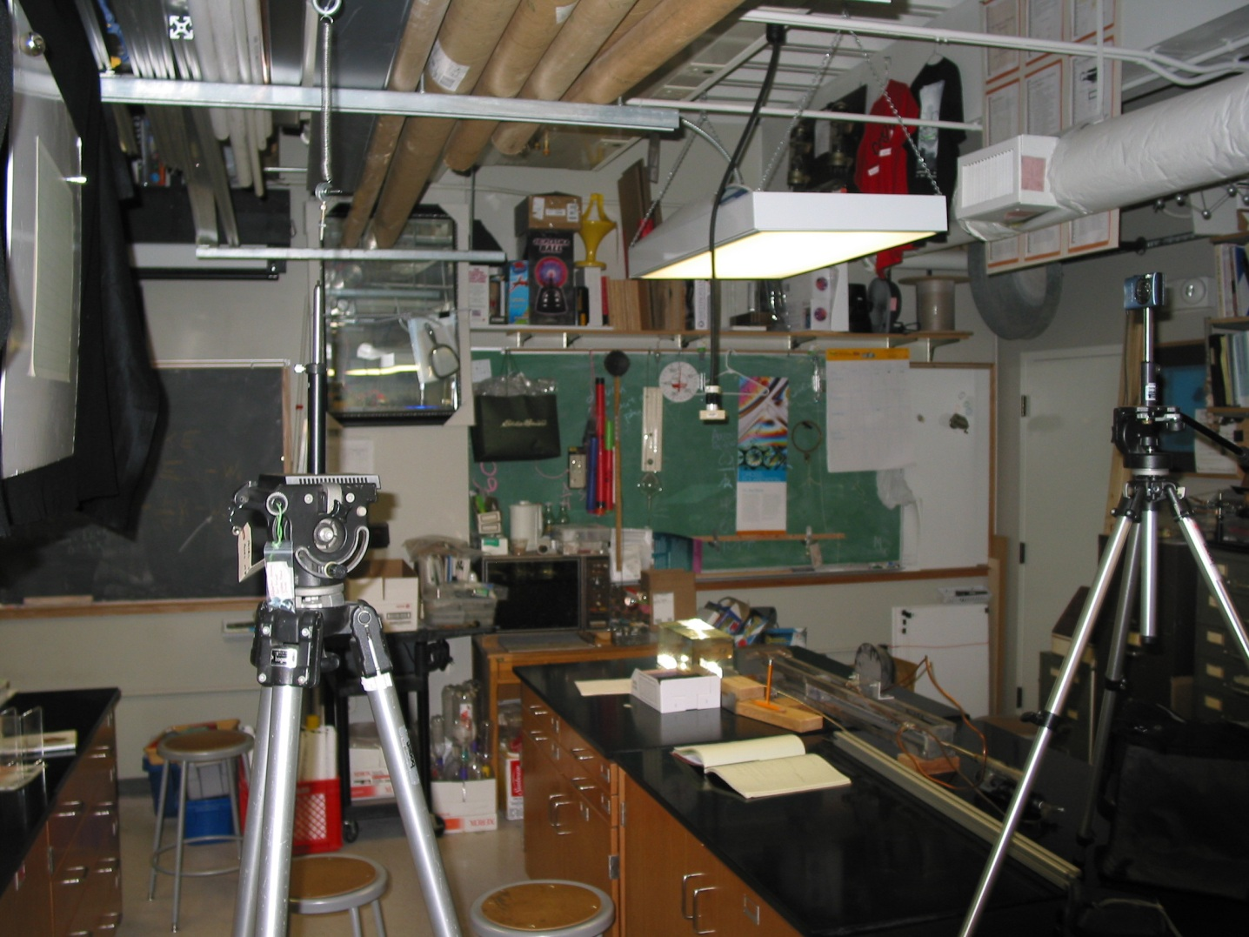

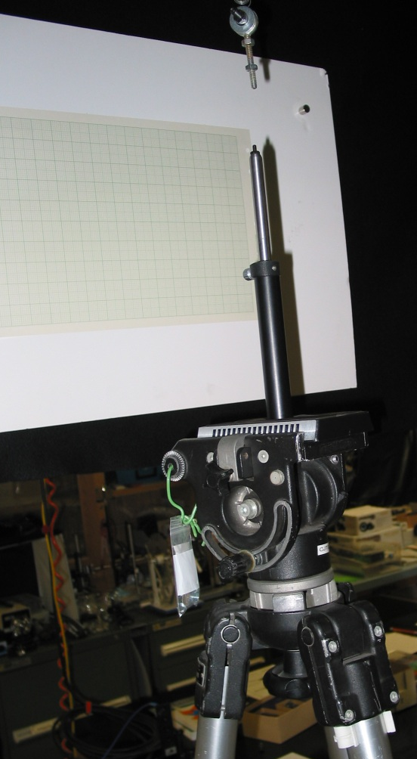
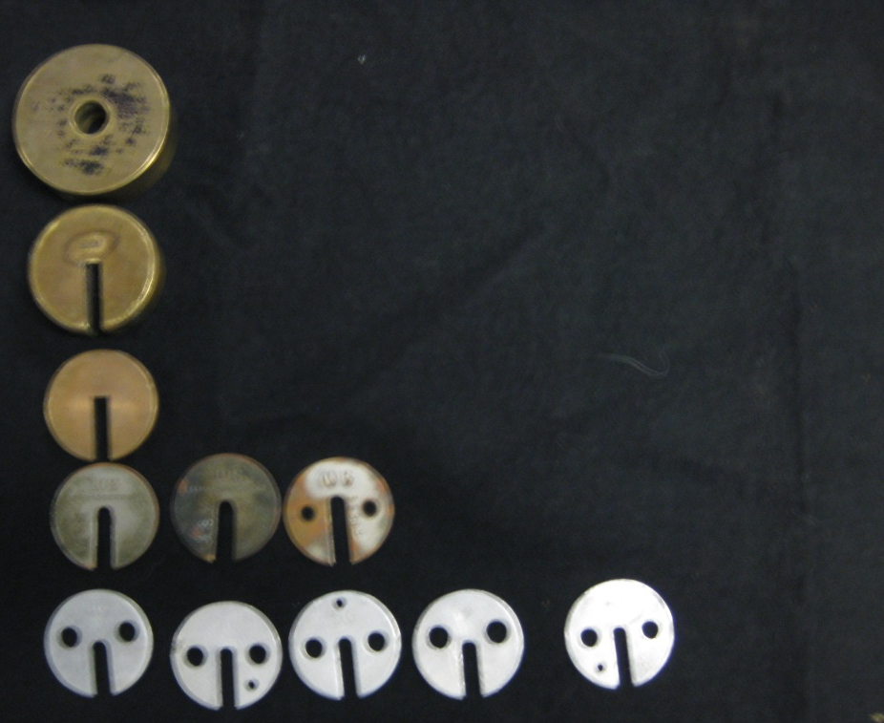
Lab Setup
Grid Paper Background
Spring Pendulum
Two tripods used, one to mount camera and one underneath pendulum to ensure vertical launches
Short bolt system used to attach weights to the spring. Bottom of spring is pinched between washers.
Spring hung from the ceiling using a zip tie
Grid paper hung on a white background for tracking the motion of mass
Videos recorded at various masses to track instabilities
Camera mount
Tripod for accuracy
500 g
200 g
Tripod for accuracy
50 g
10 g
5 g

Slide 6
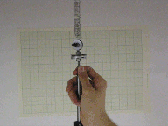
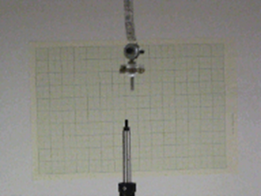
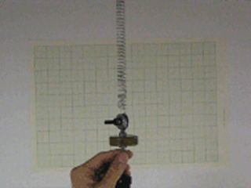
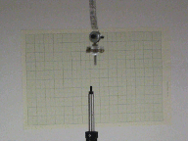

Data and Video Results
Max horizontal displacements tracked on the videos
  Max of both trials
  20 second interval
Data show clear unstable region agreeing with theory
Predicted Unstable Regime
50g added
90g added
200g added

Slide 7

Data and Video Results
Max horizontal displacements tracked on the videos
  Max of both trials
  20 second interval
Data show clear unstable region agreeing with theory
Predicted Unstable Regime
50g added
90g added
200g added

Slide 8
Data and Video Results
Max horizontal displacements tracked on the videos
  Max of both trials
  20 second interval
Data show clear unstable region agreeing with theory
Predicted Unstable Regime
50g added
90g added
200g added

Slide 9
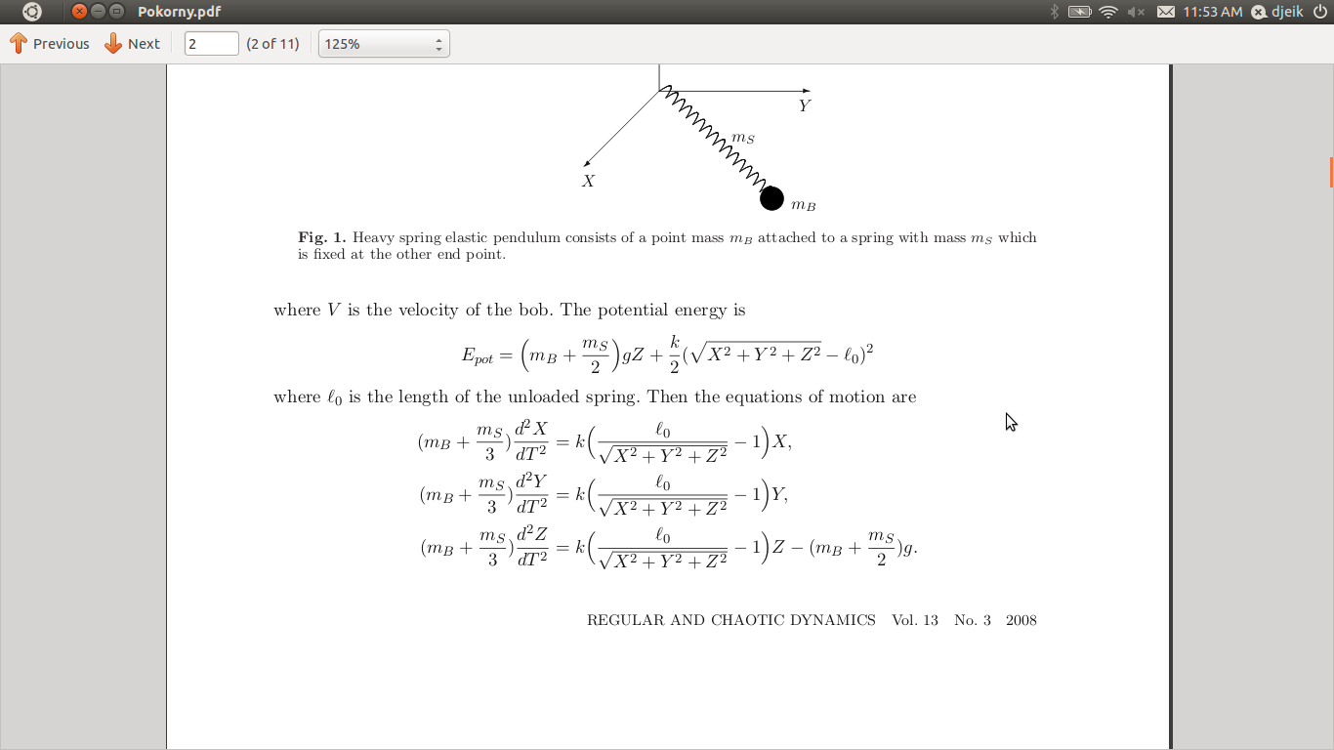
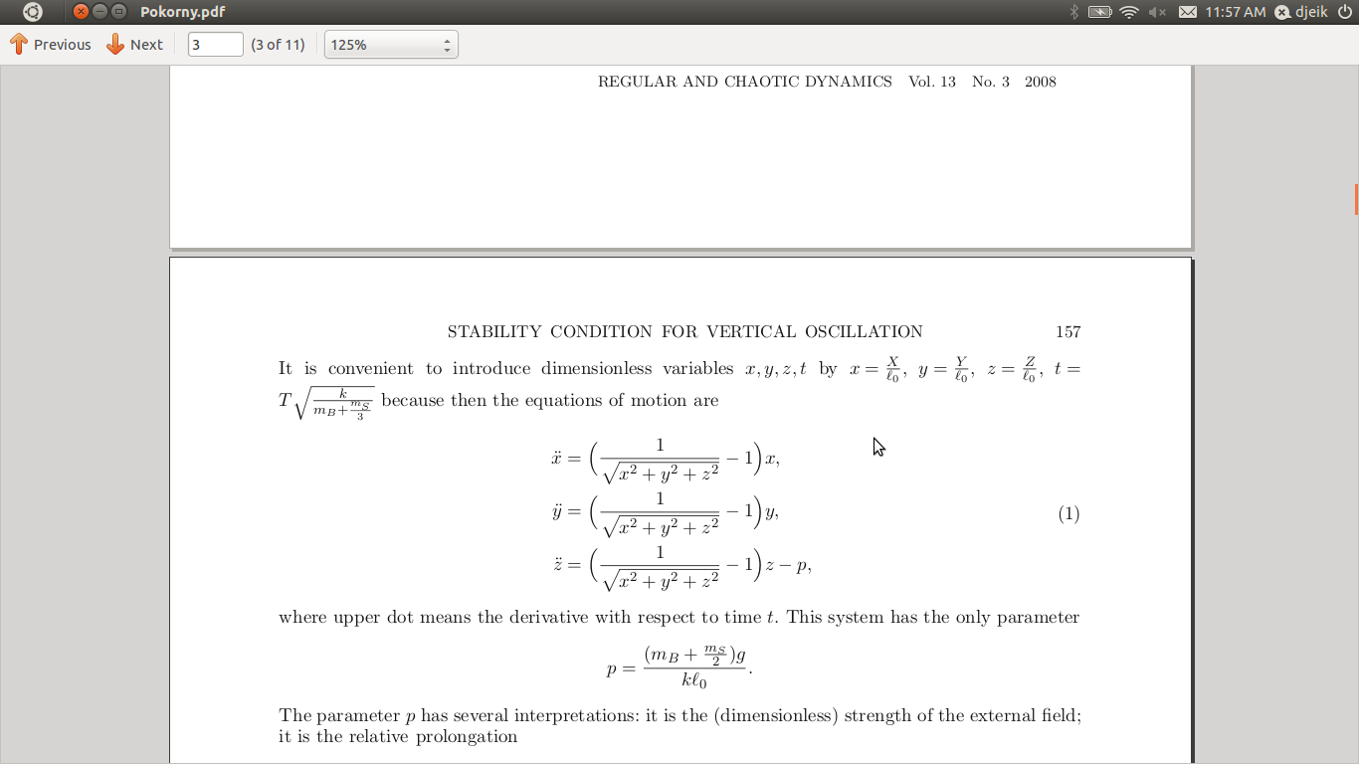
Theoretical Analysis
Using Lagrangian mechanics, we can easily find the equations of motion.
kin
Nondimensionalizing and introducing a parameter

Slide 10
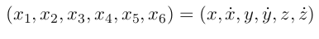
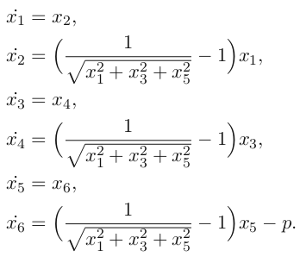
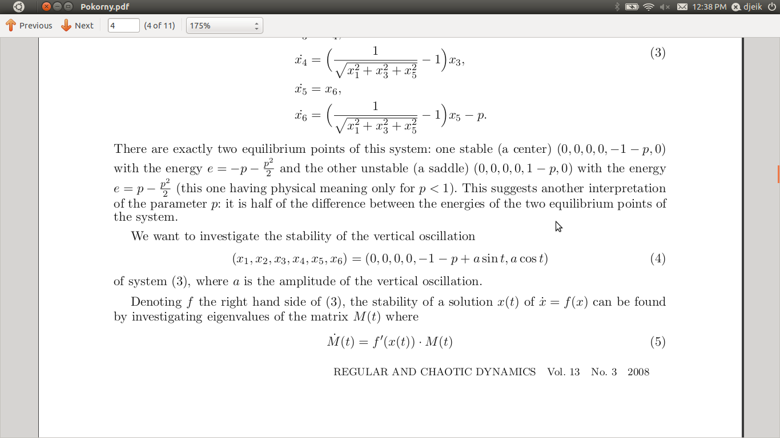
Theoretical Analysis
We can then convert the system into six first order differential equations.
We want to study vertical oscillations about the bottom equilibrium, so the oscillations have the form

Slide 11
The Variational Equation
The stability can then be analyzed by studying the so-called “Variational Equation”
where is the Jacobian matrix evaluated at the lower equilibrium.
M(t) gives the time evolution of the system, i.e. x(t)=M(t)x(0).
Since the system is periodic about the equilibrium point, we only need to consider M(2 Pi).
The system is stable if the maximum of the eigenvalues of M(2π) is 1.
The system is unstable if the maximum of the eigenvalues of M(2 π) is greater than 1.
Note: For a full explanation of the variational equation, see Arrowsmith “Introduction to Dynamical Systems” or Arnol'd “Ordinary Differential Equations”.

Slide 12
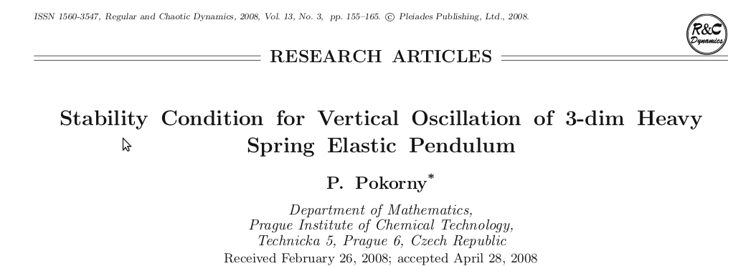
The Variational Equation cntd
Only one case is solvable by hand, see
Instead, we must solve the system numerically. Pokorny's paper gives only the results; alternatively, see Following_Pokorny's_paper.nb (Mathematica file) for the complete numerical analysis.

Slide 13
Numerical Results
The region shown below is the unstable regime. Contour lines denote the maximum eigenvalue of M(2Pi) (lighter colors->greater eigenvalues->greater instability).
Unstable Regime
Unstable Regime
a= amplitude of oscillation
a
a= amplitude of oscillation
p
Note that the system is unstable for a>0 at p=1/3, corresponding to a 2:1 spring frequency: pendulum frequency, so the system is unstable at this frequency for arbitrarily small oscillations.

