Slide 1
Learning to Teach Physics at the High School Level
Encouraging Learning in the Laboratory
Stephen Kane
Advisor: Dr. Matthew Johnson

Slide 2
Outline
Motivation
  Teaching Aspirations
  Why measure g?
  Variations in g
Kater Pendulum
  Background
  How Does it work?
  Mathematical Derivation
  Apparatus and Method
  Expected Value of g
  Results
Modern Methods of measuring g
Wilberforce Pendulum
  Background
  Mathematical and Physical Significance
  Videos
Notes:
Start with education aspect

Slide 3
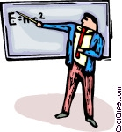
Teaching Aspirations
High school Physics teacher
Laboratory competence is a deficiency for most teachers
I will be doing a series of projects
Goals of my capstone
  Become more comfortable in lab setting
  Learn how to teach through experiments
  Be able to teach less from the book
    Keep students more engaged
  Encourage long-term interest in Physics
Notes:
Start with education aspect

Slide 4
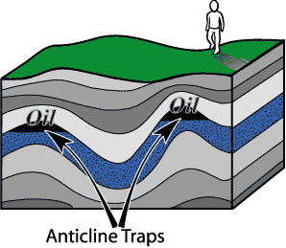
Why Measure g?
Measurements of g can be used to determine the make-up of the Earth beneath a specific, localized area
If accurate enough, measurements can reveal anomalies in the Earth’s crust because of variations in density
  Ore deposits
  Natural gas
  Oil
Important to finding oil reserves in Oklahoma
  Measurements made in early 1900’s without modern equipment
Material | Density (kg/m³)
Granite | 2700
Limestone | 2600
Copper Ore | 1900-2600
Water | 1000
Oil | 880
Natural Gas | 0.7-0.9
Notes:
Specific densities of rock (limestone, granite, ore), natural gas, water, oil

Slide 5
Expected Variations in g based on Crust Composition
Paper in Journal of Geophysical Research
  Gravity Anomalies, Crustal Structure, and Geology in Alaska
  Woollard, Ostenso, Thiel, and Bonini
Regional Bouguer gravity anomaly map of Alaska
  Found: Regional anomalies are probably more indicative of abnormal crust composition than of abnormal crust density
Positive Anomaly – thick crust or high density
Negative Anomaly – thin crust or low density
Local g can vary by about 1 milligal every km
  1 gal = 1 cm/s²
Notes:
Specific densities of rock (limestone, granite, ore), natural gas, water, oil

Slide 6
Gravity Anomaly Map
High Altitude, no peak in g
150 km
Notes:
Specific densities of rock (limestone, granite, ore), natural gas, water, oil

Slide 7
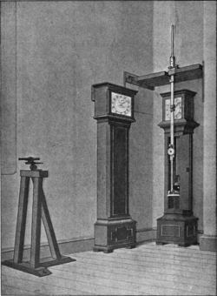
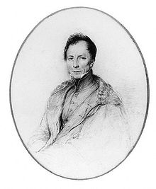
Kater Pendulum
Kater’s Pendulum
Invented by Henry Kater in 1817
Kater needed to solve inaccuracy problems of other measurement methods
  Inaccurate length factor in standard pendulums
    Elasticity of string/wire
  Center of mass hard to measure
Henry Kater
Rigid pendulum needed
Kater’s Pendulum solved these problems
Used until 1930’s as most accurate method of measuring local gravity
  Accuracy of 7 milliGal

Slide 8
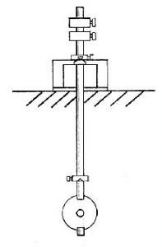
How It Works
Kater Pendulum
Two Pivot Points (knife edges)
Adjustable weight (or multiple weights) to change the period of the swings
Period timed and then pendulum flipped
  Measure Period for other side
Adjust weight until periods are the same for both sides
g measured using the period and the distance between pivot points
Adjustable Weights
Knife Edges
l1
Center of Mass
l2
Fixed Weight

Slide 9
Mathematical Derivation
T= Period
I = Moment of Inertia
M = Mass of pendulum
l = Distance from center of mass to the pivot point
L= l₁ + l₂
Adjustable Weights
Knife Edges
l1
From Parallel Axis Theorem
Center of Mass
l2
Eliminate I_{cm}
Fixed Weight

Slide 10
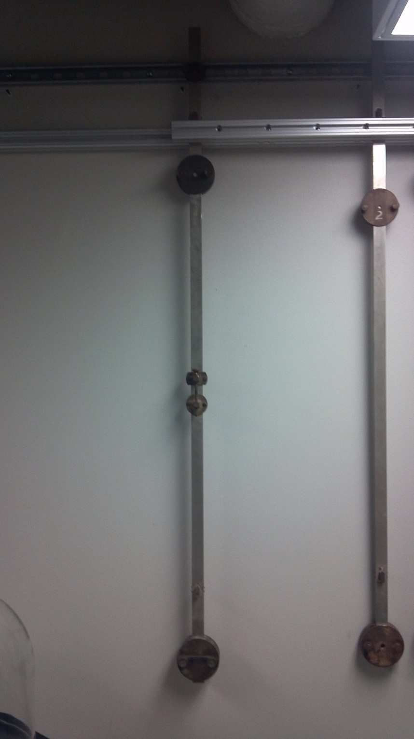
My Apparatus
Pendulum set up for T1
3 Large Weights
  Moved around to get close to same periods
  Left stationary once close
1 Small weight controlled by turning a bolt
  Measurements determined by the movement of this bolt
  Measured position of weight based on the opening
  Position is arbitrary and irrelevant to final equation
  Just used for graphs and reference

Slide 11
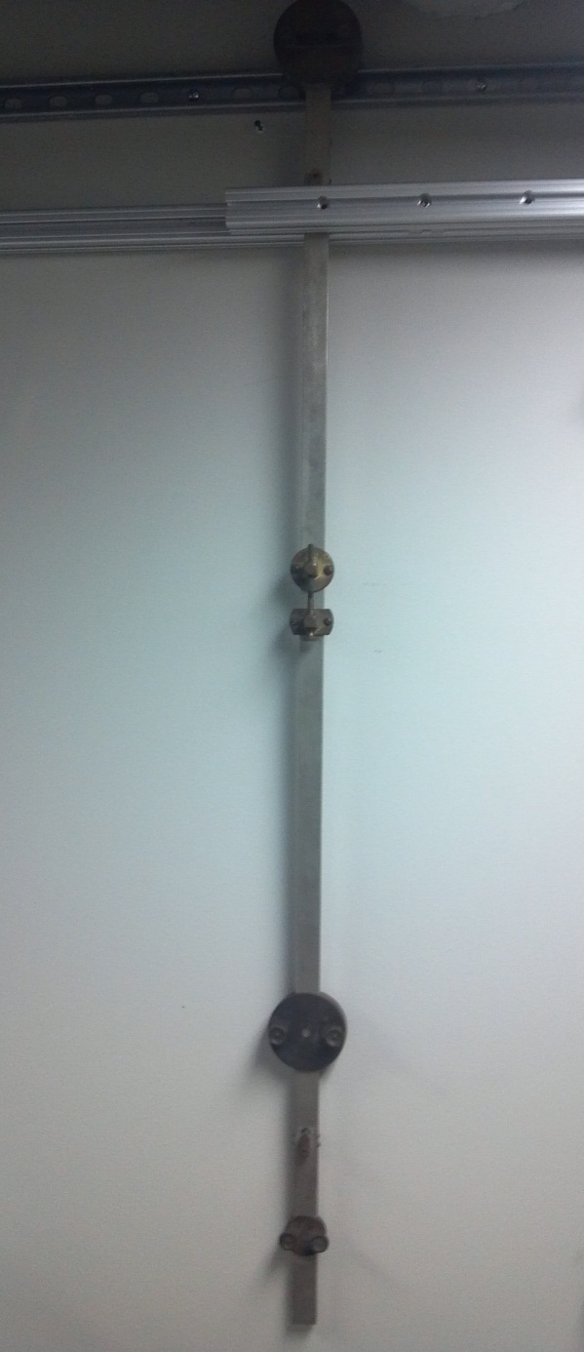
Method
Pendulum set up for T2
Once 3 large weights are set:
  Move bolt all the way open (3.4 in)
  Then take measurement of period
    5 trials
    10 periods per trial
  Move bolt incrementally at .2 in intervals and take measurements at each point until the bolt is closed completely (2.0 in)
  Flip the pendulum over and do the same for T2
Once measurements are taken:
  Plot all points in Excel and examine intersection point

Slide 12
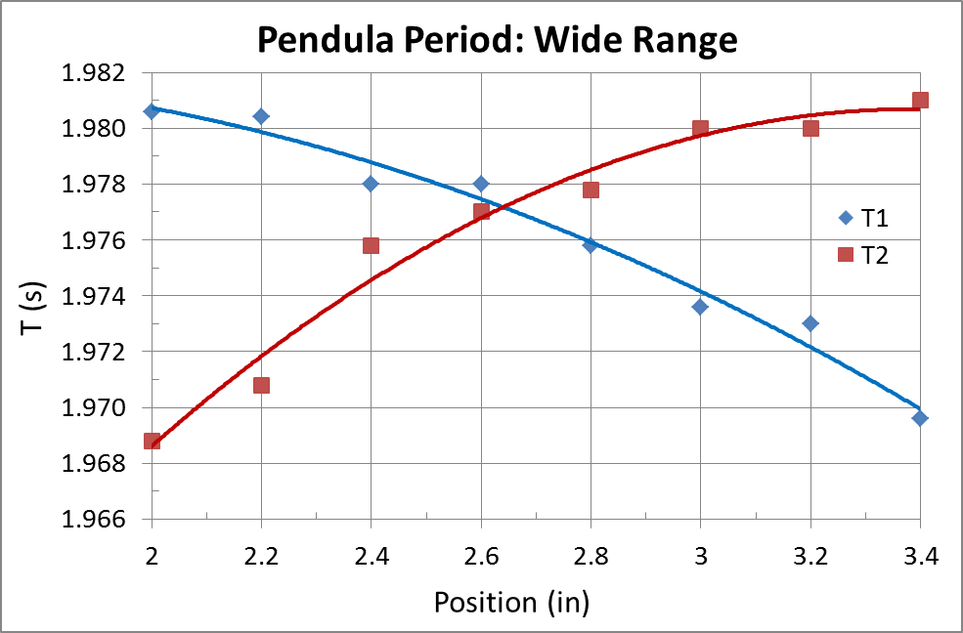
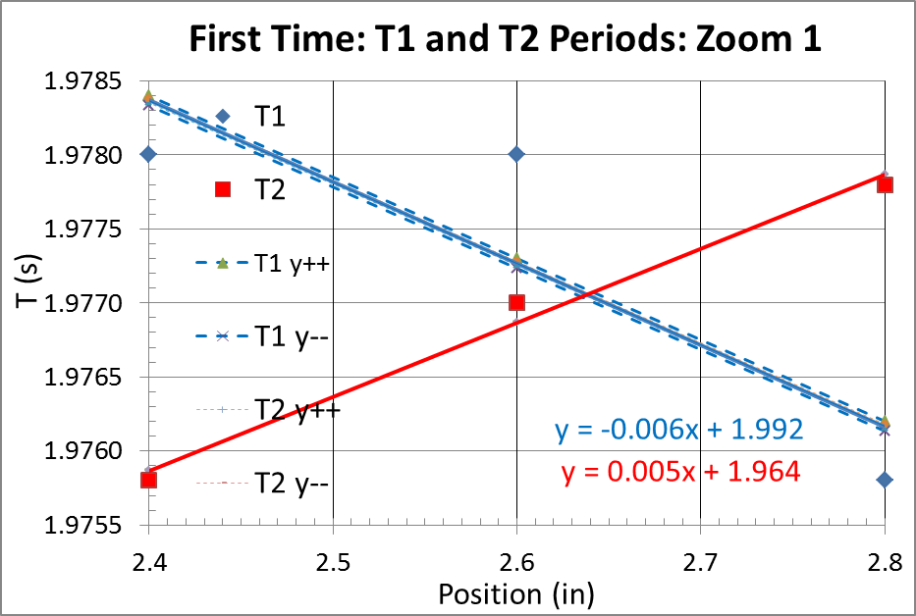
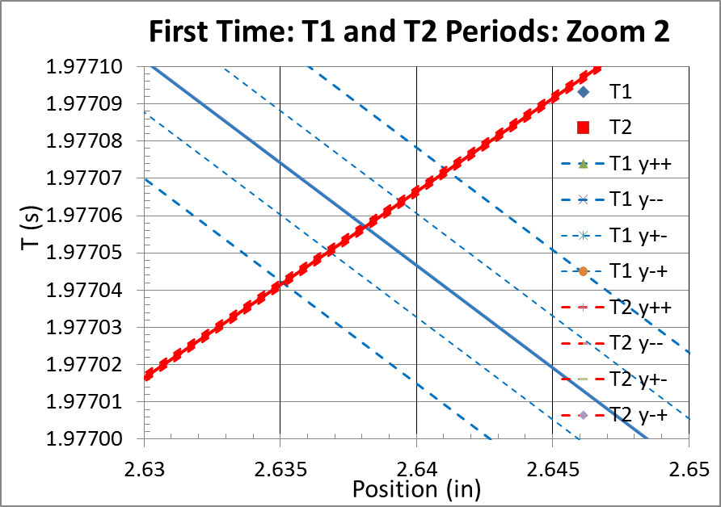
Results

Slide 13

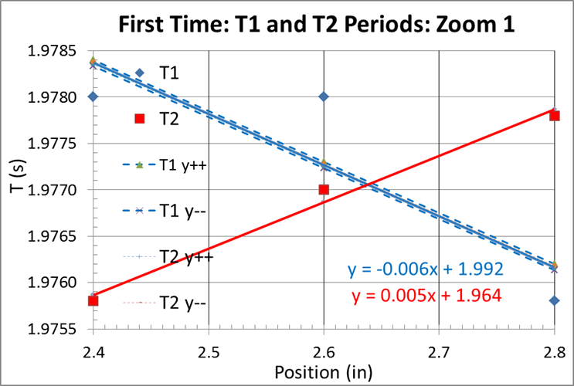
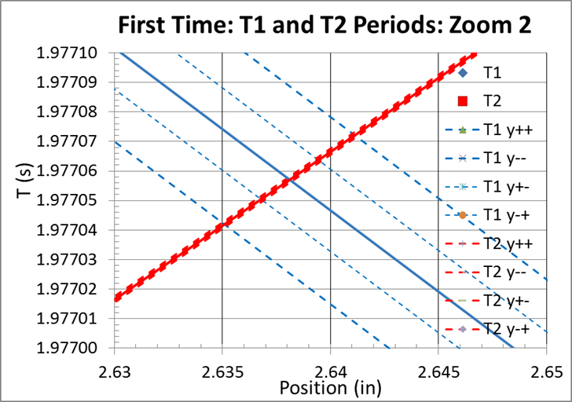
Zoom 1: Linear Fit

Slide 14
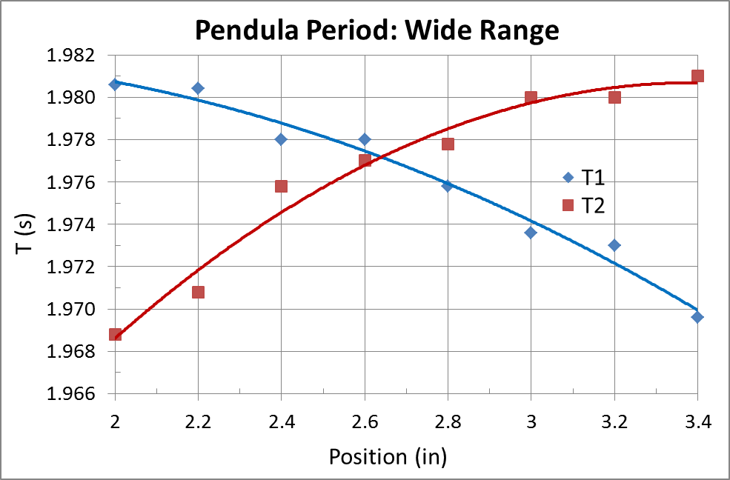
Zoom 2: Error Range
Error in T ~ 0.000015s (~10⁻⁵)
% Error ~ 0.0008%

Slide 15
Further Measurement
After analyzing this data I found:
  Fits were not quite as accurate as they should have been
  The linear fit of T1 showed a lot of error
  The data gave a good representation of the period curves, but were not accurate enough to be used as final data
Therefore:
  Ran more trials under different parameters
  1 trial of 100 periods long
  Use smaller increments (.05 in)
  Took data points at 2.55, 2.6, 2.65, and 2.7
  These data points yielded:

Slide 16
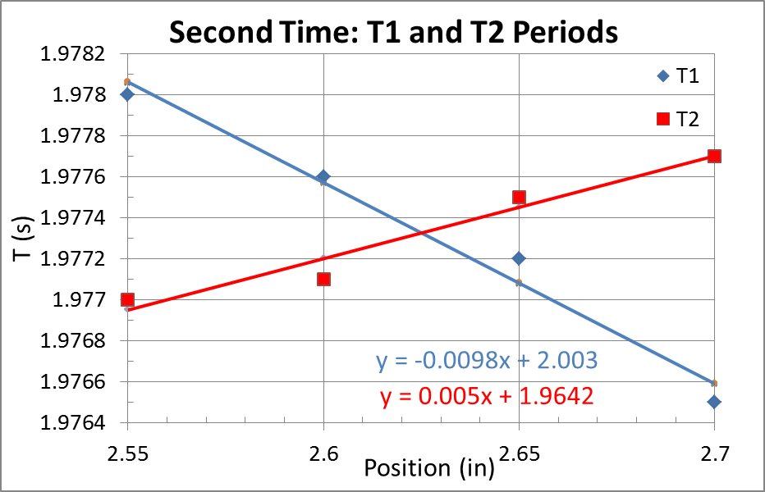
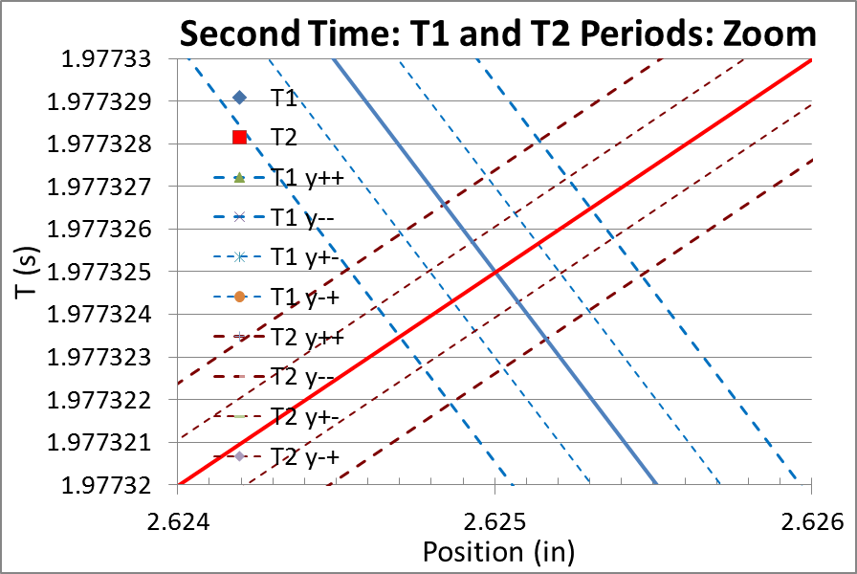
2nd Time
Linear fit for small range

Slide 17
Zoom: Error Range
Error in T ~ 0.000002s (~10⁻⁶)
% Error ~ 0.0001%

Slide 18
Error Analysis Method
Excel spreadsheet created for any 2 variable linear error analysis
  Find error in slope (m) and error in intercept (b)
  Graph combinations of highest and lowest permutations (++,+-,-+,--)
Spreadsheet can be used easily for any data set

Slide 19
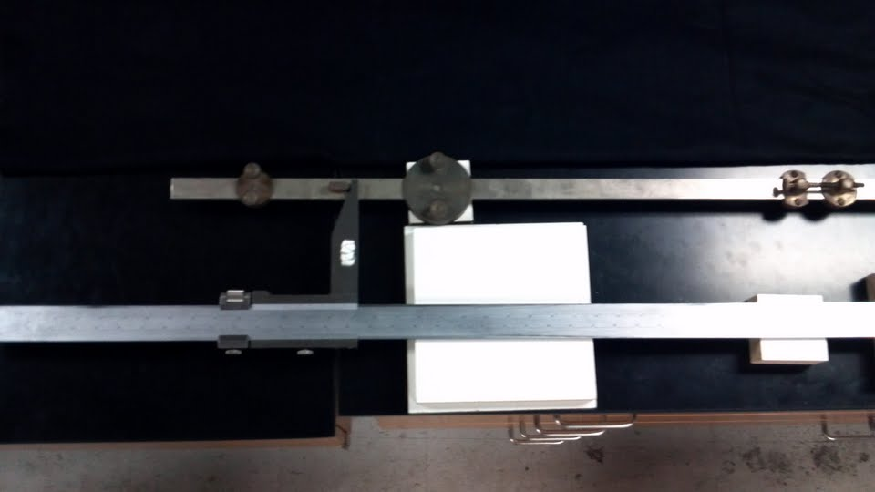
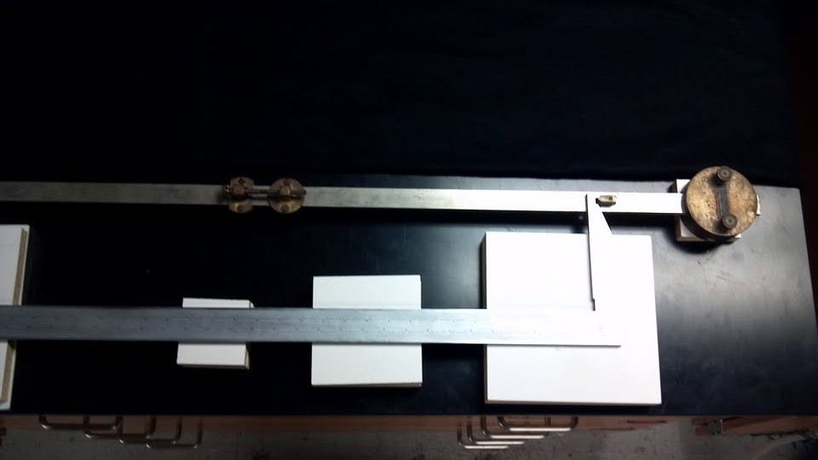
Length Measurement
Measured length using large caliper
L = 38.1697 in = 0.96951 m
L

Slide 20
Source for Expected Value of g
National Geodetic Survey (NGS) and National Oceanic and Atmospheric Administration (NOAA)
Surface gravity measurement predicted by interpolation based on observed values
Observed gravity data in the National Geodetic Survey's Integrated Data Base
International Gravity Standardization Net 1971
  1,900 Sites Worldwide - 450 U.S. Sites
  Accuracy within ±50 μGal
Official gravity datum worldwide
  Formula accounts for 99% of total variation in g worldwide
  Based on Latitude, Longitude, and Elevation
Used to find gravitational anomalies

Slide 21
Data Analysis
L= 38.1697 in = 0.96951 m
Accepted g = 9.79653 m/s²
 | T1=T2 (s) | Error (s) | % Error | g (m/s²) | % Diff.
Trial 1 | 1.9771 | 0.000015 | 0.0008% | 9.79160 | -0.050%
Trial 2 | 1.977325 | 0.000002 | 0.0001% | 9.78938 | -0.073%

Slide 22
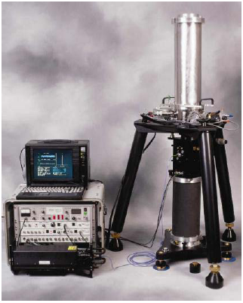
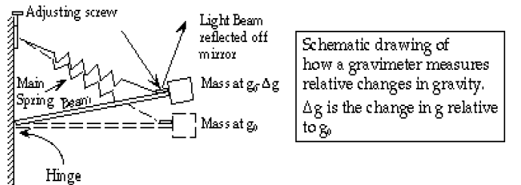
Modern Methods
Absolute Gravimeter
Relative Gravitational Measurements
  Measures changes in gravity using a spring
Absolute Gravimeter
  Drops a test mass in a vacuum
  Accuracy of 2 microGal
Relative Gravitational Measurements
Light in
Light reflected
Mirror

Slide 23
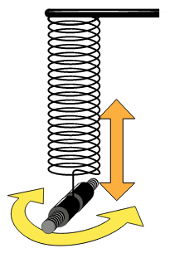
Wilberforce Pendulum
Invented in 1896 by Lionel Wilberforce
Mass on a spring
Oscillates in two directions
  Vertical (z)
  Rotation (θ)
Gradually alternates between motion in z and θ directions
Used to teach coupled oscillators and conservation of energy
Wilberforce Pendulum

Slide 24
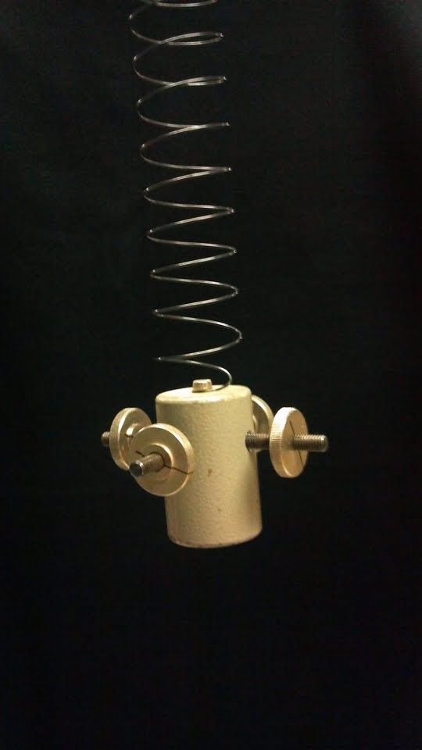
My Apparatus
Mass with four adjustable weights
  Weights move in and out from center of mass
Changing the position of the weights changes the angular velocity
  Weights all the way in → High angular velocity
  Weights all the way out → Low angular velocity
Normal modes occur when momentum is either all in z or all in θ
  Normal modes best illustrated with weights in middle of the screws

Slide 25
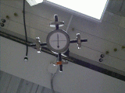
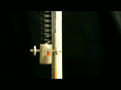
Videos
Weights in middle of screws to see normal modes best
Video from bottom to see angular velocity changes
Video from side to see vertical changes
Synchronized to see their relationship
From Side
From Bottom
10 cm

Slide 26
Questions?

Slide 27
Sources
http://www.ngs.noaa.gov/cgi-bin/grav_pdx.prl
http://www.ngs.noaa.gov/TOOLS/Gravity/grav_method.html
http://celebrating200years.noaa.gov/foundations/gravity_surveys/side.html
http://www.agu.org/journals/jz/v065/i003/JZ065i003p01021/JZ065i003p01021.pdf
http://en.wikipedia.org/wiki/Kater's_pendulum
http://faraday.physics.utoronto.ca/PHY182S/WilberforcePendulum.pdf
http://www.upscale.utoronto.ca/IYearLab/WilberforceRefBerg2of8.pdf
http://web.mit.edu/paez/Public/mit2671/WilbReport.pdf
http://en.wikipedia.org/wiki/Wilberforce_pendulum

