Slide 1
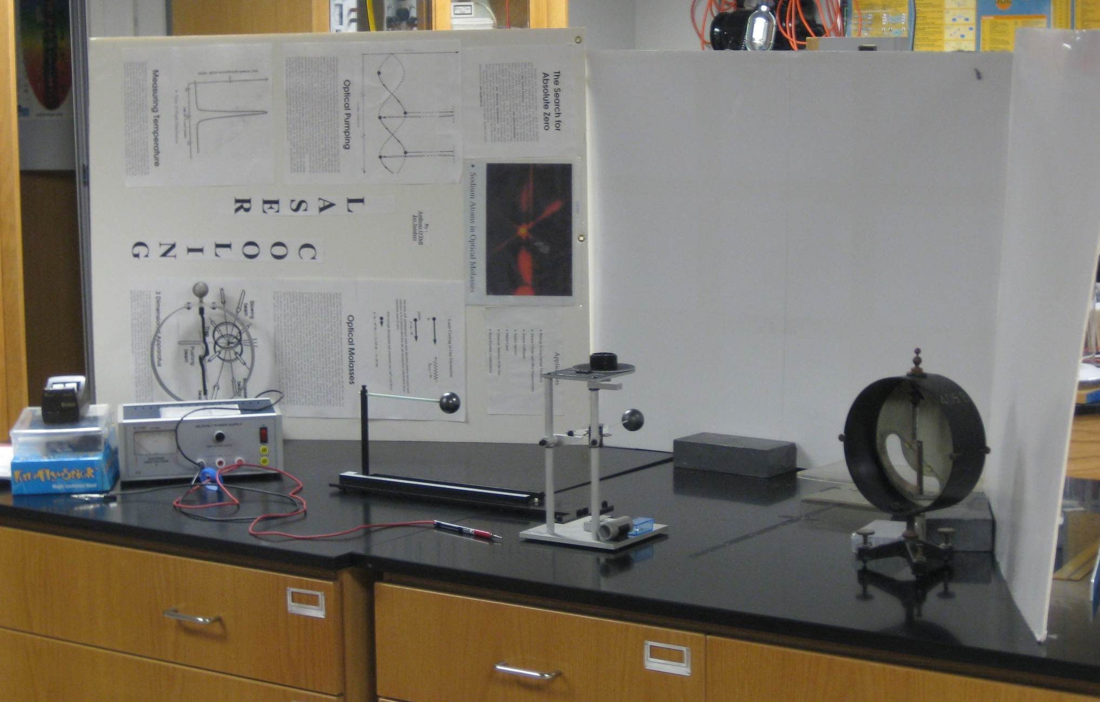
Coulomb Setup

