Slide 1
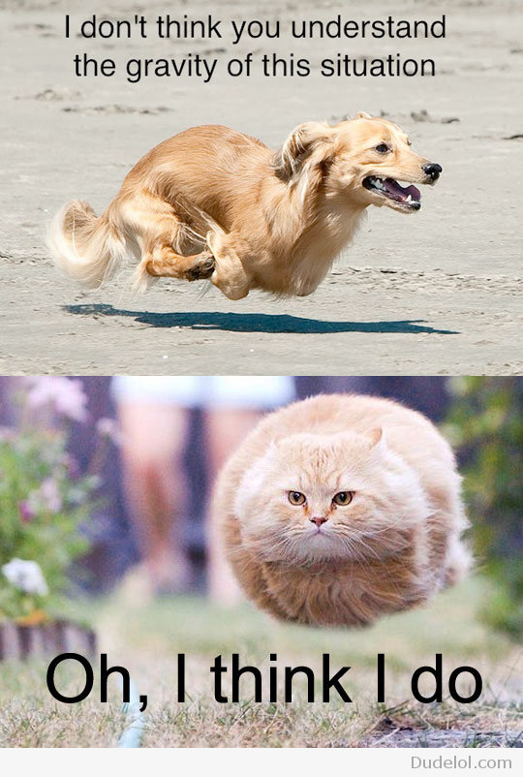
The Cavendish Experiment
Measuring the Gravitational Constant: G
Fall 2012
  Nathan Beck
  Neil McGlohon
  Michael Wilkinson
Spring 2013
  Bailey Bedford
  Seth Hodgson
  Catie Ranie
  Teddy Curtis
  Aaron Wegner
Fall 2013
Jeff Gillean
Kate Ciampa

Slide 2
Outline
Background and History
  What is the gravitational constant (G)?
  Henry Cavendish
  The Cavendish Experiment
  Why Keep Measuring?
Apparatus
  Experimental Setup
  Description of Forces
Methods of Measurement
  Equilibrium
  Constant Acceleration

Slide 3


What is G?
The strength of gravitational force between two objects is proportional to G
It’s a fundamental constant of nature
Force of gravity:
with
m₂
r
F
$$\overset{⃑}{F}=\frac{Gm_{1}m_{2}}{r^{2}}\hat{R}$$
F
m₁
$$G=6.67384×{10}^{−11} m^{3}/kg∙s^{2}$$
Uncertainty in the value of G is 0.00080x10⁻¹¹ m³/kg∙s², or about 0.012%
Notes:
Other fundamental constants:
-fine structure:
Transition: Why would you want to perform difficult/delicate experiments to find the value of G and increase precision?

Slide 4
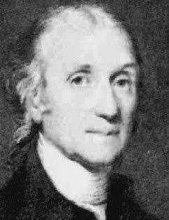
Cavendish
English scientist (1731 – 1810)
Famous for discoveries in Chemistry and Physics
  Discovered Hydrogen and measured the density of Earth
So shy he had to communicate with his housekeeper by letter
Secretiveness prevented him from publishing papers on major discoveries
Henry Cavendish

Slide 5
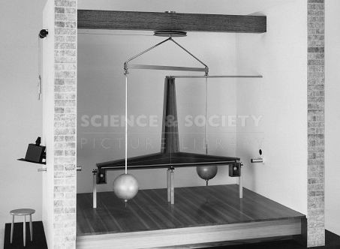
Cavendish Experiment
With his original experiment in 1797-1798, Cavendish’s goal was to determine the density of the Earth
  measured the gravitational force of attraction between two lead spheres
  compared it to the Earth’s force of gravity on the spheres
Torsion balance housed in its own shed to minimize disturbances
Cavendish looked in through a telescope
His measurements led to the first experimental value of G
Replica of Cavendish’s apparatus
Notes:
G is necessary to calculate the force between two massive objects due to their gravitational interaction. It is also needed to calculate the mass of the Earth and any other celestial body. This was why G was first measured and why it is still important today.
G is the fundamental constant that is known with the lowest accuracy. Many hope to increase this accuracy to bring it closer to the accuracy of other fundamental constants. There are also recent experiments that have tried to investigate a possible spatial dependence of G to test predictions made by string theory about alternate dimensions.
Notes were used as a basic outline, not used in talks but as a safety net in case one lost train of thought. Notes: 2008F -Cavendish2AdvLabI.ppt

Slide 6
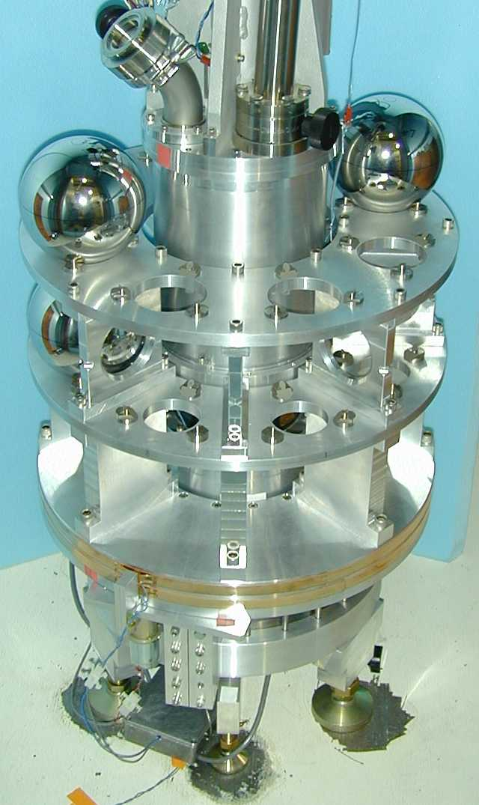
Measurements of G
Compared to other fundamental constants, G is known with relatively low accuracy
  Weakness of gravity at scales we can measure makes it hard to increase accuracy
  More than 40 orders of magnitude weaker than electromagnetism
  Apparatus must be very sensitive to measure G, and is impacted by even tiny disturbances
Measurement of G is still an active field of physics
High precision G measurement apparatus used by University of Washington, Seattle
Notes:
For comparison: fine structure constant (e^2/c hbar) α is 7.2973525698(24)×10⁻³

Slide 7
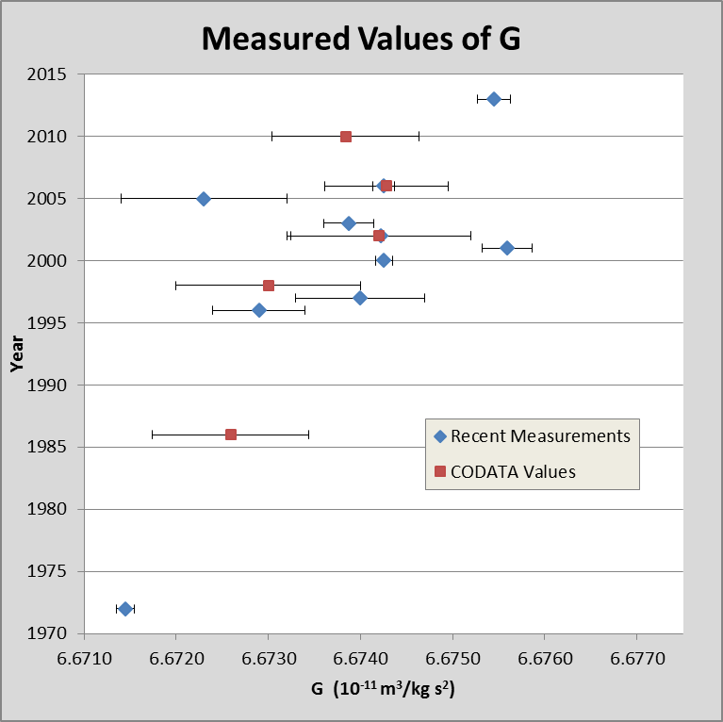
Variation in the Measurement
Values of G published periodically by the Committee on Data for Science and Technology (CODATA)
Most recent measurement (Sept. 2013) is noticeably higher than preceding values
Notes:
September 2013 value: Improved Determination of G Using Two Methods, Physical Review Letters, DOI: 10.1103/PhysRevLett.111.101102.
Earlier values: CODATA publications

Slide 8
Why Keep Measuring?
Must know G to apply Newton’s Law of gravity
  More precision in G → better measurements of planetary and stellar masses
Must know G to use the Friedmann equations that govern the expansion of the universe
  Slight variation in G → change in Hubble parameter and acceleration of expanding universe
  More precision in G → better knowledge of universe density
Is Newton’s law of gravity exactly an inverse square law?
  Measurements of G at different distances places a constraint on deviation from inverse square
Is G actually constant?
  Precise measurements of G would help determine whether G has small variations over space or time
Notes:
It is also needed to calculate the mass of the Earth and any other celestial body. This was why G was first measured and why it is still important today.
G is the fundamental constant that is known with the lowest accuracy. Many hope to increase this accuracy to bring it closer to the accuracy of other fundamental constants. There are also recent experiments that have tried to investigate a possible spatial dependence of G to test predictions made by string theory about alternate dimensions.
Notes were used as a basic outline, not used in talks but as a safety net in case one lost train of thought. Notes: 2008F -Cavendish2AdvLabI.ppt

Slide 9
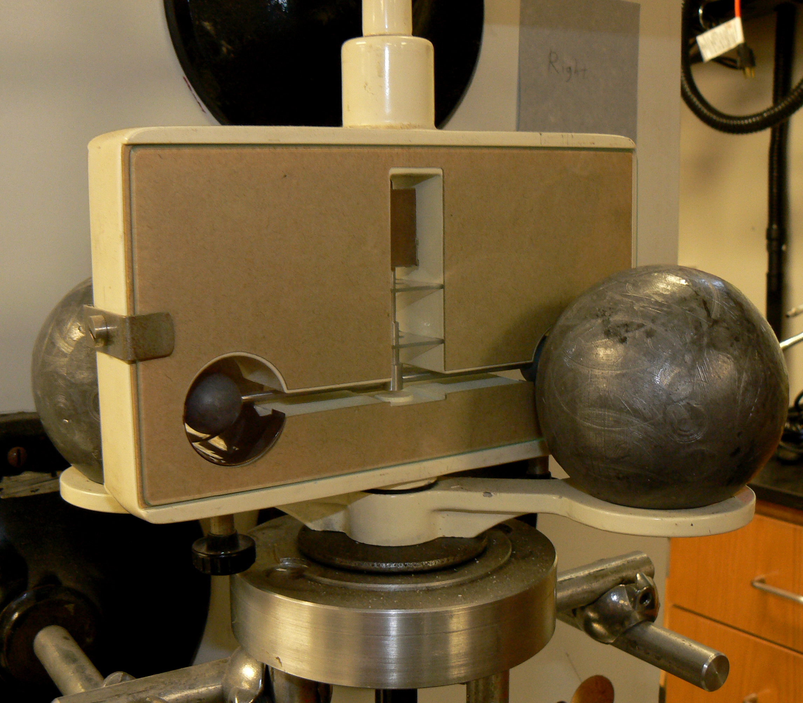
The Apparatus
Torsion wire
  Works like a spring
  Has torsion constant κ
Torsion is proportional to the twist in the wire
Notes:
The torsion wire is to torque as a spring is to force. The restoring torque of the wire is porportional to the displaced angle from equilibrium. This has similar limitations to the spring’s. Displace the angle too far and the relationship becomes more nonlinear.

Slide 10
The Apparatus
masses
laser position after one period
equilibrium position
mirror
Amplitude
laser
Notes:
Before 1st Animation
Small masses are at equilibrium
Laser reflected off mirror to the chalkboard
Laser position is unchanging
After 1st Animation
Large masses swiveled
Equilibrium of small masses is disturbed
Small masses begin to rotate, beam position oscillates
Beam position is reaches 2nd maximum at ½ of 1st period
After 2nd Animation
After 1st oscillation, beam reaches 3rd maximum
3rd maximum not as far from final equilibrium (after many periods) due to dampening
Final equilibrium is reached after at least 2 hours

Slide 11
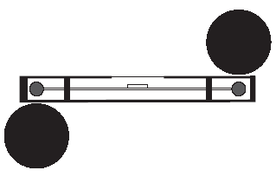
Description of the Forces
Starting Position:
System is in equilibrium
After Switching Position:
System is not in equilibrium
Gravity and Torsion are
equal and opposite
Gravity and Torsion are collinear
  Both forces are responsible for the acceleration that the small balls feel when the equilibrium positions are disturbed
  Both forces are responsible for the final equilibrium position
Notes:
The force diagrams for the small masses
Lead balls are placed in the original position. After this, the torsion wire is adjusted such that the gravitational force between the large and small masses is equal but opposite to the force due to the torsion wire. When the system is left for a long time in this position, the small masses should not feel any acceleration, hence the system will be in equilibrium.
In the final position, the large masses have now been turned, and the apparatus has been left to come to equilibrium again. This time, the force due to gravity between the large and small masses is pointing in the opposite direction. Similarly the force due to the torsion wire is in the opposite direction. The new gravitational force and the new torsion force form an equilibrium about 2 hours after the large masses have been moved. That is, it takes roughly 2 hours for the small masses to stop their motion after the large masses have been moved.
It is important to notice that the gravitational force and the torsion force are both responsible for the manner in which the small masses accelerate when the equilibrium positions are disturbed.
It is also important to notice that these forces are responsible for the equilibrium position of the small masses.

Slide 12
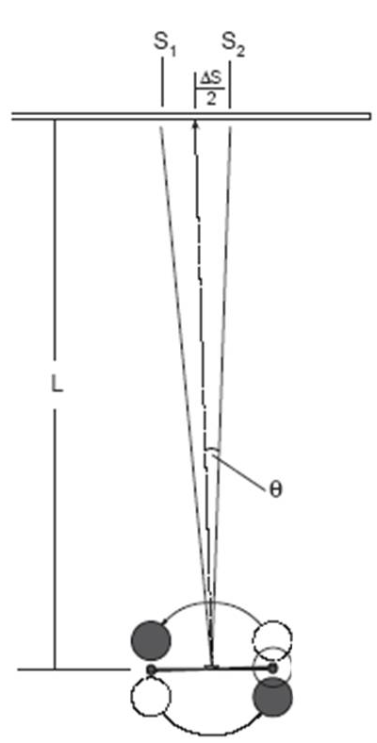
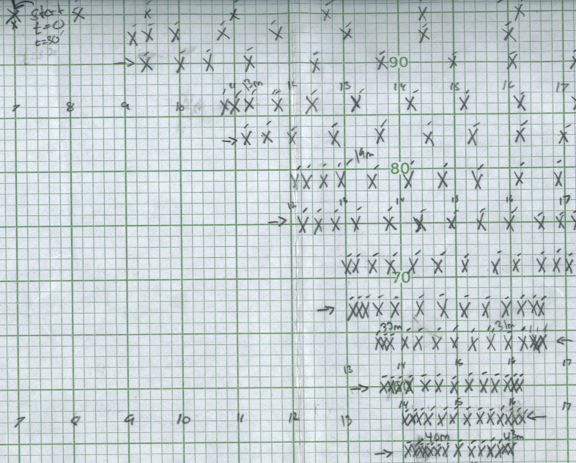
Method 1: Equilibrium Position
Measure difference on screen ∆S between equilibrium positions
  Equilibrium positions: States where lead balls are not moving
  Measurement gives angular displacement between equilibrium positions
  Combine with a measurement of the period to obtain G
Actual Data
Notes:
Lower picture is handwritten data. Laser moves across screen, in a damped harmonic oscillator pattern. To measure:
Switch apparatus from equilibrium position. Watch the laser point move across, marking every 15 seconds. Though data points drop down, this is only for ease of taking and reading data. Thus, the graph paper must be made as level as possible, for accurate results. After 45 minutes, switch apparatus back again. Repeat for 45 minutes.
With data, interpolate the distance on screen between equilibrium points and calculate period of oscillation. Calculate G with these values.

Slide 13
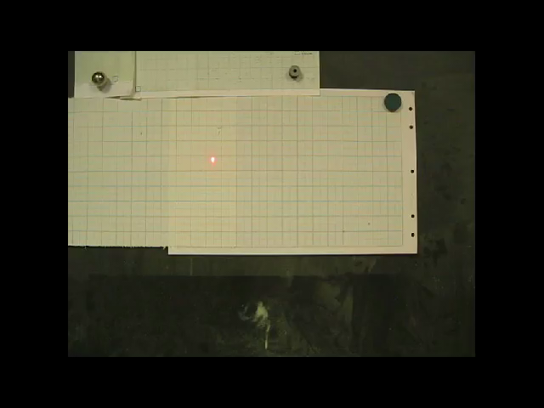
Movie
Notes:
Lower picture is handwritten data. Laser moves across screen, in a damped harmonic oscillator pattern. To measure:
Switch apparatus from equilibrium position. Watch the laser point move across, marking every 15 seconds. Though data points drop down, this is only for ease of taking and reading data. Thus, the graph paper must be made as level as possible, for accurate results. After 45 minutes, switch apparatus back again. Repeat for 45 minutes.
With data, interpolate the distance on screen between equilibrium points and calculate period of oscillation. Calculate G with these values.

Slide 14
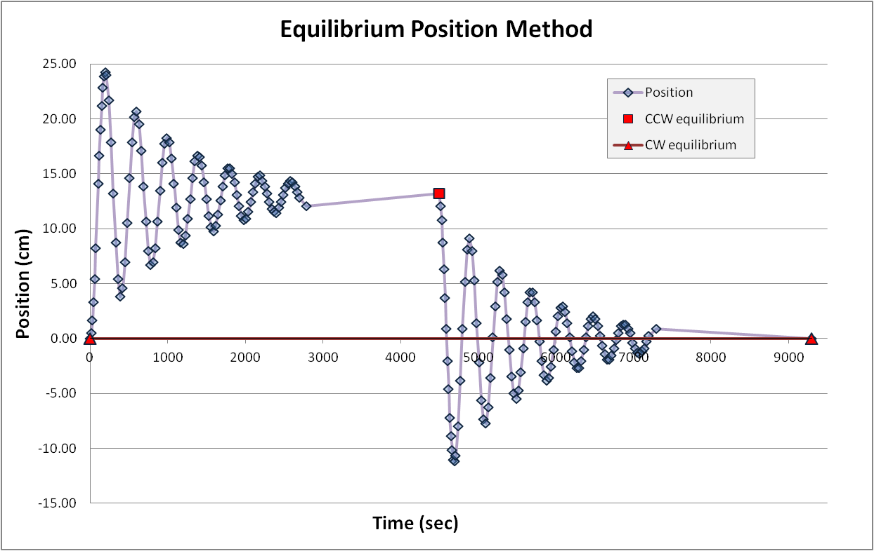
Results from Equilibrium Position Method
To measure Δs, find the distance between the two equilibrium positions
In our case, Δs = 0.132 m
G = 7.63 x10⁻¹¹ m³kg⁻¹s⁻² - 14% deviation from accepted value
Notes:
Average from 16 measurements of the period: 399.14 seconds.
Distance between equilibrium positions of the laser point was 0.132 m.
With these measurements, G = 7.63 in appropriate units.
The expected error is about 10%, so a 14% error is acceptable.

Slide 15
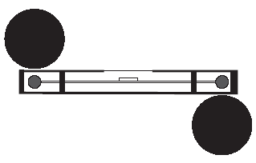
Method 2: Constant Acceleration
Once the balls are moved:
  G can be described in terms of the initial acceleration felt by the masses
Procedure:
  Start with large balls in equilibrium position
  Record the position
  Flip the large balls
  Record the position every 15 seconds for one minute
Gravity and Torsion are
equal and opposite
Gravity and Torsion are
in the same direction

Slide 16
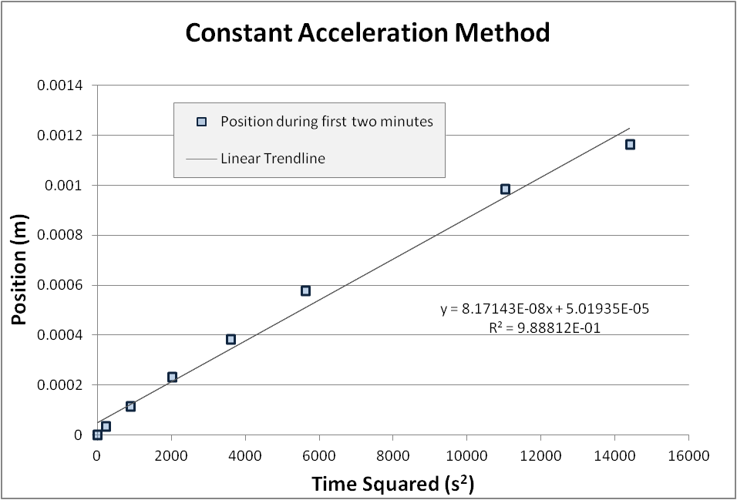
Results from Measurement of Acceleration
Find the acceleration from the slope of the graph
In our case, a=8.17x10⁻⁸ m/s²
This method gave the following value of G:
G = 6.33 x 10⁻¹¹ m³kg⁻¹s⁻² - 5.4% deviation from the accepted value
Notes:
The x-axis is our measured time squared and the y-axis is the total displacement. Hence the slope of the blue data points will represent the acceleration of the small masses. Since these data points were taken soon after the equilibrium position was disturbed, we are going to assume that the slope of the best-fit-line will represent the initial acceleration of the small masses.
This initial acceleration can now be used to calculate G, along with the measured period time of the oscillations.

