Slide 1
Cavendish Experiment
Advanced Lab II
Josh Villatoro, Hunter Ash 2013F
Seth Hodgson, Bailey Bedford, Catie Raney 2013S
Darren Erdman, Mengfei Gao 2010S
Amanda Baldwin, Paul Wright,
Thomas Kennington, Matt Whiteway, Chris Schroeder 2009F
Dan Brunski, Sung Chou,
Dustin Combs, Daniel White, 2008S
Susan Gosse, Daniel Freno,
Jason Garman, Joshua Smith, 2007F
Advisor: Dr. Johnson
Notes:
1
Intro Slide

Slide 2
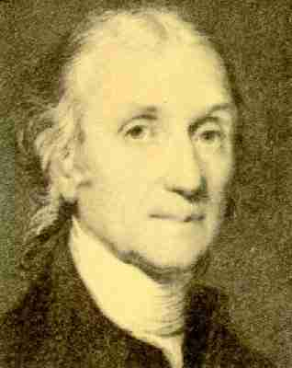
Overview
Cavendish History
Theory of Measurement
  Derivations
Apparatus
Procedure
Results
  Constant Acceleration Method
  Periodic Measurement Method
Conclusion and Sources
  Error Discussion
Procedure Appendix
Henry Cavendish
2
Notes:
2

Slide 3
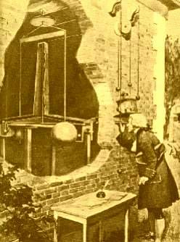
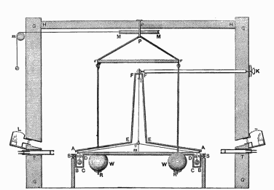
Cavendish History
Performed in 1797-1798 by Henry Cavendish
Primary result of experiment was to measure the density of the earth
  “G” and the mass of the earth were derived by others after Cavendish’s death
Torsion balance method devised by John Mitchell in 1783
  Died before experiment could be performed
  Apparatus passed eventually to Cavendish, who rebuilt it
The apparatus was extremely large, with the heavy lead spheres weighing upwards of 348 lbs
Cavendish performed the experiment inside a closed shed and observed the result from outside through a telescope. The opening in the wall was added by the artist to show the apparatus.
Vertical section drawing of Cavendish's torsion balance instrument including the building in which it was housed. The large balls were hung from a frame so they could be rotated into position next to the small balls by a pulley from outside
3

Slide 4
History of Measuring G
Experimenter | Year | Method | G Measurement | ΔG/G*10⁶
Cavendish Boys Luther Fitzgerald Schwarz Kündig | 1798 1895 1982 1995 1998 2002 | Torsion balance Torsion balance Torsion pendulum Torsion balance Free fall Beam balance | 6.75 ± 0.05 6.658 ± 0.007 6.6726 ± 0.0005 6.6656 ± 0.0006 6.6873 ± 0.0094 6.67404 ± 0.00022 | 7400 (stat.) 1000 75 90 1400 200
Problems in Determining G
  Weakest of the four fundamental forces
  Inconstancy of the torsional moment of suspension
  Sensitivity to environmental disturbances
  Sensitive to small changes in temperature
  Inability to shield gravity
  Consequently, G is the least precisely measured fundamental constant
The gravitational constant by Robert Kritzer March 11, 2003
4

Slide 5
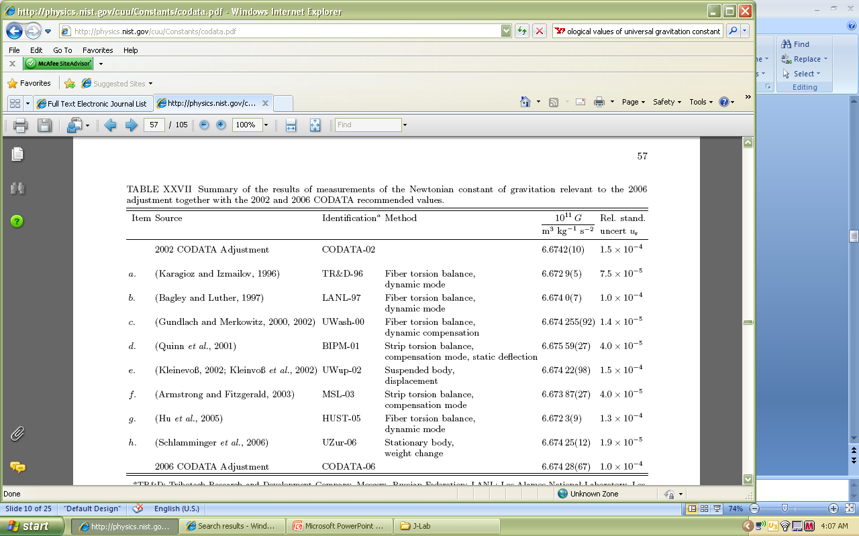
Recent Measurements of G
Peter J. Mohr and Barry N. Taylor, David B. Newell; http://physics.nist.gov/cuu/Constants/codata.pdf
5

Slide 6
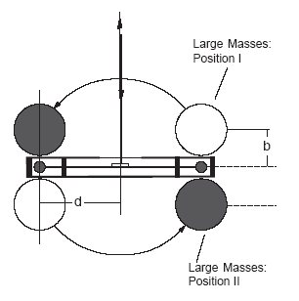
Theory of Measurement
Two methods of measurement used
Method of equilibrium positions
  Accuracy of ~5% according to PASCO
  90 to 180 min. observation time
  Involves finding equilibrium points for Positions I and II by observing oscillations, then taking the difference to determine G
Method of constant acceleration
  Accuracy of ~15% according to PASCO
  5 min. observation time
  Uses acceleration of small masses during first minute after switching large mass positions to determine G
TOP VIEW
6

Slide 7
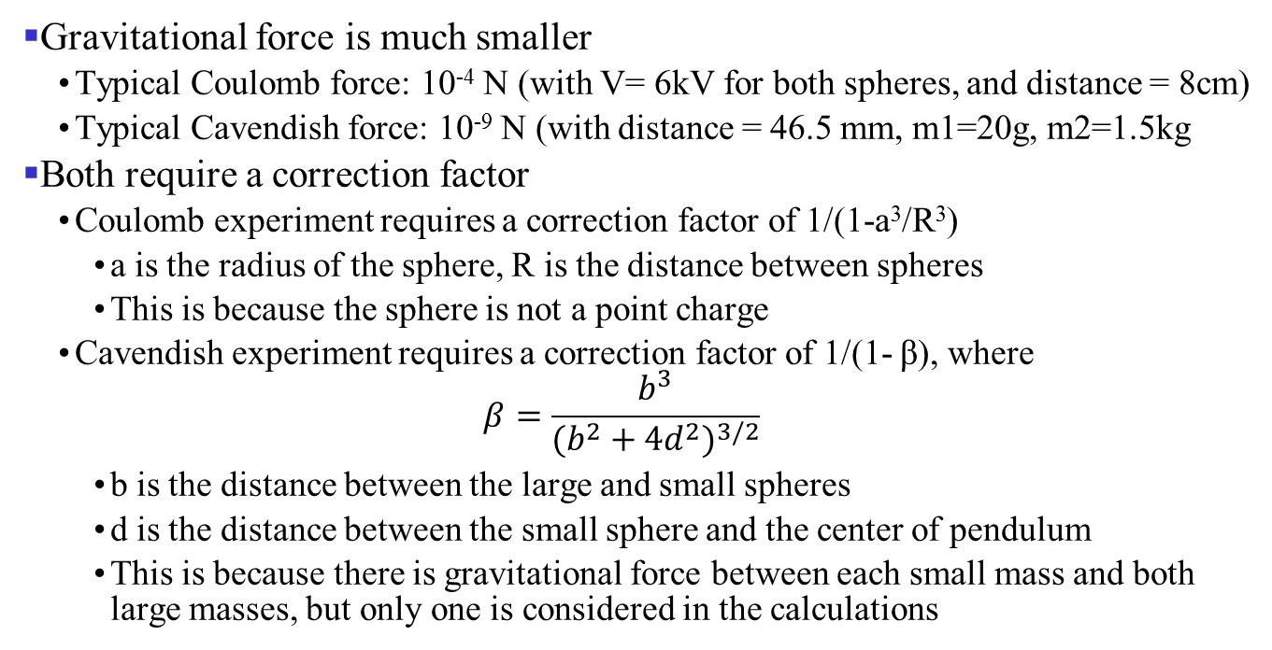
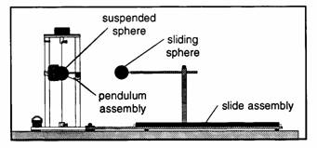
Compare With Coulomb Experiment
←Coulomb Apparatus Diagram:
Note the similarities in the experiment with the use of the torsion wire.

Slide 8


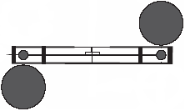
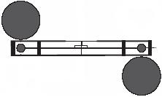


Constant Acceleration Derivation I
Starting with the law of gravitation:
Total force acting to accelerate:
Original position (in equilibrium):
Gravity and torsion
are equal and opposite
TOP VIEWS
Gravity and torsion
are in same direction
Just after “flipping” large masses:
Acceleration therefore expressed as:
Solving for G yields:

Slide 9
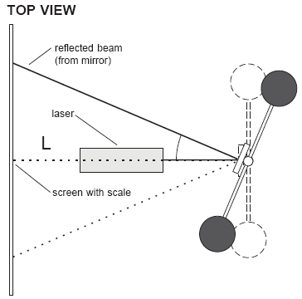

Constant Acceleration Derivation II
The Law of Reflection implies that the arc length that we measure (∆S) corresponds to an angular displacement of 2θ:
Using similar triangles, we can derive a relation between the displacement of the laser dot and the linear displacement of the small masses:
Using kinematic equation of motion for constant acceleration, a₀ can be calculated:
b = distance between masses
d = radius of torsion arm
θ = angle of rotation
L = distance from mirror to paper
m₁ and m₂ = mass of objects
Δs = linear displacement of small masses
ΔS = displacement of laser dot
Solving for G yields:

Slide 10





Equilibrium Position Derivation I
Graphical Method for measuring G
  Measured distance (meters) over time (seconds).
  Determined period T (~ 392 s ~ 6.5 min) and displacement ∆S from data
Law of gravitation given by
TOP VIEW
Attraction of masses causes torque
Torque of wire is
Combining gives
And the κθ
term is:
10

Slide 11



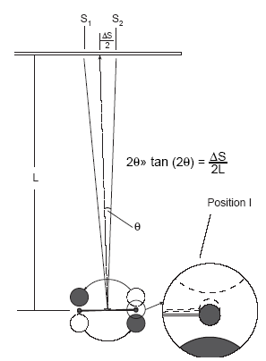

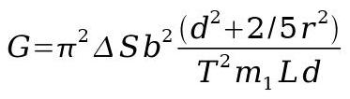
Equilibrium Position Derivation II
θ can be found from
κ can be found from
The moment of inertia is
Putting everything together yields
TOP VIEW
11

Slide 12


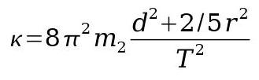
Equilibrium Position Misc.
θ = angle of deflection of masses
κ = torsion constant
T = period of oscillations (~390 s, or 6.5 minutes)
b = distance between centers of large mass and small mass, 46.5 mm
d = radius of torsion arm
ΔS = separation of equilibrium positions
r = 9.55 mm, the radius of the small spheres
m₁, m₂ = mass of objects, m₁ = 1.5 kg
L = distance from mirror to wall = 8.4 m
12

Slide 13
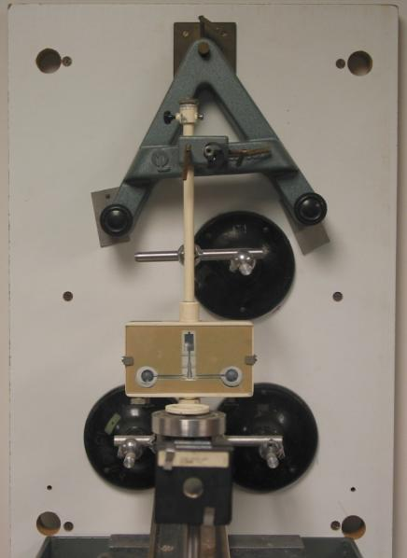
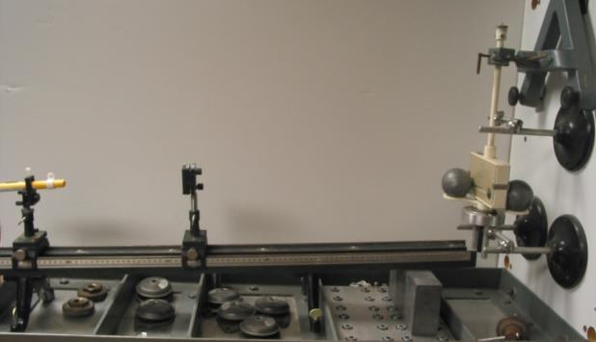
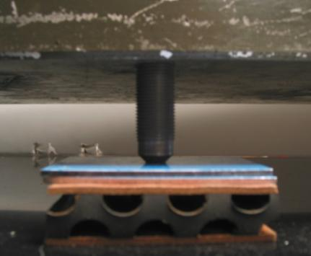
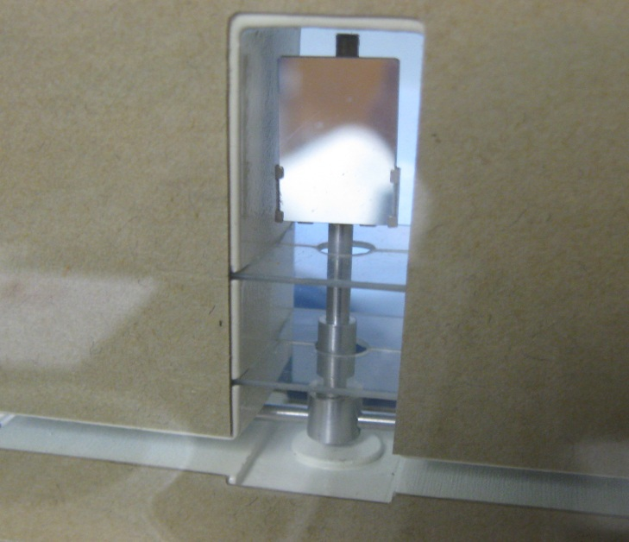
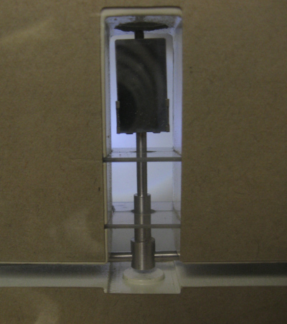
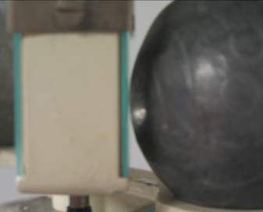
Alignment
Apparatus
Alignment
TICO LF/PA/10 absorbs shock
Center BOB over MESA
Make sure bob is free
Place lead ball as close as possible
Notes:
http://www.jameswalker.biz/group/categories/machinery_mounts.html
Tico® LF mounting pads Isolate disturbing frequencies
Scientifically designed bonded-sandwich pads.
Excellent plant/structure isolation at low frequencies.
Easy to install - no mechanical parts to maintain.
Two grades to suit most applications.
More info
Freudengerg Seals and mounts.

Slide 14
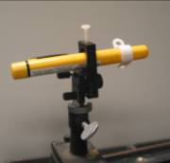
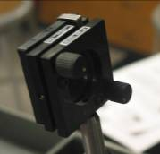
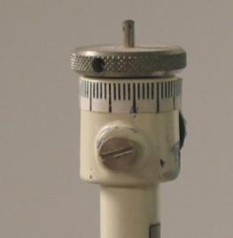
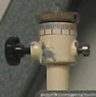
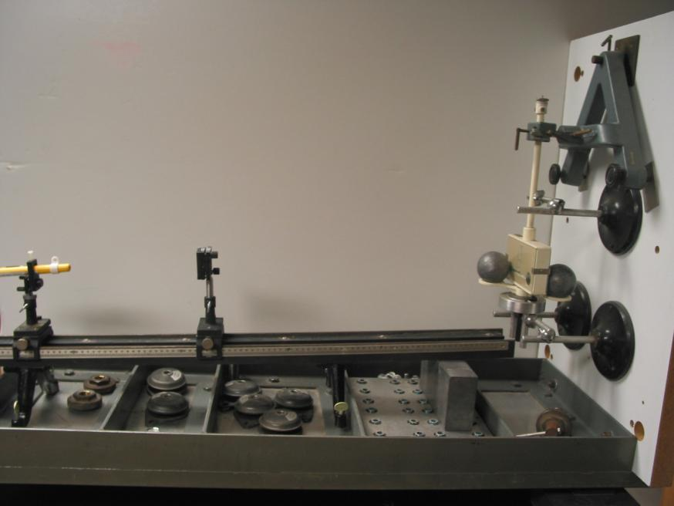
Apparatus Adjustments
Set Screw: Allows rotation of knurled knob DON’T ADJUST
Knurled Knob: Adjusts the equilibrium position
DON’T ADJUST
Window-to-window separation ≈ 20°
Knob on top of Cavendish scale has tick marks
  Large tick = 27.5°
  Small tick = 5.5°
Equilibrium separation ~0.7°
Initial amplitude ~0.7°
Typical period 6.5 minutes
14

Slide 15
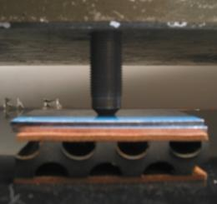

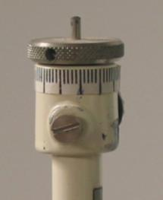
Apparatus Set-up Notes
Isolated optical table with three-point system
  Screw posts in front two holes
  Lead brick under back corner
  Placed TICO LF/PA/10 between supports and cabinet surface (make sure they are stable/level)
  Place lead bricks on table to stabilize
Elevate cabinet by placing four lead bricks near wheels
Adjust Screw Post to center Mirror Bob over Mesa
  Make sure not to bump or lean on table while centering bob
Dampen oscillations with a strong magnet held near small mass
  Apply when mass already near equilibrium point
  Longer you hold magnet near small mass, larger effect seen
  Effect due to diamagnetic response
Total angular variation from switching mass positions ≈ 2.5°
Screw Post
TICO
Mirror Bob
Knurled Knob

Slide 16
Procedure I
Set Up
  Level the experiment using the threaded feet, making sure that the mirror is hanging freely in the center of the case , and center the pendulum in the middle of the mesa.
  Make sure that when the large masses are moved that the small masses only experience small oscillations.
  Move the large masses through the full range of motion and touch the window of the case with one or both masses if possible. Do this carefully not to cause large disturbances from hitting the glass case with the masses. Note which mass doesn’t touch.
Calibration
  Using a strong magnet move the balance through the full range of motion and mark on the graph paper where the small masses touch the glass.
  To center the natural equilibrium position, we would move one small tick mark. Then we would watch which direction the masses moved towards and would move it another small tick if the movement was away from the center. Initially, one could move 2 small tick marks if one was not near the center already. The angular variation in equilibrium points from switching the mass-positions was approx. 0.01 rad = 0.8º. The total angular variation from maximums was 2.5º.
  Measure the distance from the mirror to the midpoint between the marks where the small masses touch the glass.
Taking Data
  Move the large masses to where one is kissing the glass. This will be the starting position for the measurement. Before taking data you must wait for the small masses to come to rest. The waiting time can be reduced by slowly bringing a strong magnet near one of the small masses, thereby damping the oscillations.
16

Slide 17
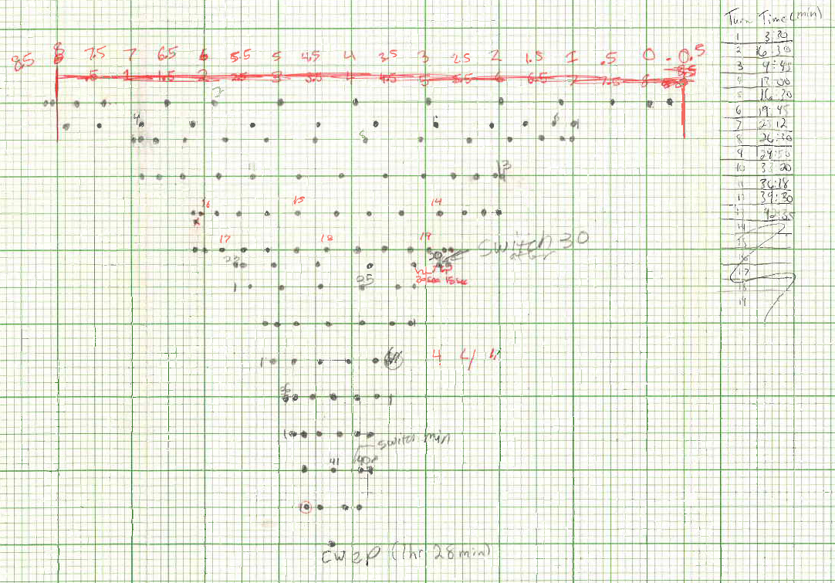

Procedure II
Making measurements
  At t=0, after the small masses have stabilized in Position I, make a mark to indicate initial position and switch the Masses to Position II
  Make marks every 15 seconds, increasing the interval as needed to fit marks, and move down a row each half oscillation. Be sure to note intervals
  Switch to Position I after it settles, and repeat the same process
17

Slide 18
Procedure III
Helpful hints
  It’s helpful to record time at which it turns around
  Number the bold vertical lines and use the distance from the bold line to the fine lines to measure distances easily
  If two intervals overlap on the same dot, go down to the next row. Either it has passed the turn around point or your intervals are too short.
  Use a timer to track overall elapsed time, and use intervals on the running time to make your marks. This is important in minimizing errors in measurements.
Calculating Equilibrium positions
  Two methods: amplitude and frequency
  For amplitude, take two separate averages of all marks for positions I and II, making sure there are an equal number of maxima in each direction
  For frequency, average the marks closest to ¼ and ¾ the time of each period
  Ideally, let it settle to the equilibrium point, and use that measurement.
18

Slide 19
Error Discussion I
Neither method had serious problems with error
  Constant acceleration method had ≈ 15% error
  Equilibrium method had ≈ 5% error
Using correction factor increases measured G by 6-9%
Possible sources of error include:
    The mirror is not planar, it is concave
      If mirror moves laterally, laser’s incident angle will change
      If laser is not centered properly on the mirror, incident angle will not change linearly with mirror rotation
    Inaccuracies in measuring the equilibrium and dot positions on the graphs
    The separation of the large and small balls, b, is taken to be constant
    There are modes of vibration due to movement in the room and background vibrations.
      These are generally small sources of error but they can lead to inaccuracies in the position of the laser at any given time.
19

Slide 20
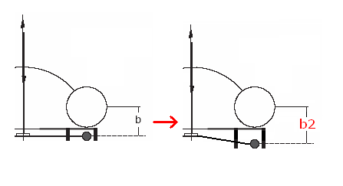
Error Discussion II
Uncertainty in the “b” value given by apparatus manual
  b changed throughout experiment as arm rotated
  The equilibrium points were not at the center between windows
  At position 1, the equilibrium was .571 m (~3.9º) from the center position
  At position 2, the equilibrium was .469 m (~3.2º) from the center position
  Total change in b (window to center) in our experiment was 0.19 cm, or 0.4% of accepted value of b
  Not a significant source of error
20

Slide 21
Sources
http://en.wikipedia.org/wiki/Cavendish_experiment
http://www.nhn.ou.edu/~johnson/Education/Juniorlab/Cavendish/Pasco8215.pdf
http://physics.nist.gov/cuu/Constants/codata.pdf
http://www.physik.uni-wuerzburg.de/~rkritzer/grav.pdf
http://www.npl.washington.edu/eotwash/publications/pdf/prl85-2869.pdf
21
Notes:
21

Slide 22
Fall 2013 Equilibrium Data
The measurements resulted in G=6.69 x 10⁻¹¹ a 0.3% deviation from the accepted value
These results are unusually close. This may be the result of our method of calculating the period with elapsed time over several oscillations or simply by chance
Josh Villatoro, Hunter Ash
22

Slide 23
Spring 2013 Equilibrium Data
The measurements resulted in G=6.81 x 10⁻¹¹ - 2% greater than the accepted value
Given that the experimental error is within 10%, these are excellent results
23

Slide 24
Spring 2013 Constant Accel. Data
Measurement gave a value of 5.74 x 10⁻¹¹ <16.3%> off the accepted value.
Given that the experimental error is around 30%, these results are fairly good
24

Slide 25
Spring 2010 Equilibrium Data
The measurements resulted in G=7.03 x 10⁻¹¹ - 4% greater than the accepted value
Given that the experimental error is within 10%, these are excellent results
Note that the equilibrium position on the first data set is above the apparent value
  This may be due to experimental error
  Probably due to the method of calculating the equilibrium position
25

Slide 26
Spring 2010 Constant Accel. Data
The measurements resulted in G= 8.68 x 10⁻¹¹ - 30% greater than the accepted value
Given that the experimental error is around 30%, these results are very good
26

Slide 27
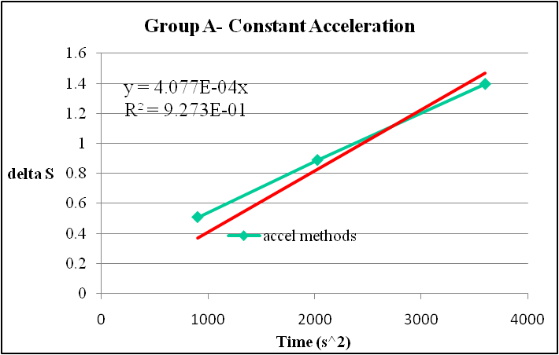
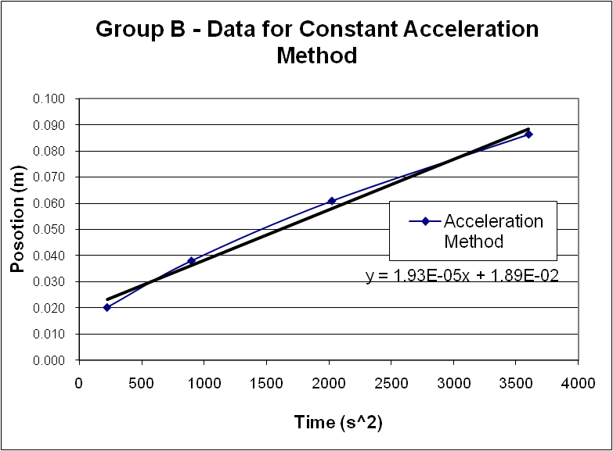
Fall 2009 Constant Accel. Data
Group A’s measurements resulted in G= 1.84 x 10⁻¹¹ - 72% of the accepted value
Group B’s measurements resulted in G= 9.35 x 10⁻¹¹ - 40% of the accepted value
Given that the experimental error is around 30%, these results are fairly good
27

Slide 28
Spring 2008 Constant Accel. Data
Group A’s measurements resulted in G=4.3 x 10⁻¹¹ - 65% of the accepted value
Group B’s measurements resulted in G=5.4 x 10⁻¹¹ - 80% of the accepted value
Given that the experimental error is around 30%, these results are fairly good
28

Slide 29
Fall 2007 Constant Accel. Data
Group A’s measurements resulted in G=5.4 x 10⁻¹¹ - 80% of the accepted value
Group B’s measurements resulted in G=5.9 x 10⁻¹¹ - 90% of the accepted value
Given that the experimental error is 15%, these are excellent results
29

Slide 30
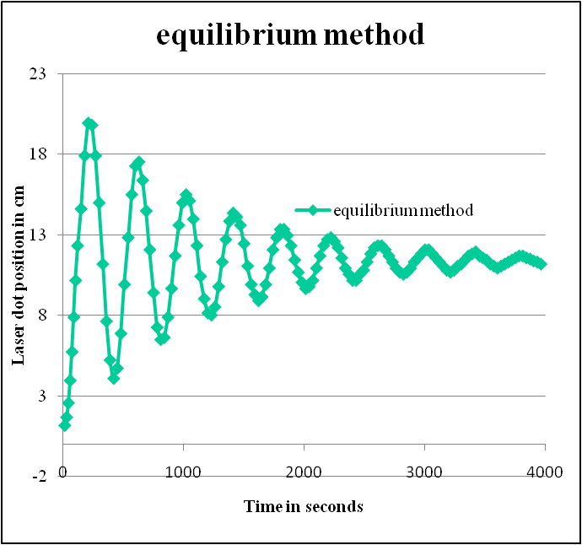
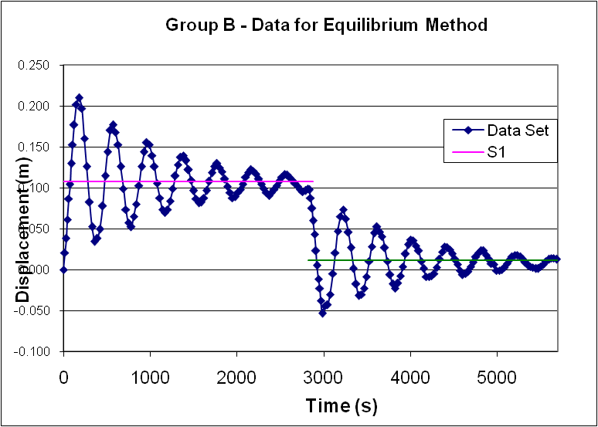
Fall 2009 Equilibrium Data
Group A’s measurements resulted in G=5.12 x 10⁻¹¹ - 26% of the accepted value
Group B’s measurements resulted in G= 6.25 x 10⁻¹¹ - 6 % from the accepted value
Given that the experimental error is within 10%, these are excellent results
30

Slide 31
Fall 2007 Equilibrium Data
Group A’s data resulted in G=2.13 x 10⁻¹⁰, which is 320% of the accepted value
Group B’s data resulted in G=2.17 x 10⁻¹⁰, which is 330% of the accepted value
Given that the experimental error is 320% and that both groups experienced similar error, there should be a systematic cause.
31

Slide 32
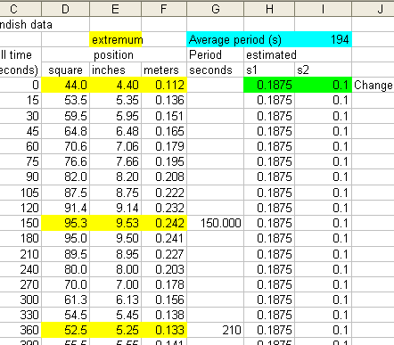
Mistake to Avoid
Group A’s data resulted in G=2.13*10⁻¹⁰, which is 320% of the accepted value
Group B’s data resulted in G=2.17*10⁻¹⁰, which is 330% of the accepted value
Should be 5.33 x 10⁻¹¹, 80% of accepted
Should be 5.43 x 10⁻¹¹, 81% of accepted
Period should be calculated from time between consecutive minima or maxima, not from one minimum to next maximum as was done here
minimum
maximum
minimum

