Slide 1
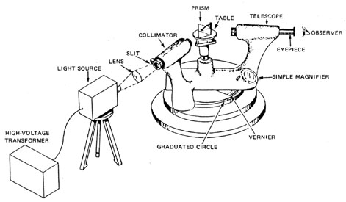
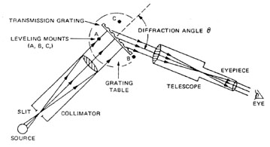
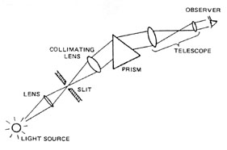
Our prism and Grating Spectrometer
http://cord.org/cm/leot/course10_Mod01/Module10-1.htm

Slide 2
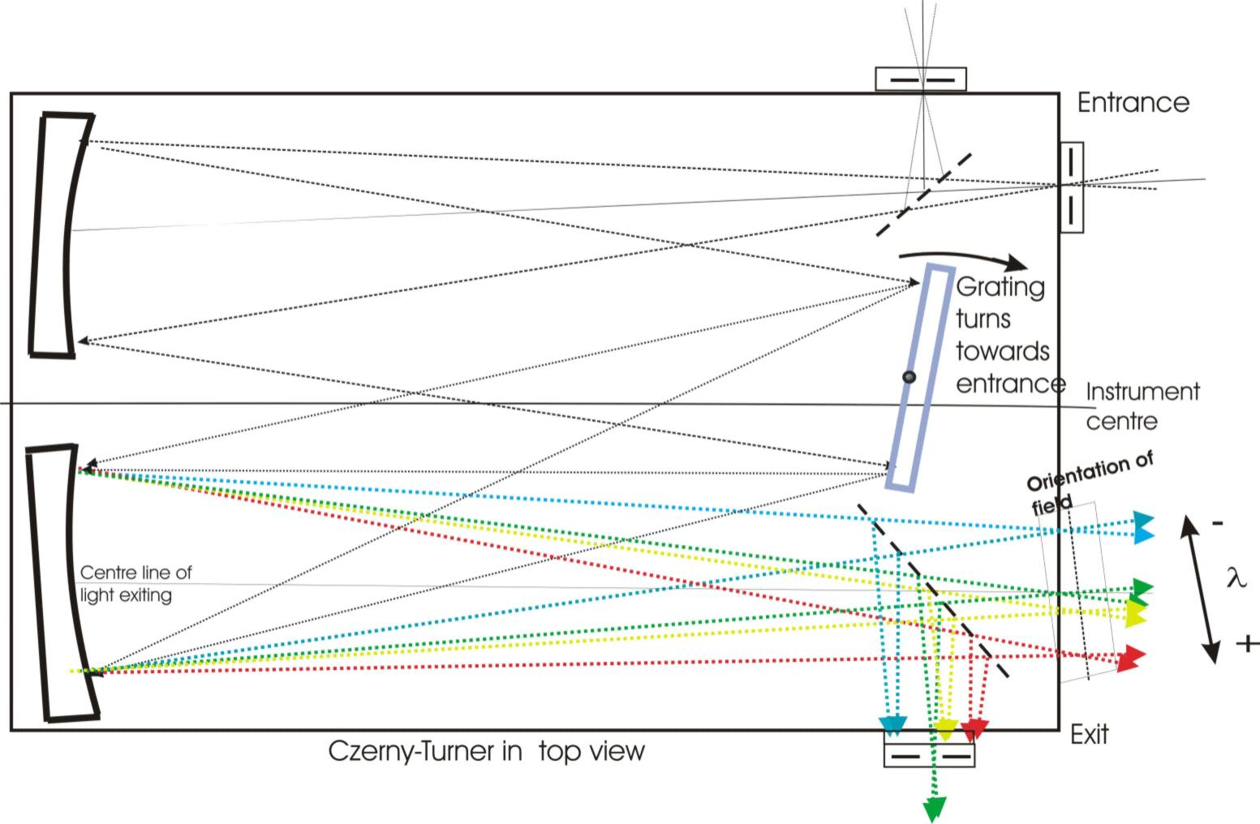
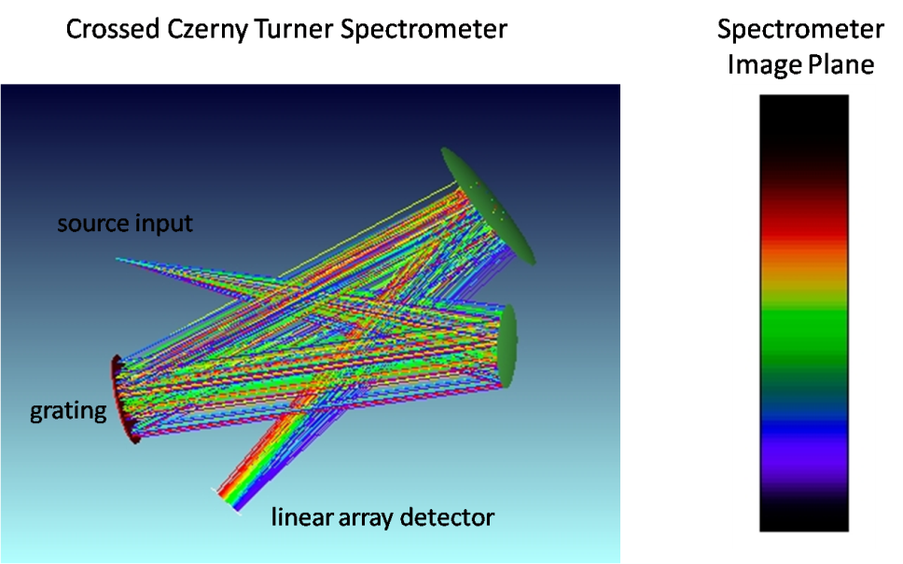
Our prism and Grating Spectrometer
http://www.spectra-magic.de/E-Configuration.htm
http://opticalea.com/Spectrometers.html

Slide 3
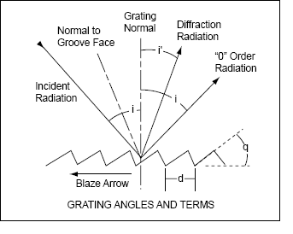
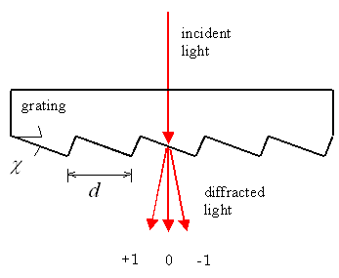
Our prism and Grating Spectrometer
http://gratings.newport.com/library/technotes/technote4.asp
GRATING EQUATION
The general grating equation is usually written as:
nλ= d(sin i’ + sin i)
where n is the order of diffraction,
λ is the diffracted wavelength,
d is the grating constant (the dist. between successive grooves),
i is the angle of incidence measured from the normal ,and
i' is the angle of diffraction measured from the normal.
For a specific diffracted order (n) and angle of incidence (i), different wavelengths (λ) will have different diffraction angles (i'), separating polychromatic radiation incident on the grating into its constituent wavelengths.

