Slide 1
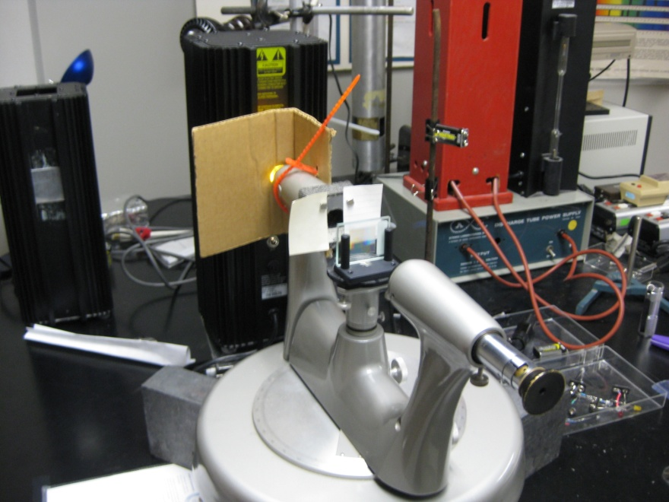
Grating Spectrometer
Paper stops that act to limit the
size of the grating (i.e., N)
Measure the doublet position for m = 2, 1, 0, -1, and -2. Note for 0 you may see a very bright line and a much less bright line. Only the very bright line is important.
For the doublet in m = 1, examine the effect of the "paper stops" on the width of each of the lines of the doublet. (The paper stops are attached with the magnets and are used to change amount of light incident on the grating.)
Reduce the separation between the stops. Once the "stops" are about 4 mm apart (about the center position) each line starts to blur. By the time the "stops"-slits are 2 mm apart the lines much more blurred. Actually we would expect the loss of resolution (blurring) to be more gradual - it should be linear with separation. There is little loss in resolution until the stops are close together because the light incident on the grating is not uniform.
Notes:
Aligning Grating Spectrometer.
Place high precision grating (on glass) with grating toward light source side.
Make sure grating is at center of turntable by sighting from top aligning to the center dot at the center of the machined alignment circles.
To set the grating to normal incidence (i = 0º) align the θ = 0º direct transmission line to the two internal reflection line.
To do this have the slit somewhat open and rotate the prism/grating pedestal.
The position of the dimmer internal reflection line (4% x 4% or 16/10,000 = 0.16% of direct) is very sensitive to rotating
pedestal.
I have found it easiest to see both lines with the lights off and slit open.

