Slide 1
Shape Commonality Index
Aaron Willard
Undergraduate Research Assistant
School of Engineering Physics
Zahed Siddique
Associate Professor
School of Aerospace and Mechanical Engineering
Special thanks to Sagar Chowdhury
Notes:
1
1

Slide 2
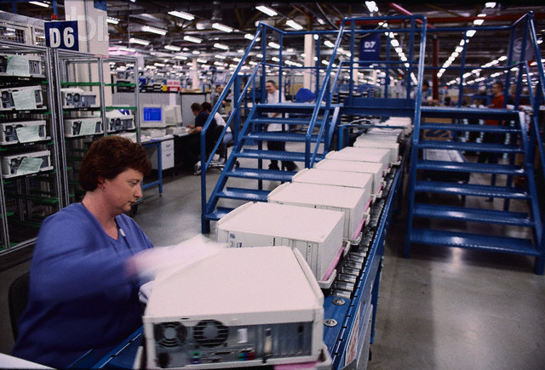
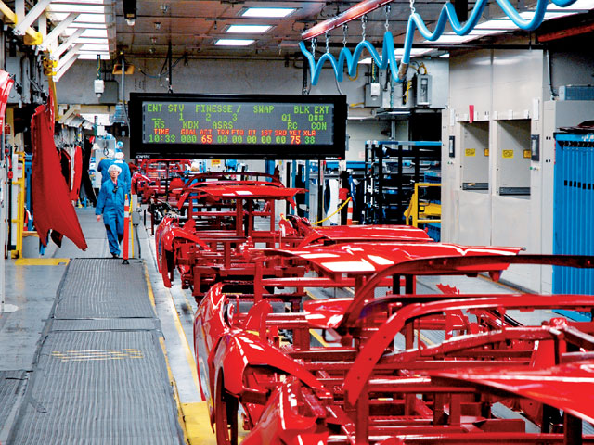
Outline
Shape Commonality Index
Commonality
Breakdown of Index
Complex Shapes
Example
Conclusion
Assembly Line Worker at Dell
2008 Chevrolet Corvette Assembly Line
Notes:
2

Slide 3
Shape Commonality Index
Gives quantitative measurement for commonality
Develop means to extract component information from Computer Aided Design (CAD) models
Using neutral format IGES (Initial Graphics Exchange Specification)
Development of new index
Identifies dissimilarities associated with translation, dimensions, etc.
Needed
Other indexes only give bulk measurement
Show why components are common
Notes:
3

Slide 4
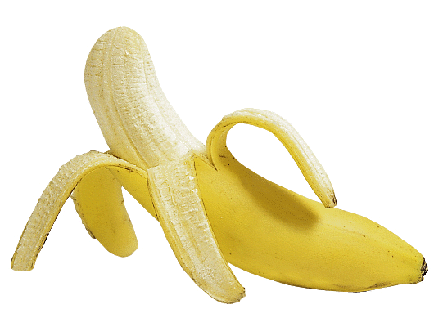
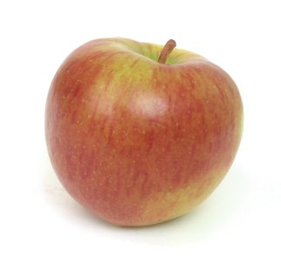
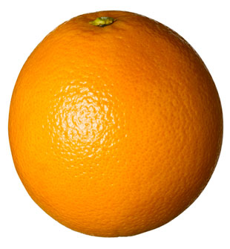
Commonality
What is it?
Shared features and attributes between objects
Applications
Engineers can find the parts they need
Help products share more parts
Increases efficiency
Lowers cost
It’s not like we are comparing apples and oranges

Slide 5
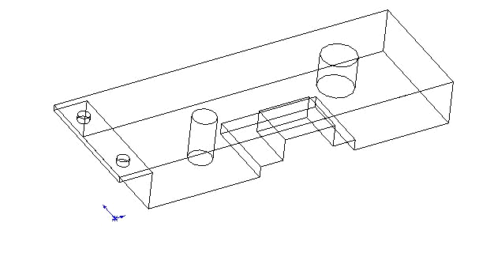
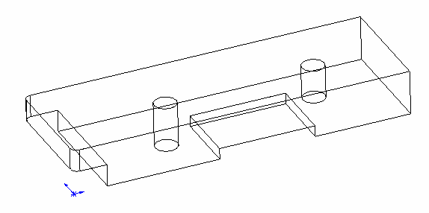
Commonality
How do you measure commonality?
Dimensions
Position
Measure Shape Similarity
Similar Components
Extraction of
Component
Information
Compare Component
Information
CAD Model
Commonality measurement steps
Identify Common Platform
Casing 1
Casing 2
Notes:
5

Slide 6
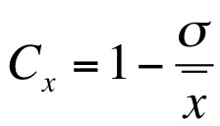
Shape Commonality Index
Angles (α) give shape of each face
Perimeter (L) gives dimension of each face
Number of faces (F) gives rough shape of component
Volume (V) provides bulk commonality measurement
C_{tot,f} = Total commonality of the feature
C_{α} = Commonality for each angle
C_{L} = Commonality for perimeter of each face
C_{V} = Commonality of volume
C_{F} = Commonality of number of faces
n = Number of faces
m = Total number of angles of the component
i = Sum over each angle
j = Sum over faces
x= Component of index measured

Slide 7
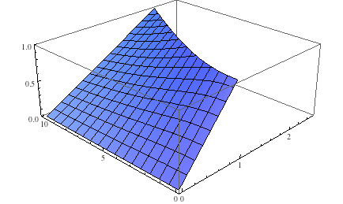
Perimeter
Circle vs Triangle of Constant Dimensions
Performs linearly over all geometries
Accounts for the dimensions of the 2D face
Commonality
Radius
Circle vs. Triangle of Constant Height
Commonality
L=side 1+side 2+side 3
L=2πr
Base of Triangle
Radius

Slide 8
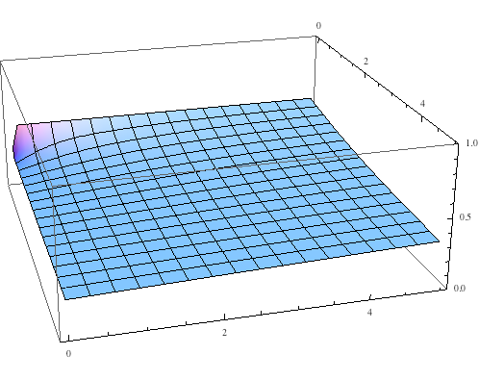
Angles
Triangle of Fixed Height vs Square of Constant Length
Provides commonality for angles that form faces
Gives baseline commonality
Between angles and perimeter=shape and dimension of face
Commonality
Base
Triangle vs. Square of Constant Length
Height
Commonality
Angles vary with height and base
90°angles
Base

Slide 9
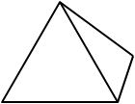
Number of Faces
Constant= Provides baseline commonality
Accounts for faces that form the shape
Constant Value
Independent of dimensions and angles
For cube and pyramid ratio= 5/6 or 83.3% Common
Six Faces
Five Faces

Slide 10
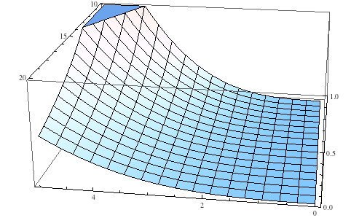
Volume
Volume of Cube vs. Pyramid of Fixed Dimensions
Gives bulk commonality measurement
Behaves cubically
Commonality
Cube Length
Volume of Cube vs. Pyramid of Fixed Height
Pyramid Base Length
V=L³
Commonality
V=⅓ L² h
Cube Length
Notes:
10

Slide 11
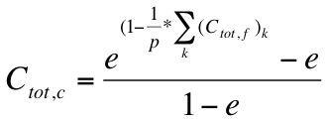
Complex Shapes
Collection of simple geometries
Allows the engineer to see how each feature is affects commonality
Casing 1
Casing 2
C_{tot,c} = Total commonality of the component
C_{tot,f} = Total commonality of the feature
p = Number of features of component with largest number of features
k = Sum over features

Slide 12
Complex Shapes
Provides more reasonable commonality
Absence of feature not as weighty in simple components
Absence of feature in complex components still relatively marginalized
Commonality vs. Ratio of Features
One Feature
Two Features

Slide 13
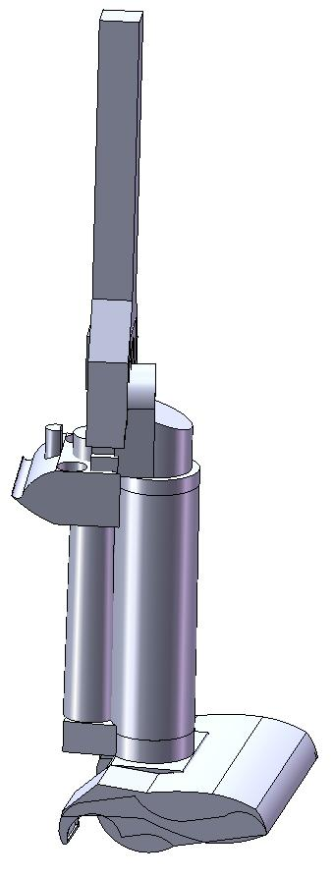
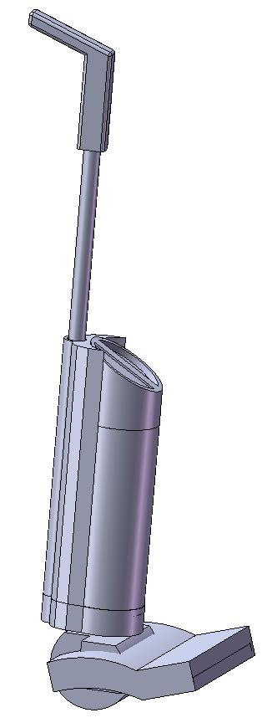
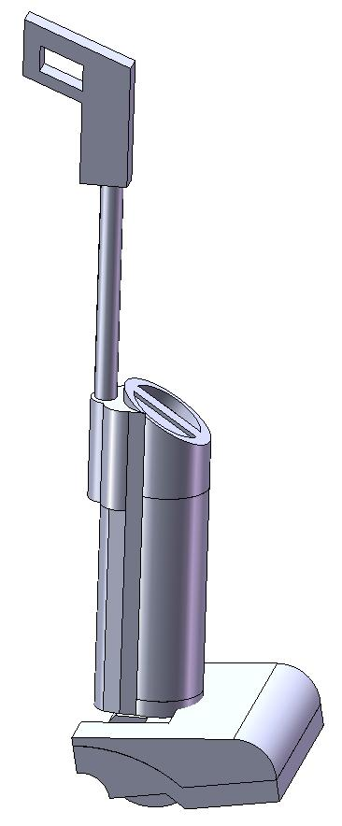
Example
Step 1: Identify components to be compared within a set of products
Vacuum 1
Vacuum 2
Vacuum 3
Notes:
13

Slide 14
Example
Step 1: Identify components to be compared within a set of products
Not Shown: Brush Tool
Handle
Crevice Tool
Tool Caddy
Container Lid
Back Support
Upper Cover
Dirt Container
Lower Cover
Motor Casing
Vacuum 1
Vacuum 2
Vacuum 3
Notes:
14

Slide 15
Example
Step 2: Identify features to be compared between a set of components
Motor Casing 1
Motor Casing 2
Motor Casing 3
Notes:
15

Slide 16
Example
Step 2: Identify features to be compared between a set of components
Supporting Structure
Extrusion
Top Cylinder
Column
Bottom Cylinder
Extension
Motor Casing 1
Motor Casing 2
Motor Casing 3
Notes:
16

Slide 17
Example
Step 3: Measure Commonalities between each feature
Supporting Structure
Extrusion
Top Cylinder
Column
Bottom Cylinder
Extension
Motor Casing 1
Motor Casing 2
Motor Casing 3
Notes:
17

Slide 18
Example
Step 3: Measure Commonalities between each feature
Since more than two components are being compared, commonality is measured using:
C_{x} = Commonality measured
σ = Standard deviation of the measured values
x = Average of the measured values
Subscript “x”= The component of the index calculated
Notes:
18

Slide 19
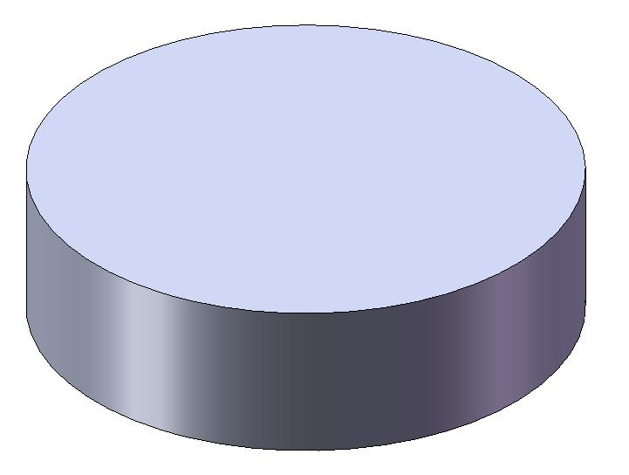
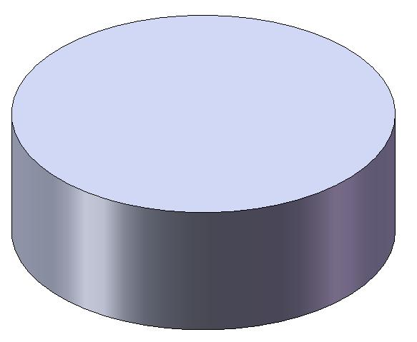
Example
Step 3: Measure Commonalities between each feature
Angles
Cylinder 1
Top= One 360° Arc
Bottom= One 360° Arc
Side= Revolved around four 90° Angles
Cylinder 2
Top= One 360° Arc
Bottom= One 360° Arc
Side= Revolved around four 90° Angles
Cylinder 3
Top= One 360° Arc
Bottom= One 360° Arc
Side= Revolved around four 90° Angles
Top Cylinder 1
Top Cylinder 2
Top Cylinder 3
Notes:
19

Slide 20
Example
Step 3: Measure Commonalities between each feature
Angles
Top
σ= 0°
x= 360°
C_{α}= 100%
Bottom
σ= 0°
x= 360°
C_{α}= 100%
Side (for each 90° angle)
σ= 0°
x= 90°
C_{α}= 100%
Avg. C_{α}= 100%
Top Cylinder 1
Top Cylinder 2
Top Cylinder 3
Notes:
20

Slide 21
Example
Step 3: Measure Commonalities between each feature
Perimeter
Cylinder 1
Top= 329.87 mm
Bottom= 329.87 mm
Side= Avg. height of 30 mm
Cylinder 2
Top= 329.87 mm
Bottom= 329.87 mm
Side= Avg. height of 30 mm
Cylinder 3
Top= 351.86 mm
Bottom= 351.86 mm
Side= Avg. height of 40 mm
Top Cylinder 1
Top Cylinder 2
Top Cylinder 3
Notes:
21

Slide 22
Example
Step 3: Measure Commonalities between each feature
Perimeter
Top
σ= 10.37 mm
x= 337.20 mm
C_{L}= 96.93%
Bottom
σ= 10.37 mm
x= 337.20 mm
C_{L}= 96.93%
Side
σ= 4.71 mm
x= 33.33 mm
C_{L}= 85.86%
Avg. C_{L}= 92.65%
Top Cylinder 1
Top Cylinder 2
Top Cylinder 3
Notes:
22

Slide 23
Example
Step 3: Measure Commonalities between each feature
Number of faces
Cylinder 1
Faces= 3
Cylinder 2
Faces= 3
Cylinder 3
Faces= 3
Volume
Cylinder 1
Vol= 259770.3 mm³
Cylinder 2
Vol= 259770.3 mm³
Cylinder 3
Vol= 394081.4 mm³
Top Cylinder 1
Commonality
σ= 0
x= 3
C_{F}= 100%
Commonality
σ= 63314.86 mm³
x= 304540.67 mm³
C_{V}= 79.21%
Top Cylinder 2
Top Cylinder 3
Notes:
23

Slide 24
Example
Step 3: Measure Commonalities between each feature
Avg. C_{α}= 100%
Avg. C_{L}= 91.39%
C_{V}= 79.21%
C_{F}= 100%
C_{tot,top} _{cylinder}= 92.65%
Top Cylinder 1
Top Cylinder 2
Top Cylinder 3
Notes:
24

Slide 25
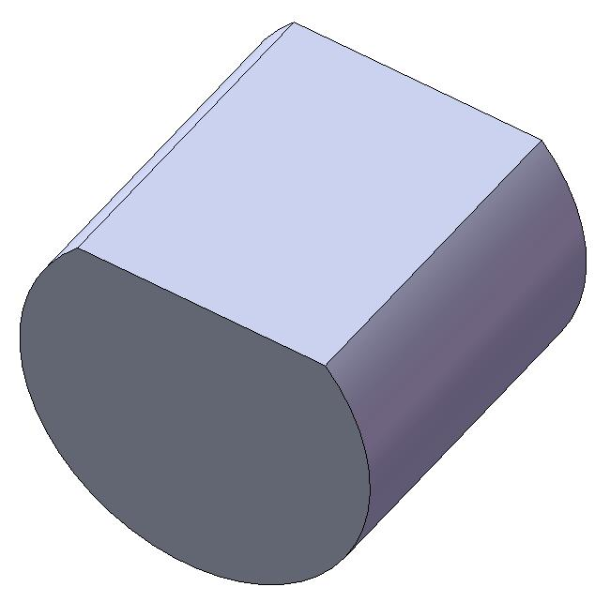
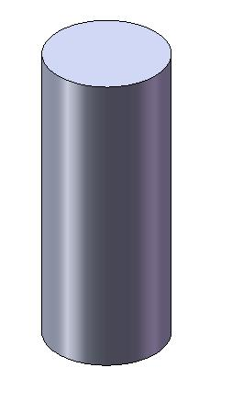
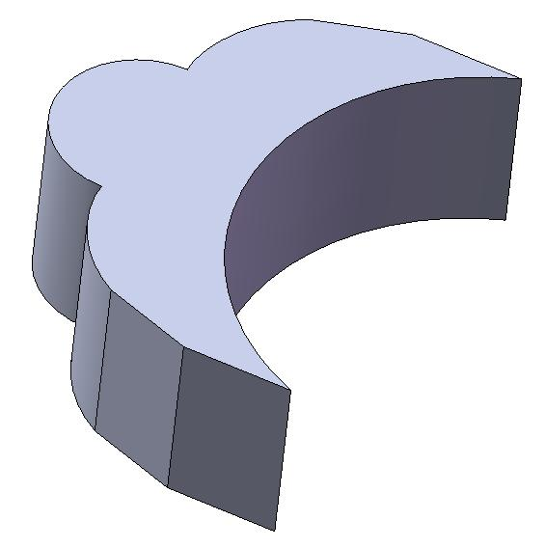
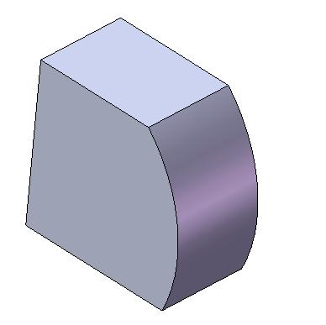
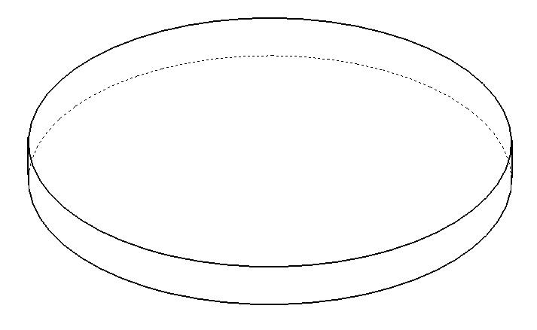
Example
Step 4: Combine the feature commonalities into a component commonality
Top Cylinders
C_{tot,top cylinder}= 92.65%
Bottom Cylinders
C_{tot,bottom cylinder}= 96.14%
Columns
C_{tot,column}= 96.14%
Extensions
C_{tot,extension}= 29.28%
Supports
C_{tot,support}= 61.75%
Extrusions
C_{tot,extrusion}= 0%
Notes:
25

Slide 26
Example
Step 4: Combine the feature commonalities into a component commonality
Motor Casing 1
Motor Casing 2
Motor Casing 3
Notes:
26

Slide 27
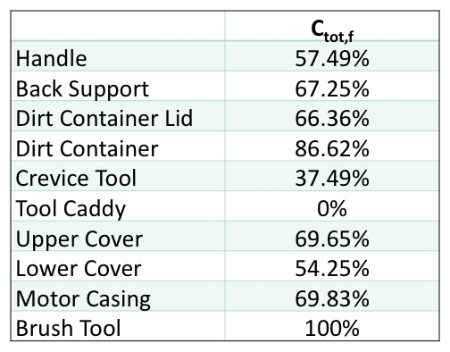
Example
Step 5: Combine the component commonalities into a product commonality
Notes:
27

Slide 28
Example
Step 5: Combine the component commonalities into a product commonality
C_{tot,p} = Total commonality of the product l = Sum over components
C_{tot,c} = Total commonality of the component
q = Number of components of product with largest number of components
Vacuum 1
Vacuum 2
Vacuum 3
Notes:
28

Slide 29
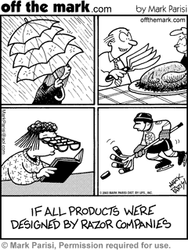
Conclusion
Identifies
Product platform
Specialized Components
Components for possible expansion of platform
Equips engineers
Consistent and objective measurement of commonality
Quantitative
Tells what is affecting commonality and why
Notes:
29

Slide 30
Limitations and Future Work
Limitations
Difficult to measure commonalities less than 30%
Does not consider position, composition of materials, assembly processes
Future Work
Incorporate position, composition of materials, and assembly processes
Couple index to process of extracting information from CAD models
Notes:
30

Slide 31
Eight Considerations
Economic: Lowers manufacturing costs for company, and in turn lowers cost to the consumer
Environmental: Reduces waste. Application of platform reduces beginning of life production waste and waste due to testing of products as platform has already been proven reliable.
Sustainability: Platform identified by index extends beyond life of a single product, can be used repeatedly for a variety of products.
Manufacturability: Identification of platform leads to mass manufacture of platform itself, same manufacturing processes, and assembly of platform first in the manufacturing process
Ethical: Provides more ethical manner of cutting costs than compromising building materials
Health and Safety: Once platform is proven safe, can guarantee same degree of safety standard for other products it is applied to
Social: Everyone gets what they want. Variety of modules can be applied to identified platform to satisfy each person’s individual needs as closely as possible
Political: Identification and use of platforms reduces manufacturing cost, which allows companies to compete with countries such as China and Mexico, providing more jobs in the United States and reducing our excessive dependence on exports.
Notes:
31

Slide 32
Bibliography of Photos
http://www.vetteweb.com/features/vemp_0709_2008_chevrolet_corvette/photo_14.html
http://pro.corbis.com/search/Enlargement.aspx?CID=isg&mediauid=%7B937AE909-9407-4C71-B669-86CEAAD66D1C%7D
http://www.offthemark.com/search-results.php?topic=none&keywords=engineering&resultsfrom=1&browseall=false
http://www.globalsecurity.org/military/systems/aircraft/f-35-commonality.htm
http://4.bp.blogspot.com/_Qwft9L1sVW4/ScZCQGwLl4I/AAAAAAAAAfU/9e2Zvmqtlac/s400/apple.jpg
http://collectingtokens.files.wordpress.com/2008/03/banana_peeled1.png
http://api.ning.com/files/vw9KsAuQbHFrV6FYrcJT1wfPDUbEJ0LUMbZx0T4fZb*GaZC6o6Q9YqBFBuudjonGwQM1IOvW8R-9sEvF4wgx3t6pQxJ94nlt/ttar_orange_01_h_launch.jpg
Notes:
32

