Slide 1
InSb-based heterostructures for Electronic Devices
Capstone Talk
PHYS 4300
Date: 14 May 2009
Author: Amanda Baldwin
Advisor: Professor Santos
Acknowledgements: Dr. Mukul C. Debnath
Dr. Joel Keay

Slide 2
Outline
Heterostructures
Quantum Wells
Motivation
  Uses of InSb (Indium Antimonide) heterostructures
InSb Crystal
Molecular Beam Epitaxy
X-Ray Diffraction
Hall Effect
Future Plans in this research
Conclusion
Questions

Slide 3
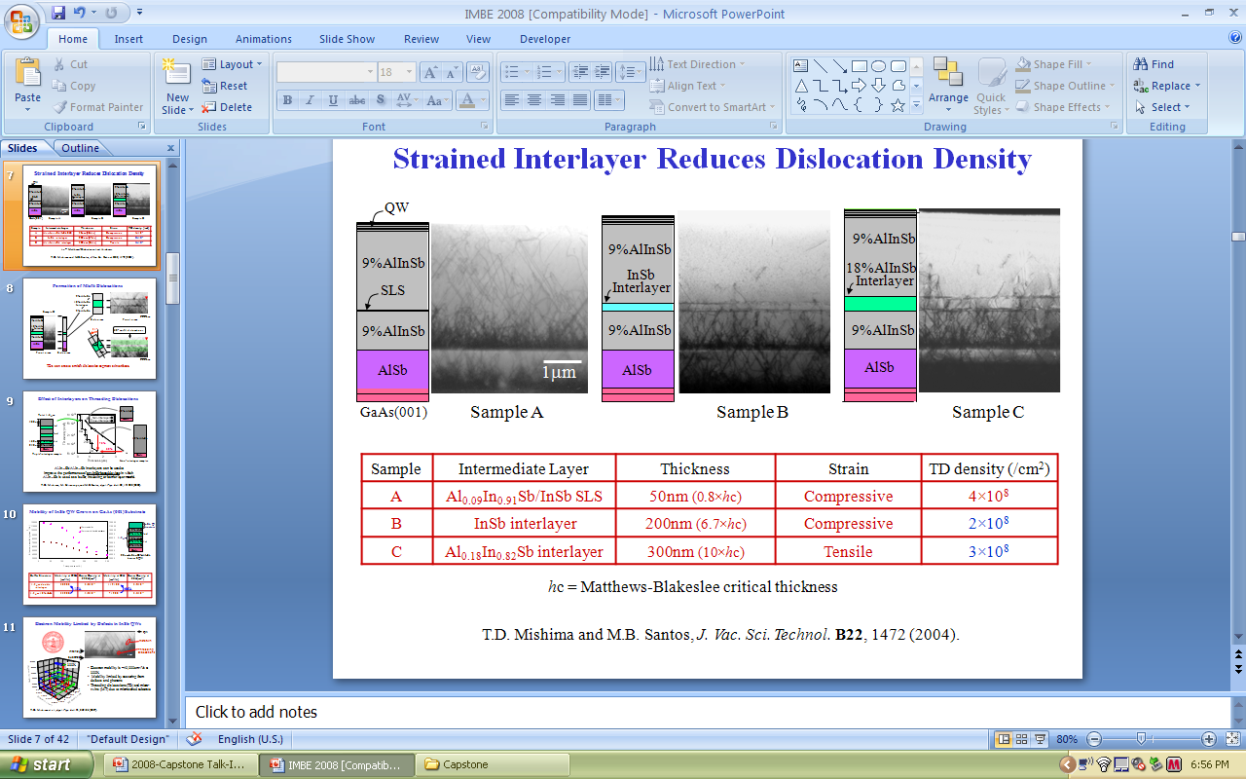
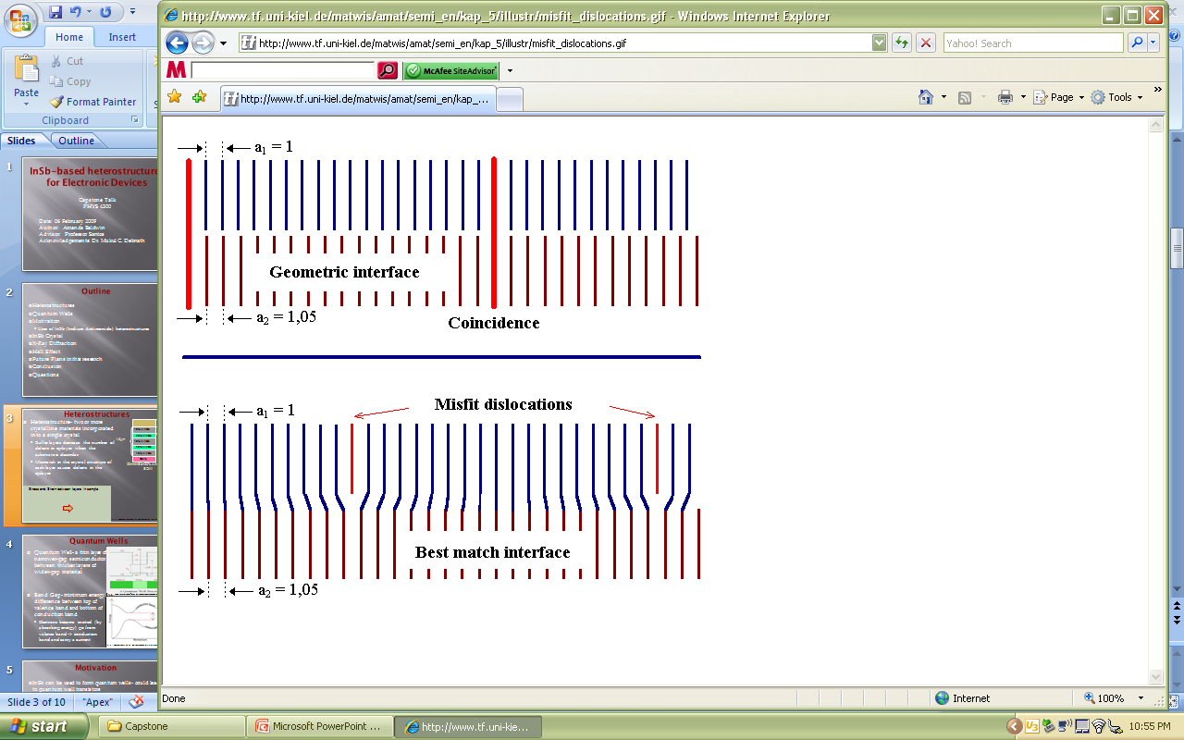
Heterostructures
Heterostructure- two or more crystalline materials incorporated into a single crystal structure
  Buffer layers decrease the number of defects in epilayer when the substrate is dissimilar
  Mismatch in the crystal structure of each layer causes defects in the epilayer
  10%AlInSb – 10%Al & 90% In mixed with Sb
InSb QW structure
10%AlInSb
20%AlInSb
Buffer Layers
10%AlInSb
20%AlInSb
10%AlInSb
GaAs
Substrate
Threading Dislocations
Misfit Dislocations
1.05
1μm
http://www.tf.uni-kiel.de/matwis/amat/semi_en/kap_5/illustr/misfit_dislocations.gif
Professor Santos’ IMBE 2008 slides

Slide 4
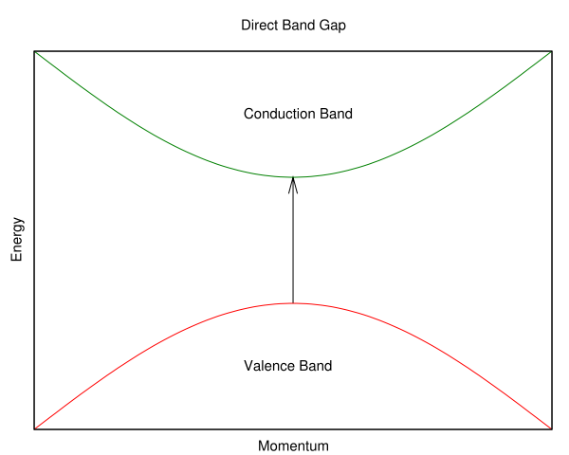
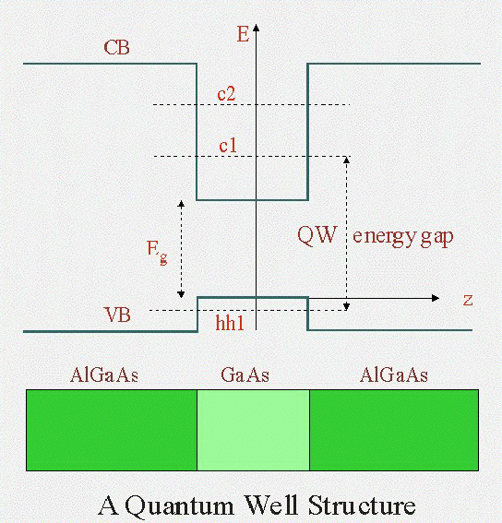
Quantum Wells
Band Gap- minimum energy difference from top of valence band →bottom of conduction band
  Electrons become excited (absorb energy) go from valence band → conduction band and carry a current
  Direct band gap- plot of band gap, conduction band is directly above valence band
Quantum Well- a thin layer of narrower-gap semiconductor between thicker layers of wider-gap material
http://en.wikipedia.org/wiki/Direct_bandgap
Band gap
http://people.seas.harvard.edu/~jones/ap216/images/bandgap_engineering/bandgap_engineering.html

Slide 5
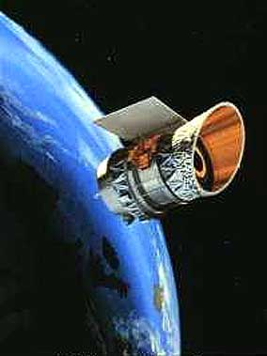
Motivation
InSb can be used to form quantum wells - could lead to quantum well transistors
  Small band gap leads to low operating voltage and faster switching speeds
InSb is used in light emitters
  Emits light in the IR range and can be used to lase targets for IR guided munitions
InSb used as infrared detectors
  Thermal imaging cameras
  Infrared homing missile guidance systems
  Infrared astronomy
Reference http://www.intel.com/pressroom/archive/releases/20050208Corp.htm
http://www.daviddarling.info/encyclopedia/I/IRAS.html
Notes:
- Such transistors are normally on and can be turned off by applying a negative voltage to the gate which contrasts to common practice of applying a voltage to switch a gate, when required
InSb semiconductors are also capable of operating with voltages under 0.5 V, reducing their power requirements
The most developed low-dimensional semiconductor structures are those based on heterostructures between Gallium arsenide and Aluminum GaAs
- Silicon nor GaAs has bandgap suitable for long-wavelength optical sources, signal processing devices or mid-infrared detectors

Slide 6
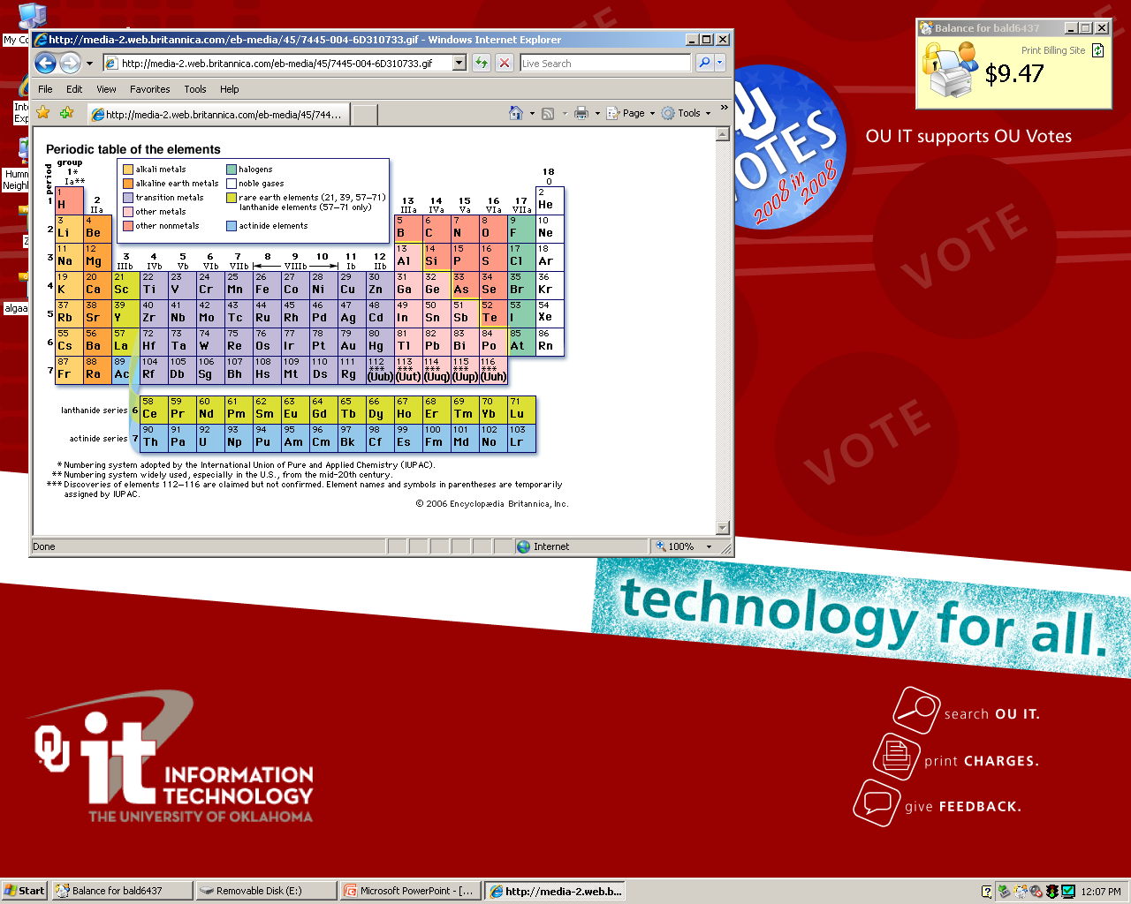
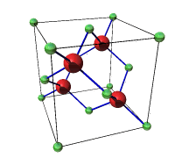
InSb Crystal Structure
InSb is III-V compound
  Elements of group III combine with elements of group V on periodic table
  Most III-V compounds are semiconductors
Face Centered Cubic (fcc) lattice with a 2-atom basis
  Group III→ Green atoms (such as In or Al)
  Group V→ Red atoms (such as Sb)
  Known as Zinc blend structure
http://media-2.web.britannica.com/eb-media/45/7445-004-6D310733.gif
InSb http://simple-semiconductors.com/

Slide 7
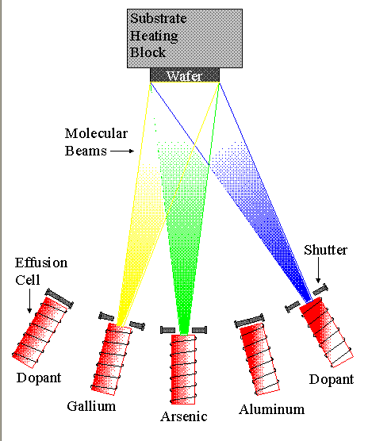
III-V Molecular Beam Epitaxy
MBE- operates by directing beams of elements at substrate (wafer)
  Effusion cells- evaporates the elements
  Shutters- control which elements flow
Select combinations of elements to grow on substrate wafer
Temperature set for optimum growth of the epilayer
http://www.nber.org/~tanwinc/DissertationDefense/1_Introduction/mbe.png
Notes:
Ultra pure elements heated in the effusion cell until they begin to change from a solid to a gas, sublimate. The elements interact and form a crystal on the substrate. The elements are referred as a beam because the evaporated atoms do not interact with each other or vacuum chamber gases until they reach the wafer.

Slide 8
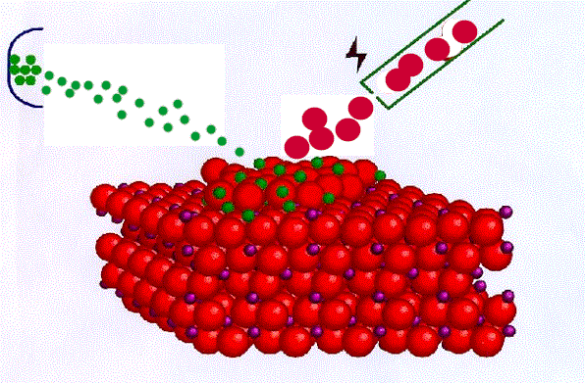
Growth of Heterostructures using MBE
MBE allows control of the growth in real time
  Heterostructure is essentially grown layer by layer
  Temperature can be changed in chamber→ alters growth rate
Films grow epitaxially
  the growth of crystalline substance that mimics orientation of substrate
  Requires an ultra high vacuum (P< 10⁻⁹mbar)
http://iramis.cea.fr/Images/astImg/488_1.gif
Notes:
RHEED: used for monitoring the growth of the crystal layers. A computer controls shutters in front of each furnace, allowing precise control of the thickness of each layer, down to a single layer of atoms. Intricate structures of layers of different materials may be fabricated this way.
Reference: http://en.wikipedia.org/wiki/Molecular_beam_epitaxy

Slide 9
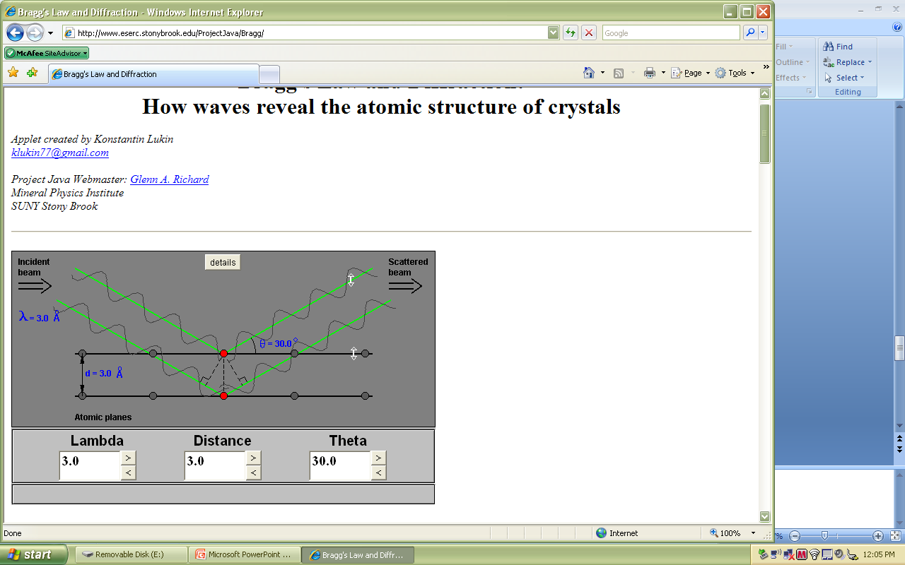
X-Ray Diffraction
N
M
Reference http://www.eserc.stonybrook.edu/ProjectJava/Bragg/
θ
θ
d sinθ
d sinθ
Braggs Law 2d sinθ = nλ
Distance d is the space between planes
Path difference of the two waves is 2d sinθ
Constructive interference occurs at nλ
  waves from adjacent planes will be in phase
  creates the diffraction pattern that can be graphed as θ vs. intensity

Slide 10
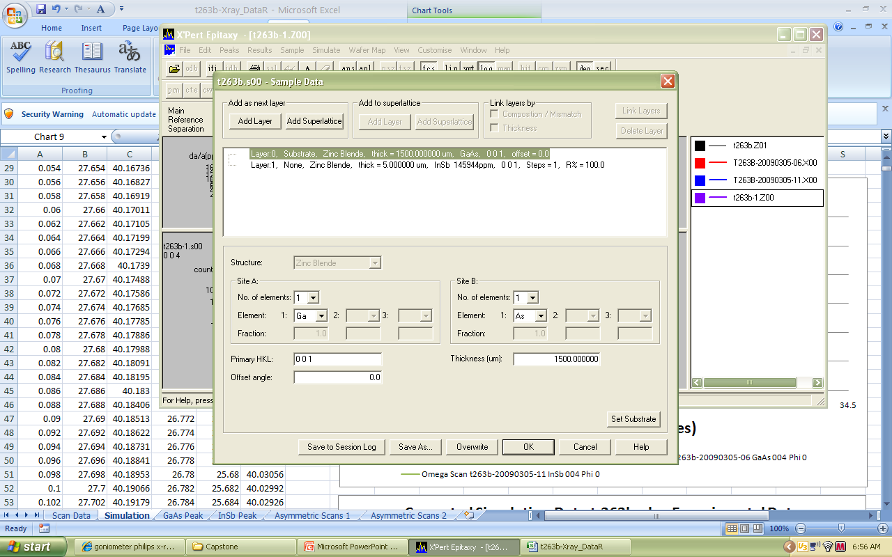
t-263b
Substrate – Gallium Arsenide (GaAs)
Epilayer- Indium Antimonide (InSb)
  Doped uniformly with Silicon
Enter Layer Structure into simulation software
Run Simulation and compare to experimental data
InSb
5.0 μm
GaAs
1.5 mm

Slide 11
Analysis of t-263b
Simulation and experimental data do not match
  GaAs peaks should match since the substrate is my known for structure and layer thickness
  Shift simulation data to match GaAs data

Slide 12
Analysis of t-263b
Simulation and experimental data for GaAs match
InSb does not
  Started with layer being fully relaxed (i.e. no strain on epilayer)

Slide 13
Analysis of t-263b
Changed InSb
  96% relaxed
  According to simulation, InSb is 4% strained

Slide 14
R008
300 layer structure
  1.0 ⁻⁴ Å = 1.0 μm
  Repeated layers give periodicity to the X-Ray diffraction pattern
Cascade Laser
  Low threshold current, high efficiency, high output power mid-IR lasers
Entered layer structure into simulation software
  Compared simulation to experimental data
InAs
2.035 μm
Active Region
512 Å x 11
Injection Region
AlAs/AlSb
17 Å
InAs
503 μm
E
e
many photons per electron
hv
hv
hv
Cascading
hv
hv
hv
hv

Slide 15
Analysis of R008
InAs (substrate peaks) not aligned
  Need to shift data to align
  Periodicity looks close

Slide 16
Analysis of R008
Added 0.013° to the simulated data to align substrate peaks
Subtracted 6 Å of AlAs from various epilayers of the heterostructure

Slide 17
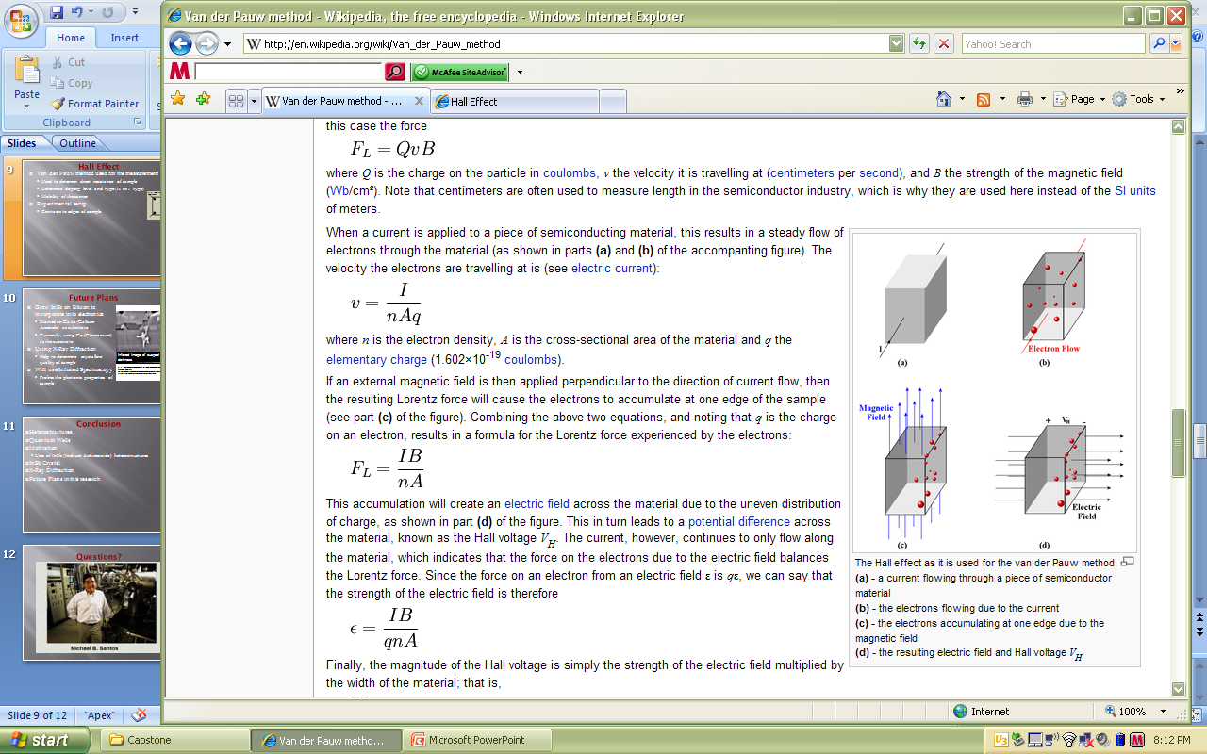
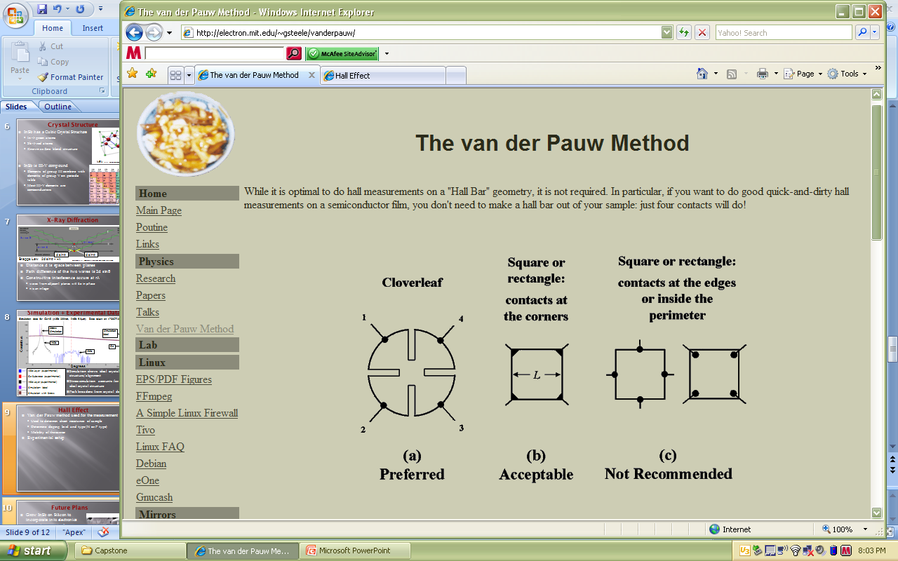
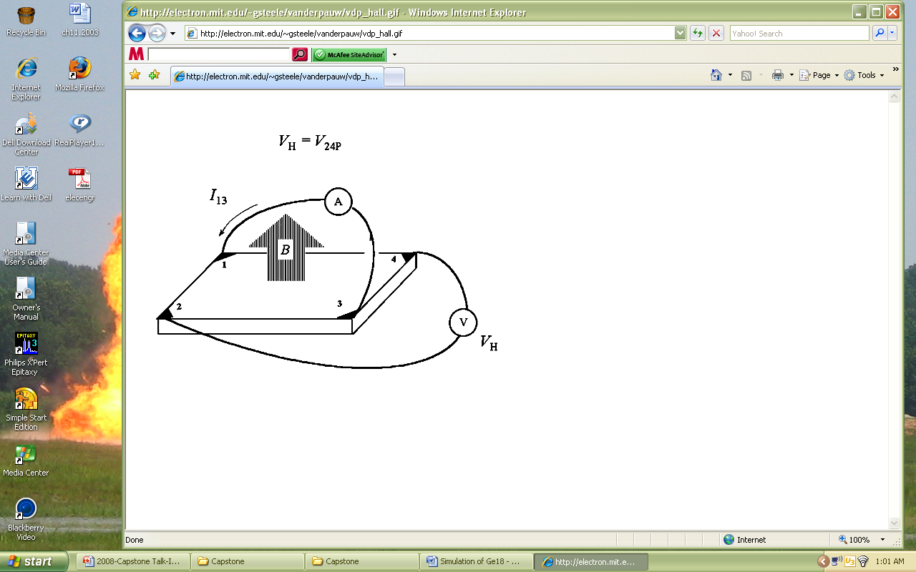
Hall Effect
http://en.wikipedia.org/wiki/Van_der_Pauw_method
Van der Pauw method
  Determine resistivity of the material
Hall Effect
  Determine carrier concentration and type (N or P type)
Experimental setup
  Contacts at edges of sample
  Current flows along 1 edge of sample
  Measure voltage across sample
  Repeat R measurement by switching polarities of V and I
Lorentz Force = q(v x B)
http://electron.mit.edu/~gsteele/vanderpauw/
http://electron.mit.edu/~gsteele/vanderpauw/vdp_hall.gif
Notes:
(a) A current flowing through a piece of semiconductor material (b) the electrons flowing due to current (c) electrons accumulating at one edge due to the magnetic field (d) the resulting electric field and Hall Voltage

Slide 18
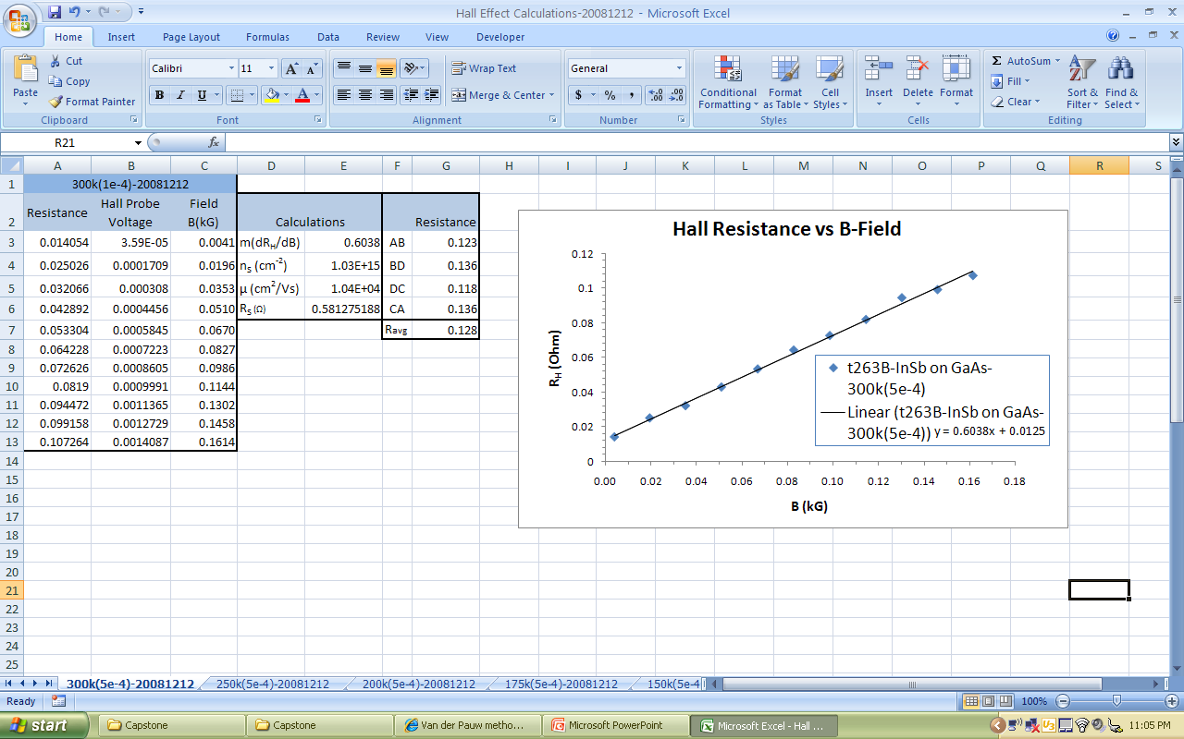
Hall Effect Experimental Data
Measurements
  Slope of linear fit
    m = dR_{H}/dB
    Positive slope= n-type doping (electrons)
  Carrier concentration – number current carriers in cm⁻³ , factor of doping
  Resistivity of the material
  Carrier mobility- proportionality constant between the drift velocity of carriers in an E-field
Determine the electronic properties of sample
A
http://electron.mit.edu/~gsteele/vanderpauw/
C
B
D

Slide 19

Future Plans
Grow InSb on Silicon to incorporate into electronics
  Started on GaAs (Gallium Arsenide) as substrate
  Currently, using Ge (Germanium) as the substrate
Use X-Ray Diffraction
  Determine crystalline quality of samples grown in MBE
Hall Effect
  Help determine electronic properties
Infrared Spectroscopy
  Help determine the photonic properties of samples
Infrared Image of suspect in total darkness
http://images.google.com/imgres?imgurl=http://www.x20.org/images/PCB_iR_microchip_evaluation.jpg&imgrefurl=http://www.x20.org/thermal/ir555.htm&h=86&w=100&sz=2&hl=en&start=3&um=1&usg=__utgjSMy-R-B_tVhPXA_YNIaKKa4=&tbnid=zNZMBU3QQOaM5M:&tbnh=71&tbnw=82&prev=/images%3Fq%3DInSb%2Bmicrochip%26um%3D1%26hl%3Den%26sa%3DN
Notes:
Started on GaAs because there is a lot of literature and many other research teams that have grown on this semiconductor, learn from this process to apply lessons to the next substrate, optimize the layers so that the crystal lattice is optimized for InSb
Using Germanium as the substrate, but there are not many people that are doing this. This is to gain information about growing InSb on a single atom basis. Also Ge is in the same family as Silicon and this will help to get procedures to optimize the growth when it is put onto silicon substrate
The infrared spectrum of a sample is collected by passing a beam of infrared light through the sample. Examination of the transmitted light reveals how much energy was absorbed at each wavelength. This can be done using a Fourier Transform instrument to measure all wavelengths at once. a transmittance or absorbance spectrum can be produced, showing at which IR wavelengths the sample absorbs. Analysis of these absorption characteristics reveals details about the molecular structure of the sample.
I am learning X-Ray Diffraction now, and will learn techniques for FTIR

Slide 20
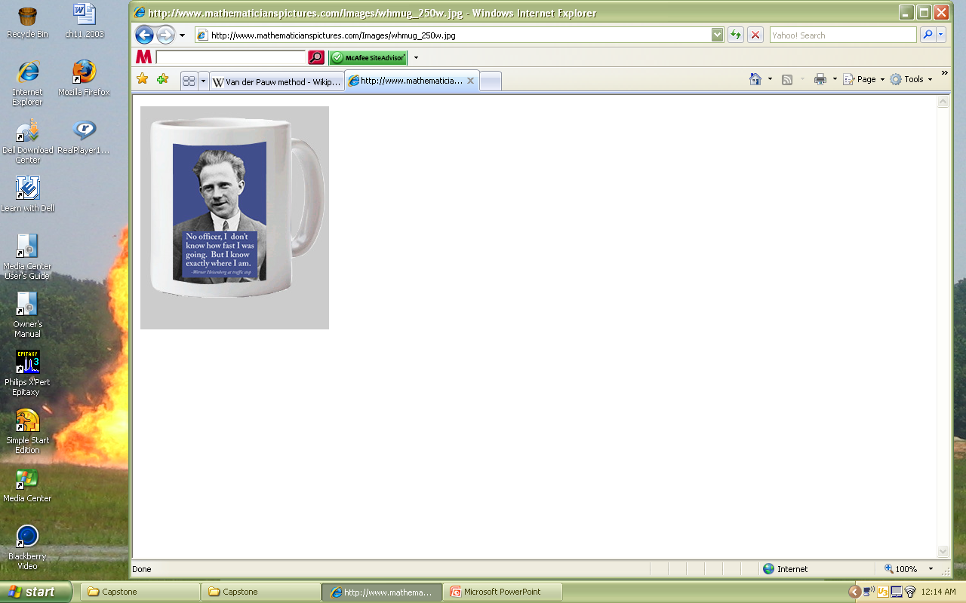
Questions?
http://www.mathematicianspictures.com/Images/whmug_250w.jpg

