Slide 1
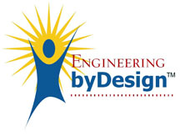
Design Concepts & Engineering Principles
In order to highlight the design content of each project, the final reports will be required to include a section that addresses the following questions:
1) What was the open-ended design problem or goal that you addressed;
Develop/design a biologically-compatible, flexible, robust coating to stop the plasticizer DEHP from leaching out of PVC biomedical materials (e.g. plasma bags and IV-tubes).
2) Describe in detail the system, component, or process that you designed to solve the problem or accomplish the goal;
Developed process to measure DEHP leaching from PVC – used UV-Vis to look at DEHP go into aqueous solution from immersed PVC. Made a matrix of coatings on PVC. Tested each coating to find the best, then optimized the coatings parameters through different thicknesses, annealing, RF and plasma treatments etc.
3) What design concepts and engineering principles did you employ;
Edisonian Approach –large matrix of samples, trial and error; Improvise; Project Charter, GANTT Chart; Critical Paths, PERT Charts; 10-Stage Design; ITEA- Design Process
4) What realistic constraints were included;
Economic, Environmental, Sustainability, Manufacturability, Ethical, Health and Safety, Social, Political:
5) How did you make use of mathematical modeling or simulation; and
Matlab, Mathematica, L-EDIT, Spice; COMSOL Multiphysics, Monte Carlo; Mechanical drawing software I-DEAS, Finite Difference and Finite Element Analysis (FEA); ANSYS, Computational Fluid Dynamics (CFD); PHOENIX and SYNOW for Supernovae
6) How was your creativity expressed in your project?
Built many prototypes, developed new procedures, new modeling techniques, developed new fitting software …
Design concepts and engineering principles did you employ
Edisonian Approach –large matrix of samples, trial and error
Improvise
Project Charter GANTT Chart
Critical Paths PERT Charts
10-Stage Design
Notes:
What was the open-ended design problem or goal that you addressed;
Develop/design a biologically-compatible, flexible, robust coating to stop the plasticizer DEHP from leaching out of PVC biomedical materials (e.g. plasma bags and IV-tubes).
Describe in detail the system, component, or process that you designed to solve the problem or accomplish the goal;
Developed process to measure DEHP leaching from PVC – used UV-Vis to look at DEHP go into aqueous solution from immersed PVC. Made a matrix of coatings on PVC. Tested each coating to find the best, then optimized the coatings parameters through different thicknesses, annealing, RF and plasma treatments etc.
What design concepts and engineering principles did you employ;
Edisonian Approach –large matrix of samples, trial and error; Improvise; Project Charter, GANTT Chart; Critical Paths, PERT Charts; 10-Stage Design; ITEA- Design Process
What realistic constraints were included;
Economic, Environmental, Sustainability, Manufacturability, Ethical, Health and Safety, Social, Political:
How did you make use of mathematical modeling or simulation; and
Matlab, Mathematica, L-EDIT, Spice; COMSOL Multiphysics, Monte Carlo; Mechanical drawing software I-DEAS, Finite Difference and Finite Element Analysis (FEA); ANSYS, Computational Fluid Dynamics (CFD); PHOENIX and SYNOW for Supernovae
How was your creativity expressed in your project?
Built many prototypes, developed new procedures, new modeling techniques, developed new fitting software …

Slide 2
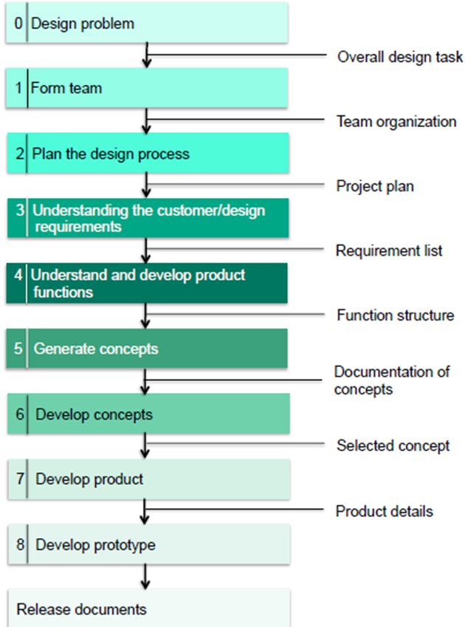
10-Stage Design –OU AME 4163
AME4163 Design Process
From:
AME 4163 Principles of Design
–Engineering design process
August 21,2013, Zahed Siddique

Slide 3
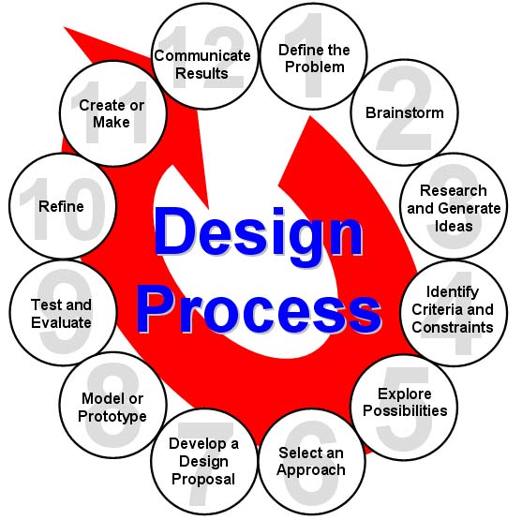
Engineering-Physics Design Process
Define the Problem
Brainstorm Possible Solutions
Research and Generate Ideas
Identify Criteria and Constraints
Explore Possibilities
Select an Approach
Develop a Design Proposal
Make a Model or Prototype
Test and Evaluate the Design
Refine the Design
Create or Make Solution
Communicate All Results
Iterate/Perfect
Back to the Drawing Board
Iterate/Perfect
WAS
ITEA: INTERNATIONAL TECHNOLOGY EDUCATORS ASSOCIATION
NOW
ITEEA: INTERNATIONAL TECHNOLOGY AND ENGINEERING EDUCATORS ASSOCIATION
– ITEEA Standards for Technological Literacy
http://www.iteea.org/
Notes:
What is Design?
The word “design” is often used as a generic term that refers to anything that was made by a conscious human effort.
Design is also a process that is used to systematically solve problems.
A design process is a systematic problem-solving strategy, with criteria and constraints, used to develop many possible solutions to solve or satisfy human needs or wants and to narrow down the possible solutions to one final choice.
– ITEA Standards for Technological Literacy

Slide 4
10-Stage Design
vs. 12-Stage Design
Identify the problem/product innovation (1.)
Define the working criteria/goals (4.)
Research and gather data (3.)
Brainstorm / generate creative ideas (2.)
Analyze potential solutions (5.)
Develop and test models (7.,8.,9.)
Make the decision (6.)
Communication and specify (12.)
Implement and commercialize (11.)
Perform post-implementation review and assessment (--.)
These Look better for a Product
from “Engineering Your Future:
A Comprehensive Introduction to Engineering “
by William C. Oakes, Les L. Leone, Craig J. Gunn, John L. Gruender
- Oxford University Press ISBN 0199797560
Define the problem (1.)
Brainstorm Possible Solutions (4.)
Research and Generate Ideas (3.)
Identify Criteria and Constraints (4.)
Explore Possibilities (5.)
Select an Approach (7.)
Develop a Design Proposal (6.)
Make a Model or Prototype (6.)
Test & Evaluate the Design (6.)
Refine the Design (--.)
Create or Make Solution (9.)
Communicate Results (8.)
These look better for Research
– ITEA Standards for Technological Literacy

