Slide 1
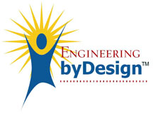
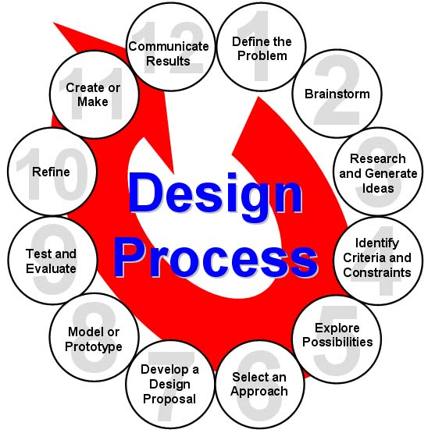
Engineering/Physics Design Process
Define the Problem
Brainstorm Possible Solutions
Research and Generate Ideas
Identify Criteria and Constraints
Explore Possibilities
Select an Approach
Develop a Design Proposal
Make a Model or Prototype
Test and Evaluate the Design
Refine the Design
Create or Make Solution
Communicate All Results
Iterate/Perfect
Back to the Drawing Board
Iterate/Perfect
WAS
ITEA: INTERNATIONAL TECHNOLOGY EDUCATORS ASSOCIATION
NOW
ITEEA: INTERNATIONAL TECHNOLOGY AND ENGINEERING EDUCATORS ASSOCIATION
– ITEEA Standards for Technological Literacy
http://www.iteea.org/
Notes:
The International Technology and Engineering Educators Association (ITEEA) is a nonprofit professional organization for technology, innovation, design, and engineering education. It was created in 1939 as the American Industrial Arts Association. At that time, it was created to support the study of the industrial arts in schools. That focus has migrated with the advancement of technology and the changing nature of industrial world to a mission of promoting technological literacy for all students through professionalism in the teaching and learning about technology and engineering. This focus has caused the association to be one of the prime players within the STEM education movement with primary interest in the “T & E” of STEM.
The association has always had high interest in the K‐12 level of education including technology and engineering teachers, administrators, and university personnel who represent all levels of education. One of the association’s initial publications was called The Industrial Arts Teacher that still exists today as the Teacher and Engineering Teacher. Other publications include monographs, books, electronic media plus Children’s Technology and Engineering, which is a journal for elementary school technology and engineering education. STEM Connections, an electronic newsletter, has been designed to give information quickly to the profession.
Over the years, four ITEEA councils have represented the elementary teacher, university teacher education, college/university students and leadership/supervision. These councils have given added emphasis regarding their specific focus that has helped to strengthen the profession.
Members of the association have been rigorous advocates of public policy by frequently providing information to government, agencies, associations, and other special interest groups concerning technology and engineering education at the K‐12 level. The Association strives to provide concerned publics with an understanding of the importance of the profession that unleashes the spirit of innovation through teaching about technological literacy.
The Association has been a constant advocate of strong teaching and learning methods used to advance curriculum and instruction in pace with our fast advancing, highly sophisticated technological society. The Association’s name has been synonymous with major curriculum efforts that have spawned over decades of technology teaching. These advances were especially significant during the 1960’s when numerous curriculum efforts were being launched by state departments of education and selected university’s intent on moving the field forward. These curriculum efforts were practiced until the standards movement was started to describe what the student should know and be able to do as it related to technological literacy. The standards were quickly followed by a curriculum effort that is today known as Engineeringby Design. Today, efforts continue to advance the standards and curriculum through various project efforts.
A brief summary of the decades of the Association’s historical progress follows:
1939/1940s – Association was created and the early governance evolved in an effort to promote and enhance industrial arts in general education reflecting the study of industry and technology. The first journal was published.
1950s – Councils were created within the Association to represent teacher educators, supervisors, and state association officers. Student club work began. Work continued to advance industrial arts in general education advocating behavioral changes in preference to the trade or occupational analysis (vocational) approach to teaching.
1960s – Elementary school initiatives were advanced with project work, conferences, and the creation of a council. Various curriculum projects were pursued as a decade of legislation and funding occurred to advance professional development in philosophical thought and teaching strategies.
1970s – Psychological, sociological, and technological thought progressed through writings, forums, and conferences. Major initiatives dealing with career education and industrial arts in vocational legislation evolved. Efforts continued to support work in curriculum projects and the creation of standards.
1980s – Name changes took place with AIAA becoming ITEA; names of councils, affiliate associations, and journals; and titles of programs describing the field. Numerous publications were created to advance the study of technology as a national imperative, promote implementation, address certification and accreditation issues, and further relate to other science and technology organizations. A national advisory council and foundation were created to further strengthen the field.
1990s – Major funding and efforts sought to create a rationale and structure, standards, curriculum, and assessments for technology teaching. Closer working relationships were created with the mathematics, science, technology, and engineering communities. International relationships were further advanced. A Center was created to advance research, curriculum, professional development, and special projects for technology teaching.
2000s – Work will continue to refine curriculum to reflect technology as society evolves in an age with informational, physical, biological, and chemical technology challenges and opportunities. Education in virtual, instantaneous, and international settings will be delivered. Efforts will continue as the technology teaching discipline continues to play a more central role in all education dealing with human innovation in action.
ITEEA has had a rich history that is approaching 75 years of providing wholesome changes in learners. In humankind’s constant quest to improve our lives, ITEEA has worked to connect science, technology, design, and engineering in forward thinking ways. The Associations’ continued efforts will hopefully help to provide a next generation technological work force to meet 21st century needs.
ITEA has officially become the "International Technology and Engineering Educators Association" (ITEEA)

Slide 2
10-Stage Design
Identify the problem/product innovation
Define the working criteria/goals
Research and gather data
Brainstorm / generate creative ideas
Analyze potential solutions
Develop and test models
Make the decision
Communication and specify
Implement and commercialize
Perform post-implementation review and assessment
From:
Your Future: A Comprehensive Introduction to Engineering
by William C. Oakes, Les L. Leone, Craig J. Gunn, John L. Gruender
- Oxford University Press ISBN 0199797560
1-Identify the problem/product innovation
2-Define the working criteria/goals
3-Research and gather data
4-Brainstorm / generate creative ideas
5-Analyze potential solutions
6-Develop and test models
7-Make the decision
8-Communication and specify
9-Implement and commercialize
10-Perform post-implementation review and assessment
Notes:
Engineering Your Future: A Comprehensive Introduction to Engineering [Book]: $75 online
April 2011 - By William C. Oakes, Les L. Leone, Craig J. Gunn, John L. Gruender
- Oxford University Press - 2011.04.01 - Paperback - 604 pages - ISBN 0199797560
Engineering--a field that is both academically rigorous and creatively demanding. Faced with endless career opportunities, today's students matriculate without a clear idea about the study and practice of engineering. Fortunately, there is Engineering Your Future: A Comprehensive Introduction to Engineering, Seventh Edition, an authoritative guide to the academic expectations and professional opportunities that help direct students down the path to a rewarding career in the engineering field. Features * Introduces students to the broad spectrum of engineering disciplines, with up-to-date data on degrees granted, employment opportunities, and salaries * Highlights the ethical responsibilities of engineers * Focuses on developing all-important problem-solving and communication skills that are critical to success both in the classroom and in the working world * Offers guidance both for leading teams and, just as importantly, being an effective member of a team * Introduces a design methodology that can be used immediately and in subsequent design courses * Provides a handy review in units and conversions, mathematics, and engineering fundamentals * The exceptionally broad coverage provides instructors unparalleled flexibility in using the Engineering Your Future in any type of introductory course New to this Edition * Updated Computer Tools chapter covers computer use from the history of the internet through advanced engineering packages, including spreadsheets, mathematical programs, social media, and communicating via email * Effective coverage of teamwork for engineering classes shows students how a diversity of skills is essential to their future careers * Updated green and bioengineering information address current issues including sustainability and advancing human health * Fresh new profiles of contemporary engineers and their current research give students an insider's glimpse into what fields they may be most suited for * Up-to-date statistics for the job market provide critical data to help inform students' career decisions * Timely financial aid information covers student loans, financial assistance, grants, and avoiding scams Instructor's Resources Oakes EYF Comprehensive IRCD (9780199798513) Instructor's CD contains PowerPoint-based lectures and computerized test bank.

Slide 3
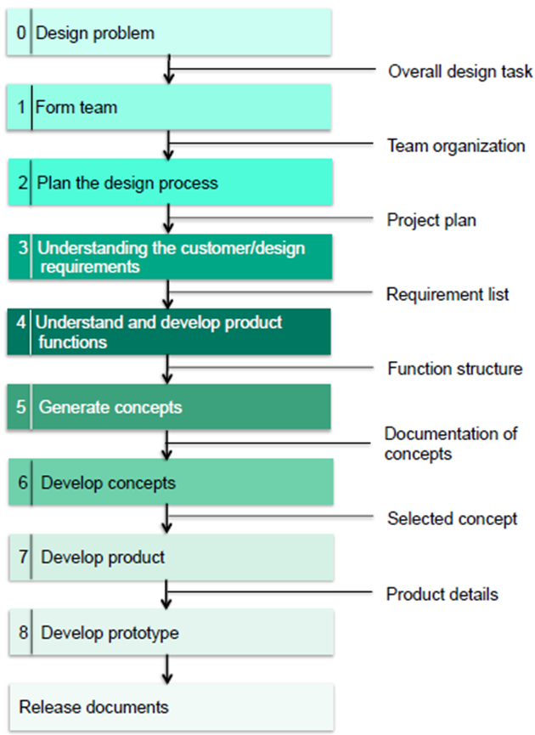
10-Stage Design –OU AME 4163
AME4163 Design Process
From:
AME 4163 Principles of Design
–Engineering design process
August 21,2013, Zahed Siddique

Slide 4
10-Stage Design
vs. 12-Stage Design
Identify the problem/product innovation (1.)
Define the working criteria/goals (4.)
Research and gather data (3.)
Brainstorm / generate creative ideas (2.)
Analyze potential solutions (5.)
Develop and test models (7.,8.,9.)
Make the decision (6.)
Communication and specify (12.)
Implement and commercialize (11.)
Perform post-implementation review and assessment (--.)
These Look better for a Product
– Engineering Your Future
Define the problem (1.)
Brainstorm Possible Solutions (4.)
Research and Generate Ideas (3.)
Identify Criteria and Constraints (4.)
Explore Possibilities (5.)
Select an Approach (7.)
Develop a Design Proposal (6.)
Make a Model or Prototype (6.)
Test & Evaluate the Design (6.)
Refine the Design (--.)
Create or Make Solution (9.)
Communicate Results (8.)
These look better for Research
– ITEA Standards for Technological Literacy

Slide 5
10-Stage Design
vs. 12-Stage Design
Identify the problem/product innovation
Define the working criteria/goals
Research and gather data
Brainstorm / generate creative ideas
Analyze potential solutions
Develop and test models
Make the decision
Communication and specify
Implement and commercialize
Perform post-implementation review and assessment
These Look better for a Product
– Engineering Your Future
Identify & Define a Justified Problem
Brainstorm Possible Solutions
Research and Generate Ideas
Identify Criteria and Constraints
Explore Possibilities
Select an Approach
Develop a Design Proposal
Make a Model or Prototype
Test and Evaluate the Design
Refine the Design
Create or Make Solution
Communicate Results
Theses look better for Research
– ITEA Standards for Technological Literacy

Slide 6
Example Design Process
Identify & Define a Justified Problem
Brainstorm Possible Solutions
Research and Generate Ideas
Identify Criteria and Specify Constraints
Explore Possibilities
Select an Approach
Develop a Design Proposal
Make a Model or Prototype
Test and Evaluate the Design using Specifications
Refine the Design
Create or Make Solution
Communicate Processes and Results
– ITEA Standards for Technological Literacy
Project Lead the Way
Notes:
There are many design processes that guide professionals in developing solutions to problems. The example that you see here is the design process that we will use for this course and the rest of the Project Lead The Way, Inc. courses you will take.

Slide 7
Example Design Process
Define the Problem
Brainstorm
Research and Generate Ideas
Identify Criteria and Constraints
Explore Possibilities
Select an Approach
Develop a Design Proposal
Model or Prototype
Test and Evaluate
Refine
Create or Make
Communicate Results
– ITEA Standards for Technological Literacy
Project Lead the Way
Notes:
There are many design processes that guide professionals in developing solutions to problems. The example that you see here is the design process that we will use for this course and the rest of the Project Lead The Way, Inc. courses you will take.

Slide 8
Design Concepts & Engineering Principles
Edisonian Approach –large matrix of samples, trial and error
Improvise
Project Charter
GANTT Chart
Critical Paths
PERT Charts
10-Stage Design
ITEA- Design Process
INTERNATIONAL TECHNOLOGY AND ENGINEERING EDUCATORS ASSOCIATION
http://www.iteaconnect.org/

