Slide 1
How to Read a Scientific Paper
Brad Abbott

Slide 2
Reading a scientific paper is an ACTIVE task. It requires thinking critically as you read.

Slide 3
You will often have to read a paper more than once
You often will not read a paper straight through
Different sections of a typical paper:
Abstract
Introduction
Details of measurement
Results
Conclusion
References

Slide 4
Abstract
This is a paper summary
A (tiny) bit of background & motivation
Summarizes findings and main results
Summarizes main conclusions

Slide 5
Abstract from HEP
Note the terminology: Terms are often specific to each subfield

Slide 6
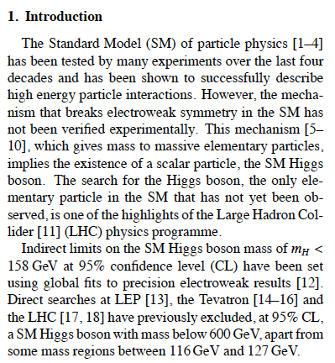
Introduction
Details background information
Gives reader context to know what’s going on and why the subject Is being studied
Poses the relevant questions being answered in the paper
So: what is known, what is not known, and what they authors are trying to learn

Slide 7
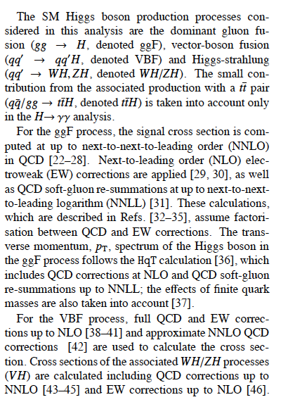
Details
Details how authors went about obtaining their results
Should have enough details that others can duplicate the results
This is a difficult section to read through as it can be highly technical

Slide 8
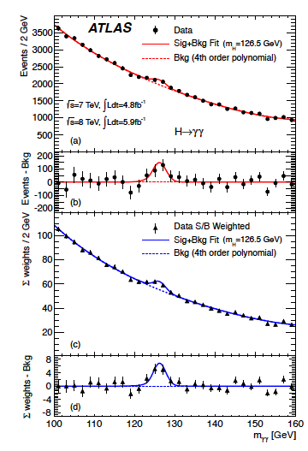
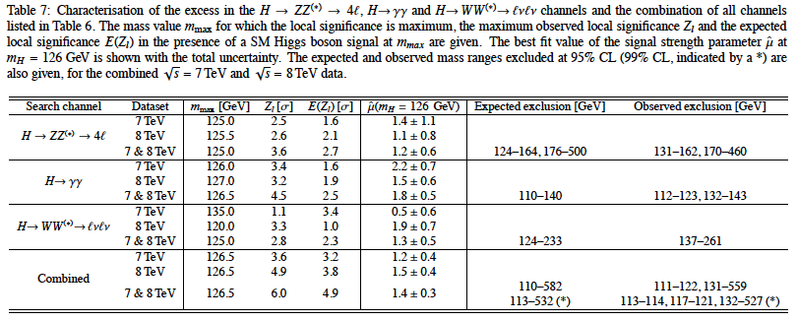
Results
Describes what experiments were done
Explains the results
(usually) contains most of the plots (graphs)

Slide 9
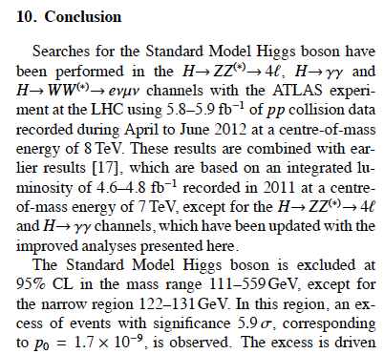
Conclusions
The interpretation section
Analyzes the data and draws conclusions
Explains sources of error and uncertainty

Slide 10
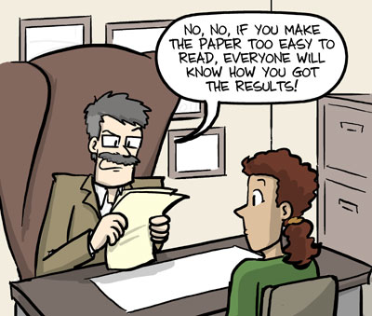
What is the point of a paper?
A paper is written as a means of archiving and storing information derived from an experiment
A paper isn’t meant to tell you a story, or maintain your interest- that’s not how it’s written (sadly)
So you’ll have to read a scientific paper a bit differently…
Often have page limits so every sentence/word is important

Slide 11
How I read a paper
Start with the abstract- it’s a great summary!
Read the Intro and conclusions - Similar to the abstract but with more details
Try to figure out which plots correspond to each conclusion and examine those plots
Now I’m ready to read the paper through as it’s written- I have some baseline idea of what the main points are and which plots are important
Think about the main measurement posed in the paper and the results. Do I understand them.
If I can’t, I read the paper again!

Slide 12
Questions to ask yourself as you read a paper
What specific problem does this research address?
What are the specific findings? Am I able to summarize them succinctly?
What evidence supports the findings? Do I believe the evidence/methods?
Is there an alternative explanation to the findings presented? Has this been addressed?
How do these findings relate to what I’m working on/interested in?
How might I apply these methods/results to my work?

Slide 13
Hard work to read papers
I often find that I can only read a few papers before I need a break
Often start skimming the paper so not really understanding it
Often need to stop reading paper to look up reference for additional details
If trying to reproduce results, I often need to read paper many many times to fully understand all of the details
We often have paper reading sessions with students and it is not uncommon to only get through 1 paragraph in an hour.

Slide 14
